Slide 1
PHY 711 Classical Mechanics and Mathematical Methods
10-10:50 AM MWF Olin 103
Plan for Lecture 5:
    Chapter 2 – Physics described in an accelerated coordinate frame

Slide 2
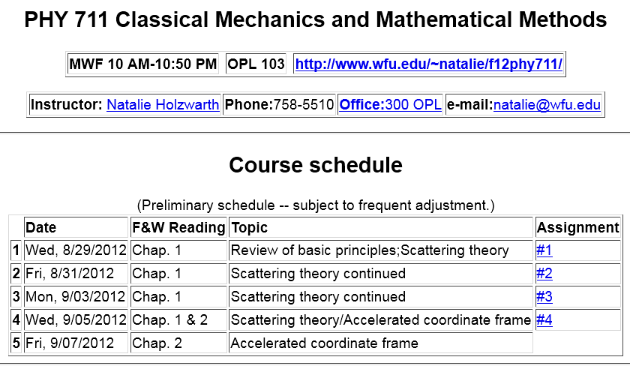
#5

Slide 3
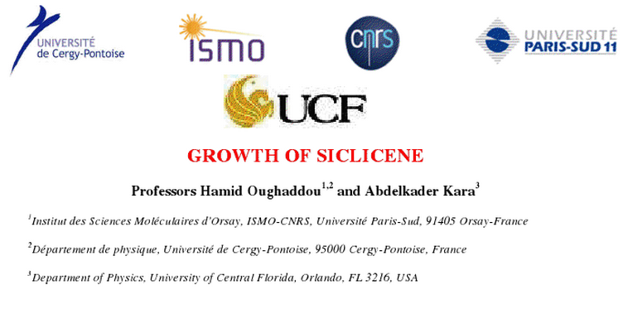
Special seminar today: 11-11:50 AM Olin 103
SILICENE

Slide 4
Application of Newton’s laws in a coordinate system which has an angular velocity and linear acceleration
Newton’s laws; Let r denote the position of particle of mass m:
Centrifugal
force
Coriolis
force

Slide 5
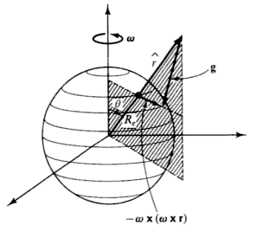
Motion on the surface of the Earth:

Slide 6
Non-inertial effects on effective gravitational “constant”
0.03 m/s²
9.80 m/s²

Slide 7
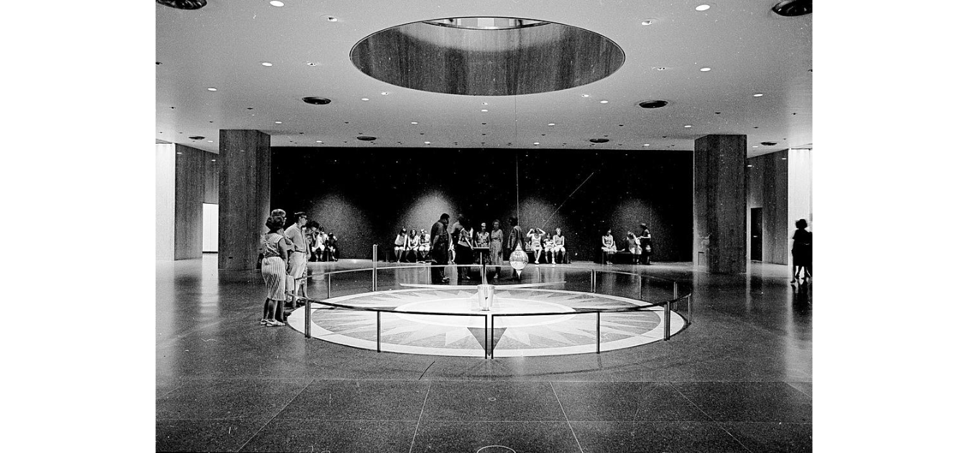
Foucault pendulum
http://www.si.edu/Encyclopedia_SI/nmah/pendulum.htm
The Foucault pendulum was displayed for many years in the Smithsonian's National Museum of American History. It is named for the French physicist Jean Foucault who first used it in 1851 to demonstrate the rotation of the earth.

Slide 8
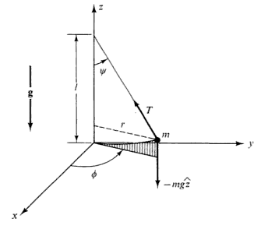
Equation of motion on Earth’s surface
ω
y (east)
z (up)
θ
x (south)

Slide 9
Foucault pendulum continued – keeping leading terms:

Slide 10
Foucault pendulum continued – keeping leading terms:

Slide 11
Foucault pendulum continued – coupled equations:

Slide 12
Foucault pendulum continued – coupled equations:

