Slide 1
PHY 711 Classical Mechanics and Mathematical Methods
10-10:50 AM MWF Olin 103
Plan for Lecture 1:
Welcome & overview
Class structure & announcements
Introduction to Maple software
Chapter 1 – scattering theory

Slide 2
Textbook:

Slide 3
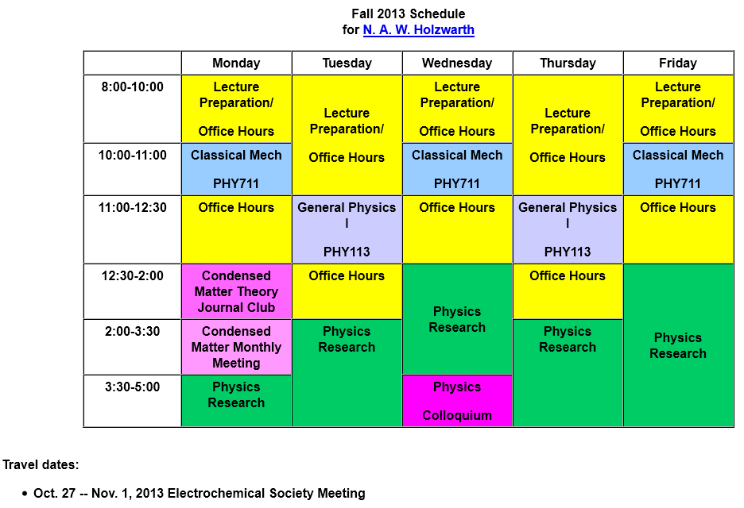

Slide 4
Comment about Physics Colloquia

Slide 6
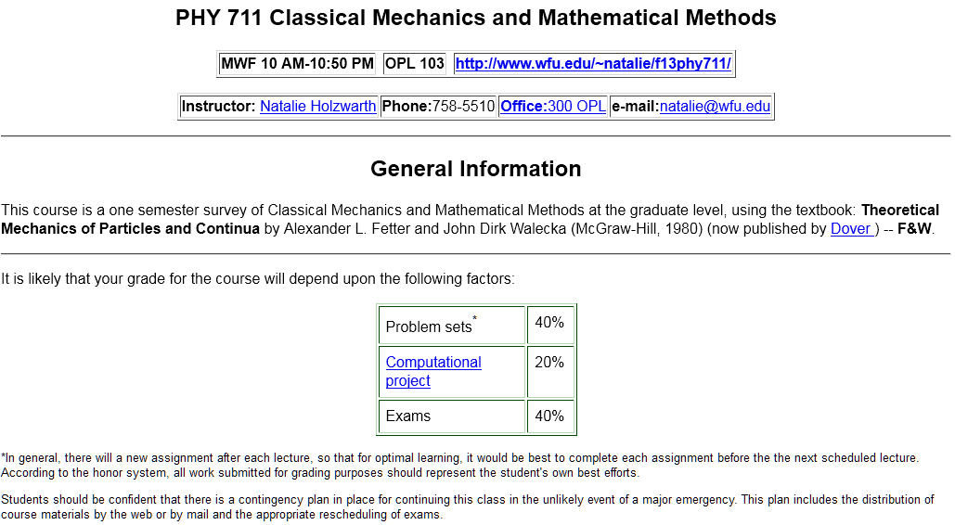

Slide 7
Introduction to algebraic manipulation software
Available from the webpage:
http://help.wfu.edu/public/vcl
If you have any trouble with this installation and setup, please contact Ching-Wan Yip at yipcw@wfu.edu
Note: This is a remote server that the university is testing. If you are off campus you will need to use VPN to gain access.

Slide 8
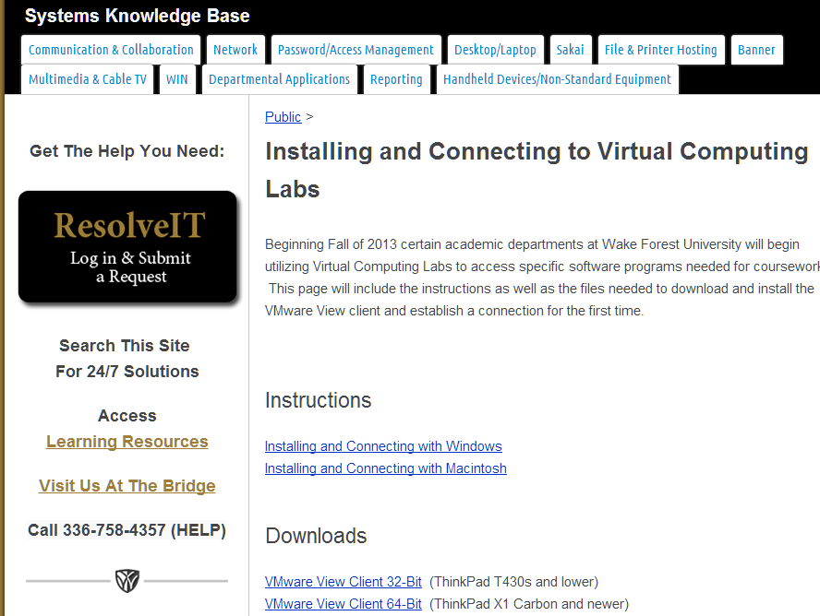

Slide 10
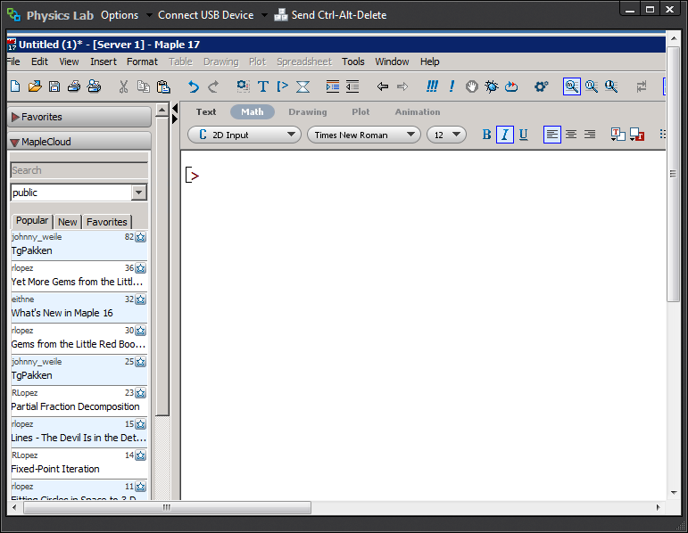

Slide 11
Example plot from Maple

Slide 12
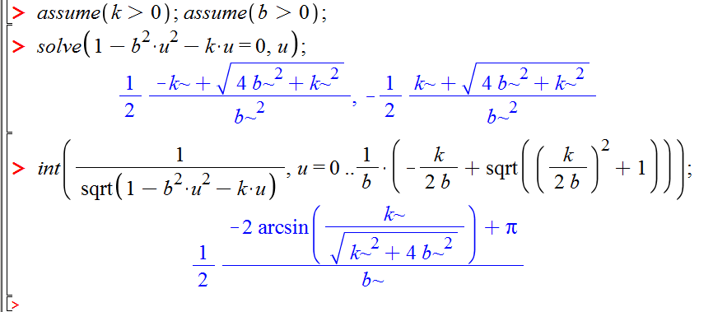
Maple example:
Evaluation of algebraic and integral expressions

Slide 13
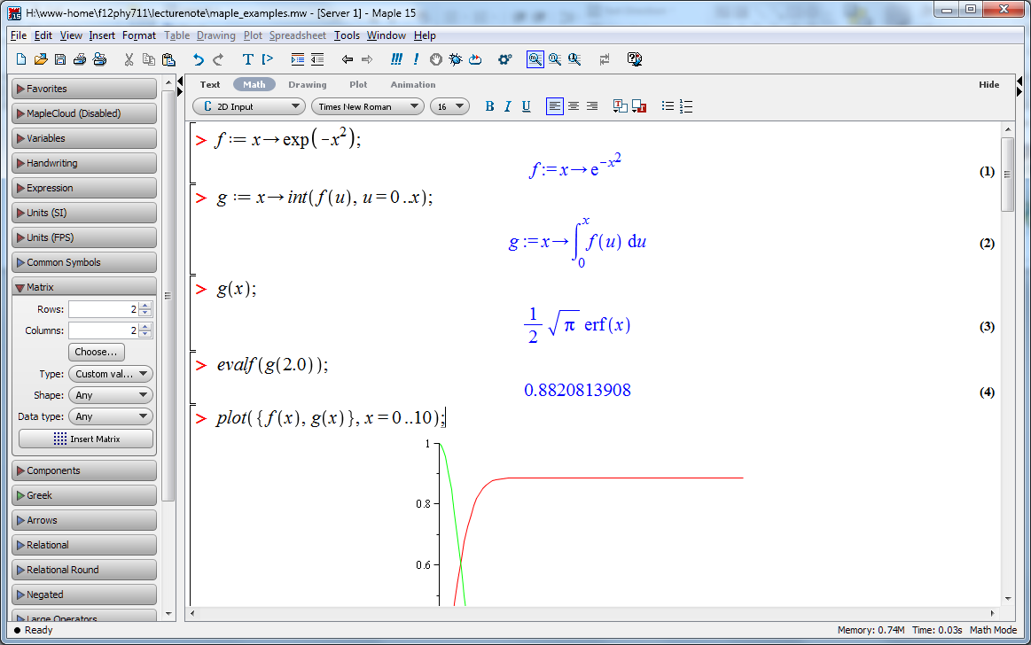
http://www.wfu.edu/~natalie/f13phy711/lecturenote/maple_example.mw

Slide 14
Scattering theory:

Slide 15
Figure from Marion & Thorton, Classical Dynamics

Slide 16
Differential cross section

Slide 23
Evaluation of scattering expression:

