Slide 1
PHY 711 Classical Mechanics and Mathematical Methods
10-10:50 AM MWF Olin 103
Plan for Lecture 16:
Continue reading Chapter 4
Normal modes for extended one-dimensional systems
Normal modes for 2 and 3 dimensional systems

Slide 2
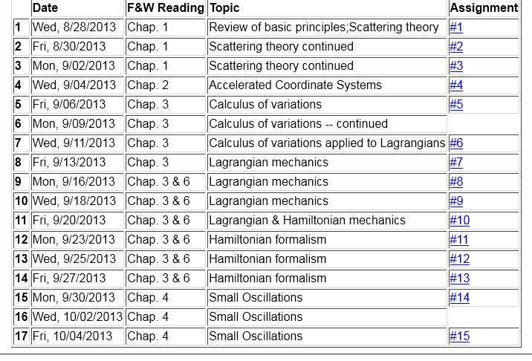

Slide 3
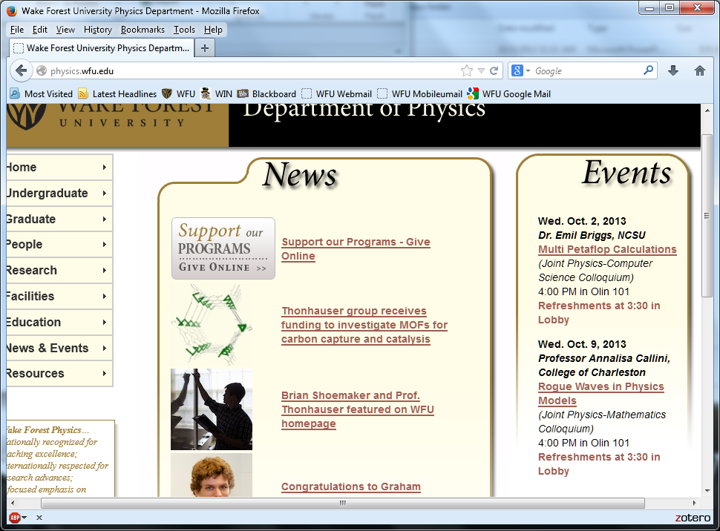

Slide 4
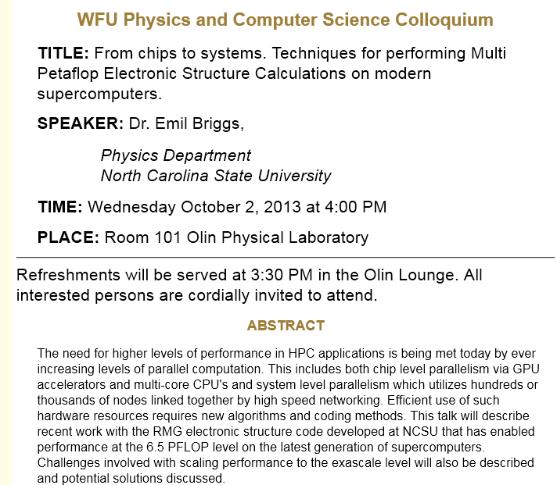

Slide 5
Consider an extended system of masses and springs:
m
m
m

Slide 11
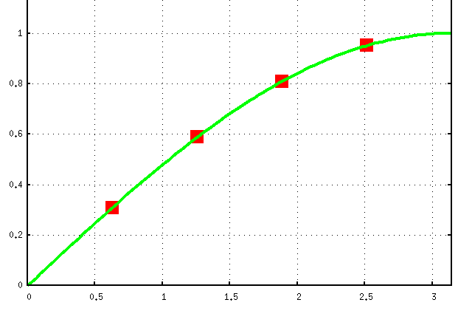

Slide 12
Consider an infinite system of masses and springs:
m
m
m

Slide 14
Infinite system of masses and springs -- continued
m
m
m

Slide 15
