Slide 1
PHY 711 Classical Mechanics and Mathematical Methods
10-10:50 AM MWF Olin 103
Plan for Lecture 17:
Continue reading Chapter 4
Normal modes for extended one-dimensional systems
Normal modes for 2 and 3 dimensional systems

Slide 3
Consider an infinite system of masses and springs:
m
m
m

Slide 5
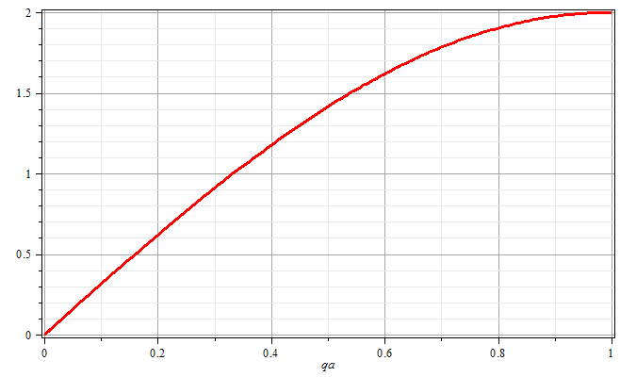
qa/π

Slide 6
Consider an infinite system of masses and springs now with two kinds of masses:
m
M
m
M
m
m

Slide 8
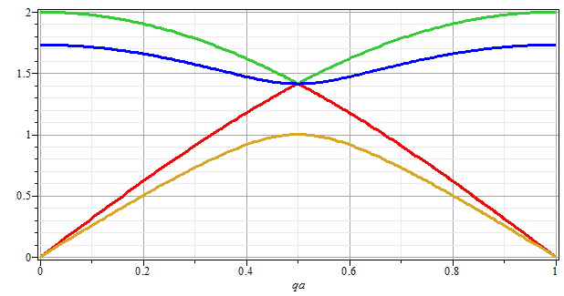
ω
qa/π

Slide 9
Eigenvectors:

Slide 10
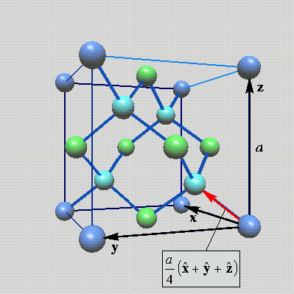
Lattice vibrations for 3-dimensional lattice
Example: diamond lattice
Ref: http://phycomp.technion.ac.il/~nika/diamond_structure.html

Slide 14
B. P. Pandy and B. Dayal, J. Phys. C. Solid State Phys. 6 2943 (1973)

Slide 15
Example – normal modes of a system with the symmetry of an equilateral triangle
3
u₃
m
k
k
u₂
1
2
u₁
k
m
m

Slide 16
Example – normal modes of a system with the symmetry of an equilateral triangle -- continued
3
u₃
u₂
1
2
u₁

Slide 17
Example – normal modes of a system with the symmetry of an equilateral triangle -- continued

Slide 18
Example – normal modes of a system with the symmetry of an equilateral triangle -- continued
= ω²

Slide 19
Example – normal modes of a system with the symmetry of an equilateral triangle -- continued
3
u₃
m
k
k
u₂
1
2
u₁
k
m
m

