Slide 1
PHY 711 Classical Mechanics and Mathematical Methods
10-10:50 AM MWF Olin 103
Plan for Lecture 19:
Continue reading Chapter 7
Wave equation
General solution methods for Sturm-Liouville equations
Digression on several numerical methods

Slide 2
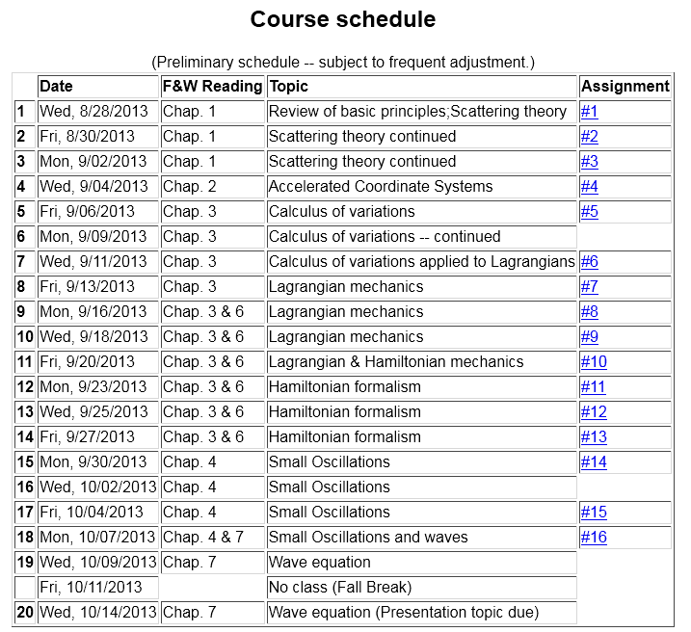

Slide 9
The wave equation and its solutions
More general discussion of Sturm-Liouville equation solution methods --

