Slide 1
PHY 711 Classical Mechanics and Mathematical Methods
10-10:50 AM MWF Olin 103
Plan for Lecture 2:
Comments on Maple software
Chapter 1 – scattering theory
Rutherford scattering
Scattering for arbitrary potential

Slide 3
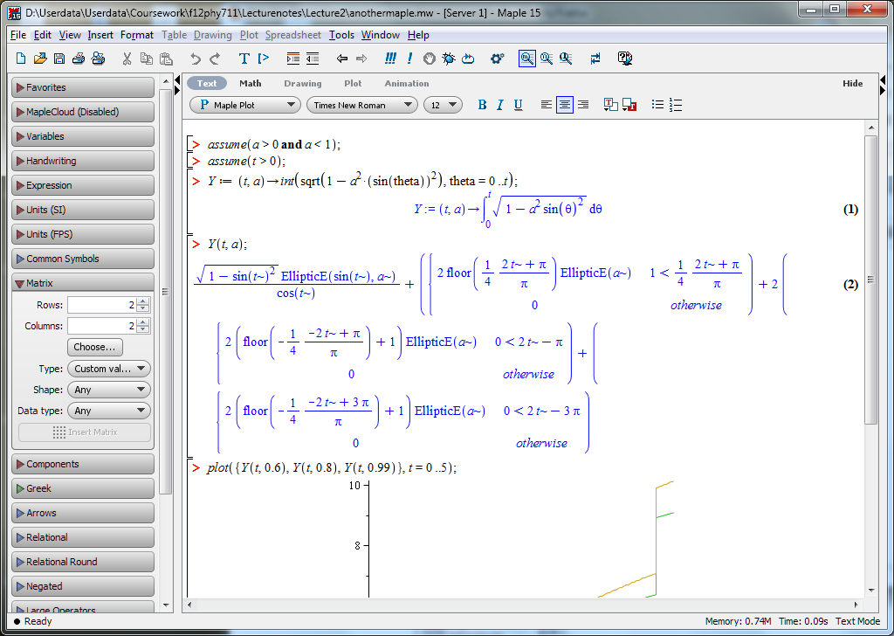
Some additional Maple examples

Slide 4
Scattering theory:

Slide 5
b
Figure from Marion & Thorton, Classical Dynamics

Slide 6
Note: The following analysis will be carried out in the center of mass frame of reference.
In laboratory frame: In center-of-mass frame:
V₁
v₁
μ
m₁
r
origin
v_{CM}
m_{target}
Also note: We are assuming that the interaction between particle and target V(r) conserves energy and angular momentum.

Slide 7
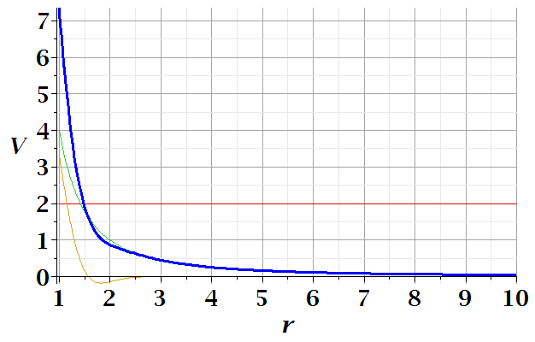
In center of mass reference frame:
E
r_{min}

Slide 8
φ
r_{min}
r(φ)

Slide 14
Relationship between φ_{max} and θ:

Slide 18
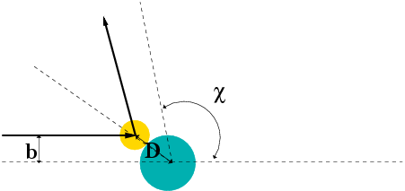
Hard sphere scattering

