Slide 1
PHY 711 Classical Mechanics and Mathematical Methods
10-10:50 AM MWF Olin 103
Plan for Lecture 21:
Summary of mathematical methods
Contour integration
Fourier transforms
Fast Fourier transforms

Slide 7
Example
Im(z)
Re(z)

Slide 8
Example -- continued
Im(z)
Re(z)

Slide 9
Example -- continued
Im(z)
x’
Re(z)

Slide 10
Example -- continued
Kramers-Kronig relationship

Slide 12
Example:
Im(z)
Re(z)

Slide 13
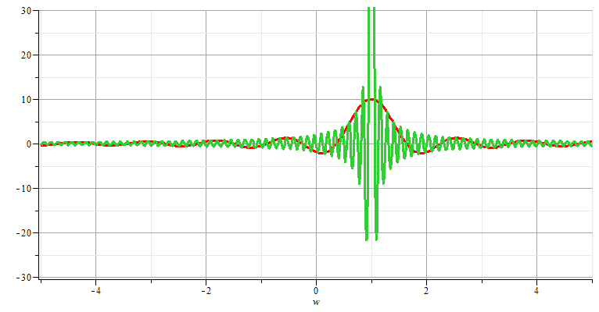
Fourier transforms

Slide 20
Cooley-Tukey algorithm: J. W. Cooley and J. W. Tukey, “An algorithm for machine calculation of complex Fourier series” Math. Computation 19, 297-301 (1965)

