Slide 1
PHY 711 Classical Mechanics and Mathematical Methods
10-10:50 AM MWF Olin 103
Plan for Lecture 26:
Traveling and standing waves in 1 and 2 dimensions
Brief review of 1-d from Chap. 7
Waves in 2-d elastic membranes – Chap. 8

Slide 3
Review of wave equation in one-dimension – here μ(x,t) can describe either a longitudinal or transverse wave.
Traveling wave solutions --

Slide 5
Standing wave solutions of wave equation:

Slide 7
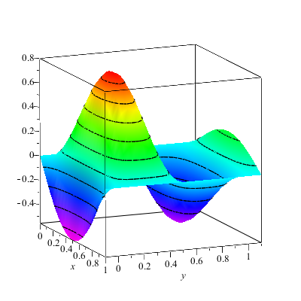
Extension of ideas to wave motion on a two-dimensional surface – elastic membrane (transverse wave; linear regime).
u(x,y,t)

Slide 10
Consider a rectangular boundary:
a
b

Slide 11
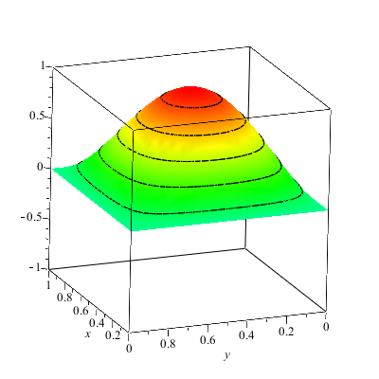
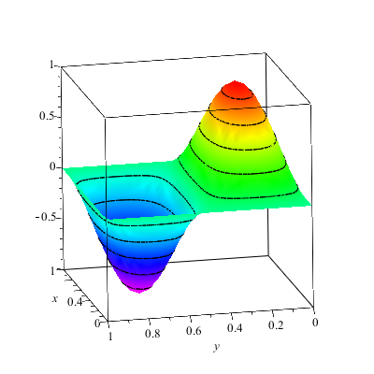
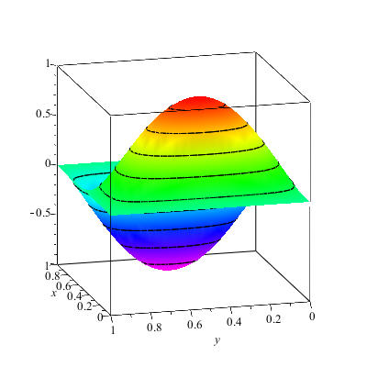
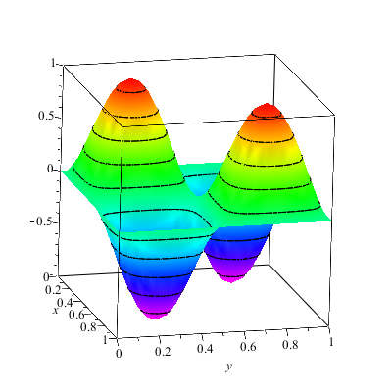

Slide 12
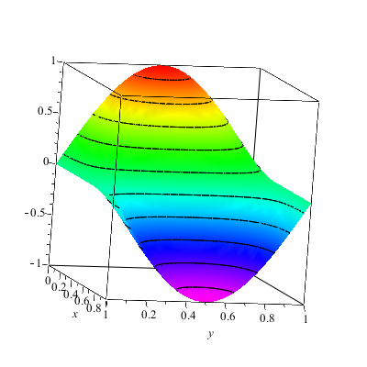
More general boundary conditions:

Slide 13
Consider a circular boundary:
R

Slide 14
Consider circular boundary -- continued

Slide 15
Some properties of Bessel functions

Slide 16
Some properties of Bessel functions -- continued

Slide 17
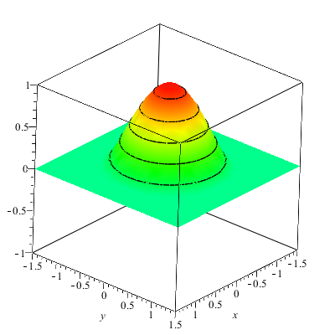
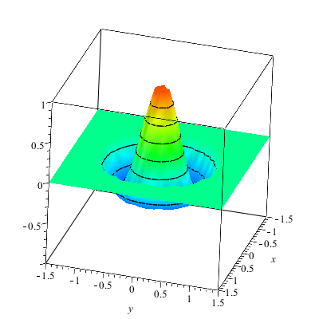

Slide 18
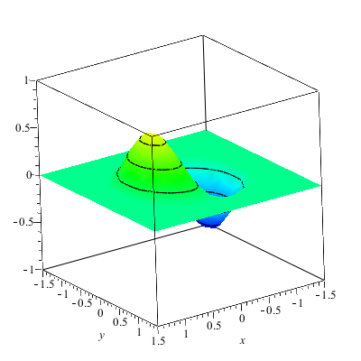
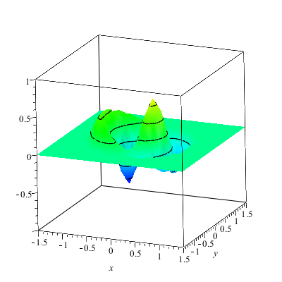

Slide 19
Maple server evaluation project
Request from Rick Matthews, Associate Provost for Technology and Information Systems
The University is exploring the possibility of making Maple available on a server rather than on individual computers
Need students to exercise the software
Need students to assess the performanc
Need students to identify issues
Entirely voluntary
Possible pizza party or ??? rewards

Slide 20
Introduction to algebraic manipulation software
Available from the webpage:
http://help.wfu.edu/public/vcl
If you have any trouble with this installation and setup, please contact Ching-Wan Yip at yipcw@wfu.edu
Note: This is a remote server that the university is testing. If you are off campus you will need to use VPN to gain access.

Slide 21
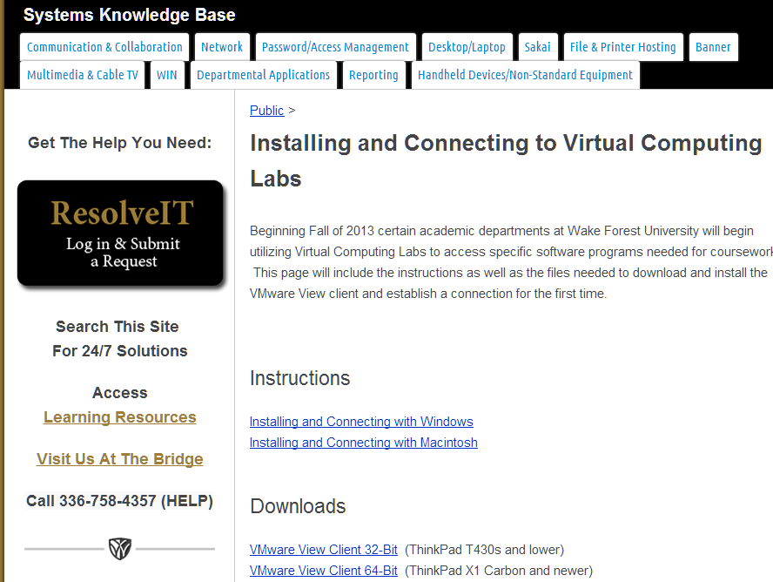

Slide 23
