Slide 1
PHY 711 Classical Mechanics and Mathematical Methods
10-10:50 AM MWF Olin 103
Plan for Lecture 27:
Introduction to hydrodynamics
Motivation for topic
Newton’s laws for fluids
Conservation relations

Slide 2
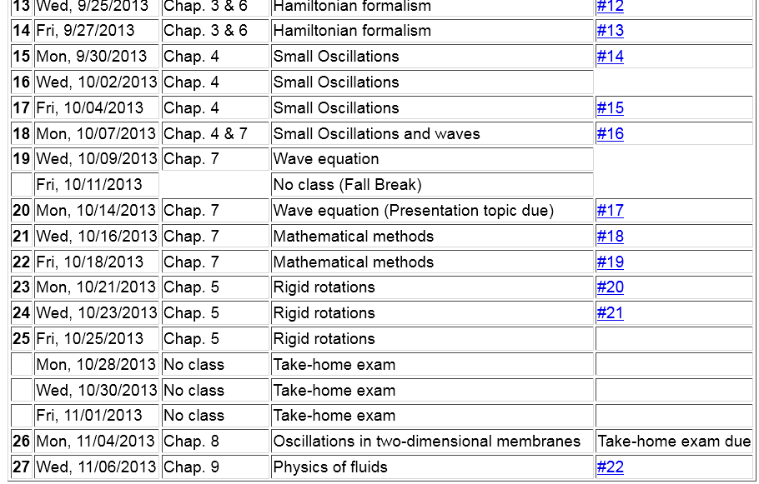

Slide 5
Motivation
Natural progression from strings, membranes, fluids; description of 1, 2, and 3 dimensional continua
Interesting and technologically important phenomena associated with fluids
Plan
Newton’s laws for fluids
Continuity equation
Stress tensor
Energy relations
Bernoulli’s theorem
Various examples
Sound waves

Slide 6
Newton’s equations for fluids
Use Lagrange formulation; following “particles” of fluid

Slide 7
p(x)
p(x+dx)

Slide 8
Newton’s equations for fluids -- continued

Slide 10
Newton’s equations for fluids -- continued

Slide 11
Continuity equation:

Slide 12
Solution of Euler’s equation for fluids

Slide 13
Bernoulli’s integral of Euler’s equation

Slide 14
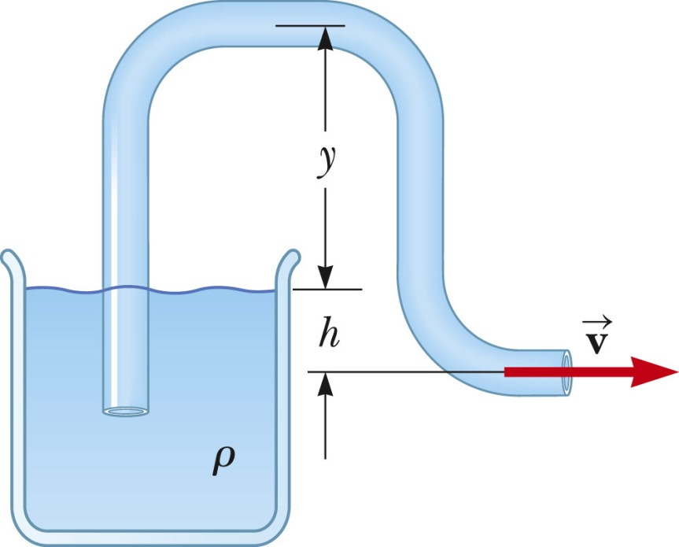
Examples of Bernoulli’s theorem
1
2

Slide 15
Examples of Bernoulli’s theorem -- continued
1
2

Slide 16
Examples of Bernoulli’s theorem -- continued
2
1

Slide 17
Examples of Bernoulli’s theorem -- continued
2
1

Slide 18
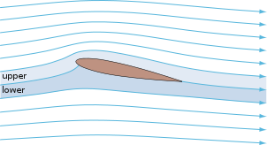
Examples of Bernoulli’s theorem – continued
Approximate explanation of airplane lift
Cross section view of airplane wing
http://en.wikipedia.org/wiki/Lift_%28force%29
1
2

Slide 19
Some details on the velocity potential

Slide 20
Example – uniform flow
b
a
z

Slide 21
Example – flow around a long cylinder (oriented in the Y direction)
^
X
^
v₀ Z
r=a
^
θ
v₀ Z
^
Z

