Slide 1
PHY 711 Classical Mechanics and Mathematical Methods
10-10:50 AM MWF Olin 103
Plan for Lecture 29 --
Chap. 9: Wave equation for sound
Standing waves
Green’s function for wave equation; wave scattering

Slide 2
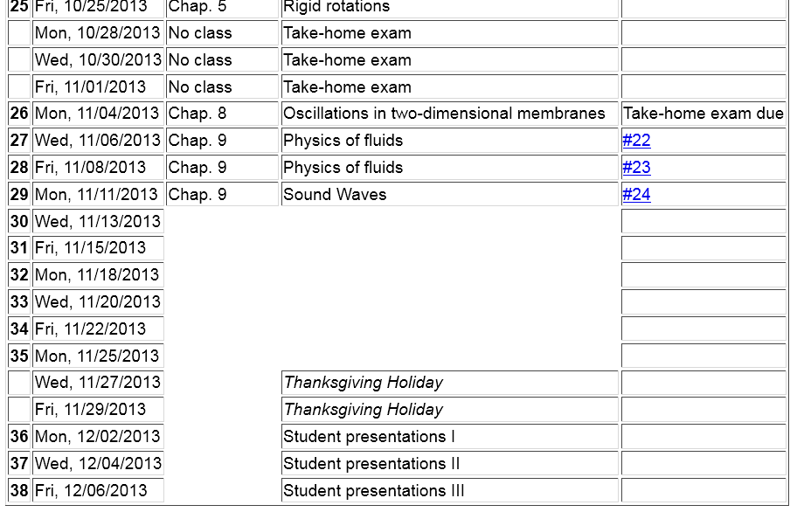

Slide 5
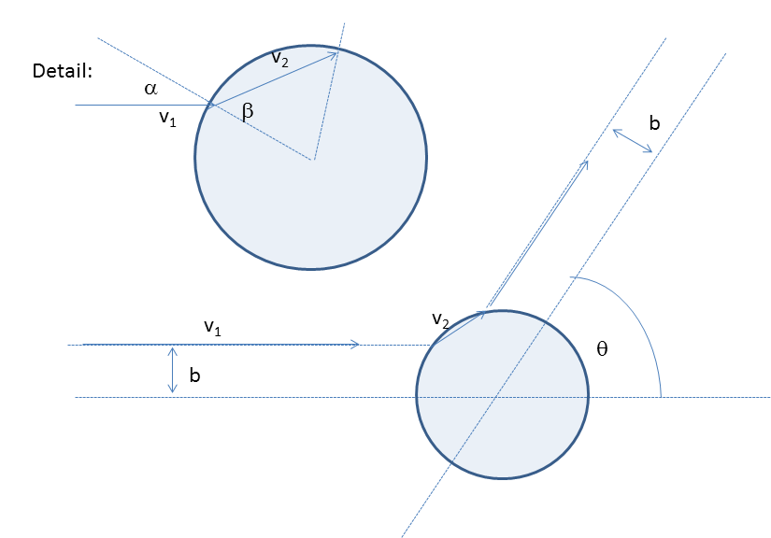
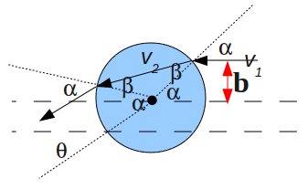
Comments about exam
Note that this figure is misleading; α>β for physical case

Slide 6
Comment about exam – continued

Slide 7
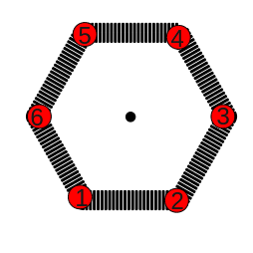
Comment about exam – continued

Slide 8
Linearization of the fluid dynamics relations:

Slide 11
Time harmonic standing waves in a pipe
a
L

Slide 15
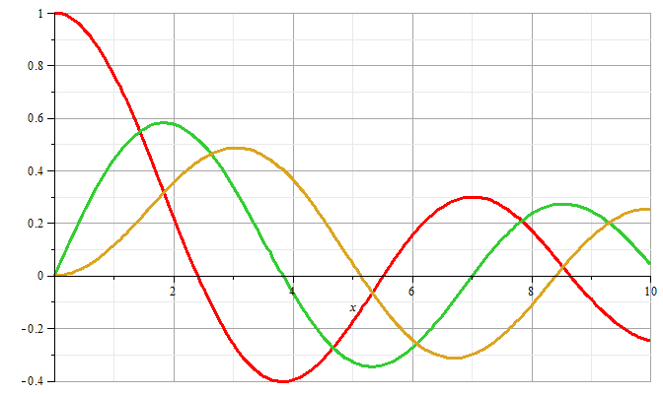
m=0
m=1
m=2

Slide 16
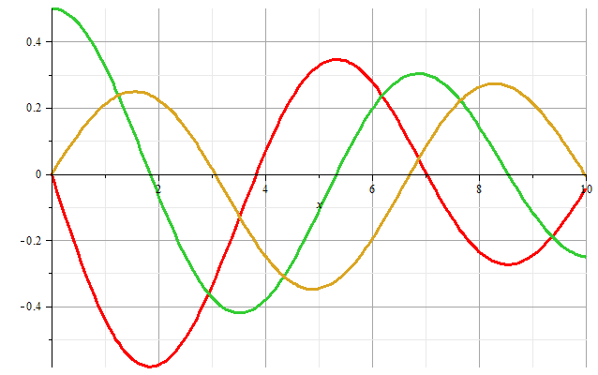
m=1
m=2
m=0
Zeros of derivatives: m=0: 0.00000, 3.83171, 7.01559
m=1: 1.84118, 5.33144, 8.53632
m=2: 3.05424, 6.70613, 9.96947

Slide 17
Boundary condition for z=0, z=L:

Slide 18
Example

Slide 19
Alternate boundary condition for z=0, z=L:

Slide 20
Other solutions to wave equation:

Slide 21
Wave equation with source:

Slide 22
Wave equation with source -- continued:

Slide 23
Derivation of Green’s function for wave equation

Slide 24
Derivation of Green’s function for wave equation -- continued

Slide 25
Derivation of Green’s function for wave equation -- continued

Slide 26
Derivation of Green’s function for wave equation -- continued

Slide 27
Derivation of Green’s function for wave equation – continued
need to find A and B.

Slide 28
Derivation of Green’s function for wave equation – continued

Slide 29
Derivation of Green’s function for wave equation – continued

Slide 30
For time harmonic forcing term we can use the corresponding Green’s function:
In fact, this Green’s function is appropriate for boundary conditions at infinity. For surface boundary conditions where we know the boundary values or their gradients, the Green’s function must be modified.

Slide 33
Wave equation with source:
z
y
x

Slide 34
Treatment of boundary values for time-harmonic force:

