Slide 1
PHY 711 Classical Mechanics and Mathematical Methods
10-10:50 AM MWF Olin 103
Plan for Lecture 32:
Chapter 10 in F & W: Surface waves
Water waves in a channel
Wave-like solutions; wave speed

Slide 2
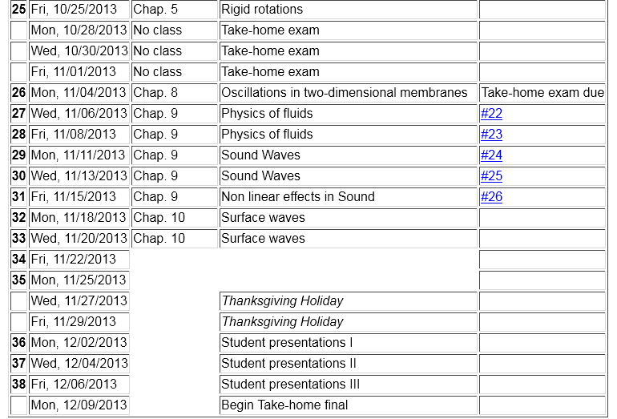
preparation for presentations

Slide 4
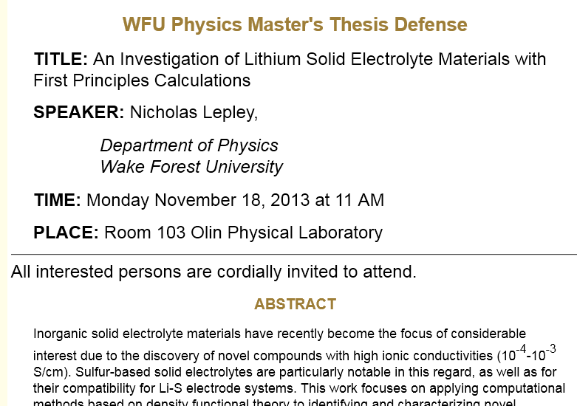

Slide 5
Physics of incompressible fluids and their surfaces
Reference: Chapter 10 of Fetter and Walecka

Slide 6
Consider a container of water with average height h and surface h+ζ(x,y,t); (h ⬅➔ z₋₀ on some of the slides)
p₀
ζ
z
h
y
x

Slide 8
dζ(x,y,t)/dt
z₀
v(x,y,t)
v(x+dx,y+dy,t)

Slide 10
More details: -- recall setup --
Consider a container of water with average height h and surface h+ζ(x,y,t)
p₀
ζ
z
h
y
x

Slide 12
p₀
ζ
z
h
y
x

Slide 13
Full equations:
Linearized equations:

Slide 14
For simplicity, keep only linear terms and assume that horizontal variation is only along x:

Slide 15
For simplicity, keep only linear terms and assume that horizontal variation is only along x – continued:

Slide 16
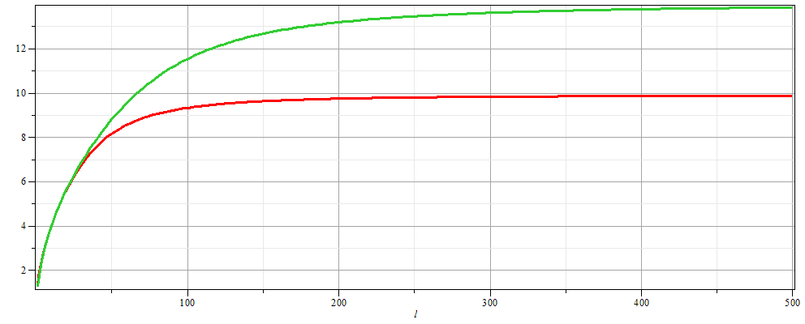
For simplicity, keep only linear terms and assume that horizontal variation is only along x – continued:
h=20 m
c
h=10 m
λ

Slide 17
For simplicity, keep only linear terms and assume that horizontal variation is only along x – continued:

Slide 18
General problem
including
non-linearities
p₀
ζ
z
h
y
x

