Slide 1
PHY 711 Classical Mechanics and Mathematical Methods
10-10:50 AM MWF Olin 103
Plan for Lecture 33:
Chapter 10 in F & W: Surface waves
-- Non-linear contributions and soliton solutions

Slide 2
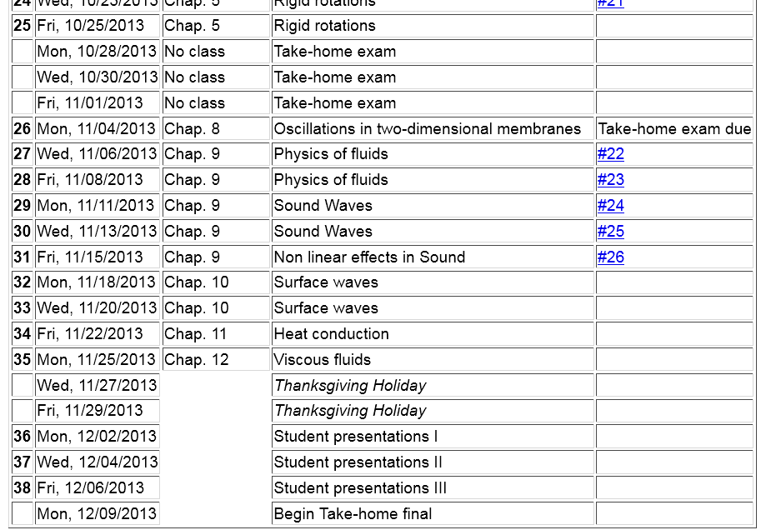
preparation for presentations

Slide 5
General problem
including
non-linearities
p₀
ζ
z
h
y
x

Slide 6
p₀
ζ
z
h
y
x

Slide 7
Some links:
Details of soliton equations
Maple animation
Website – http://www.ma.hw.ac.uk/solitons/

