Slide 1
PHY 711 Classical Mechanics and Mathematical Methods
10-10:50 AM MWF Olin 103
Plan for Lecture 34:
Chapter 11 in F & W:
Heat conduction

Slide 2
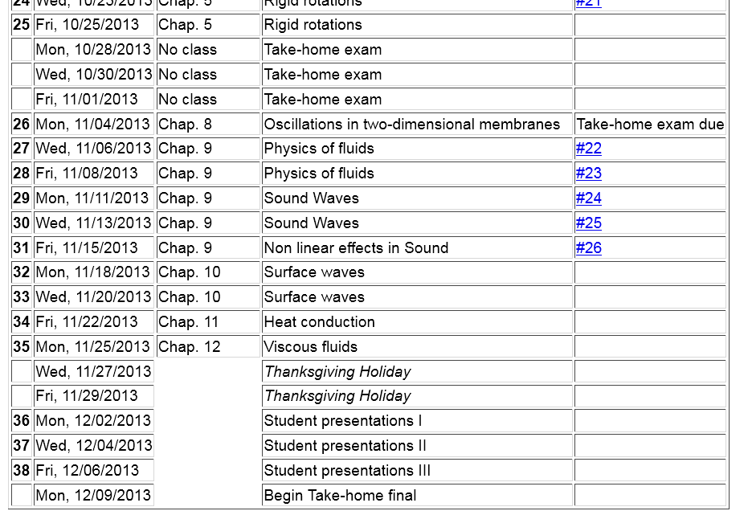
preparation for presentations

Slide 3
Conduction of heat
T(r,t)
j_{h}

Slide 4
Conduction of heat -- continued
heat flux
heat source

Slide 5
Conduction of heat -- continued

Slide 6
Boundary value problems for heat conduction
T₀
c
b
a

Slide 7
Boundary value problems for heat conduction
T₀
c
b
a

Slide 8
Boundary value problems for heat conduction
T₀
c
b
a

Slide 9
Boundary value problems for heat conduction
T₀
c
b
a

Slide 10
Initial value problem in an infinite domain; Fourier transform

Slide 11
Initial value problem in an infinite domain; Fourier transform

Slide 12
Initial value problem in an infinite domain; Fourier transform

Slide 13
Heat equation in half-space

Slide 14
Heat equation in half-space -- continued

