Slide 1
PHY 711 Classical Mechanics and Mathematical Methods
10-10:50 AM MWF Olin 103
Plan for Lecture 4:
Chapter 2 – Physics described in an accelerated coordinate frame
Linear acceleration
Angular acceleration
Foucault pendulum

Slide 5
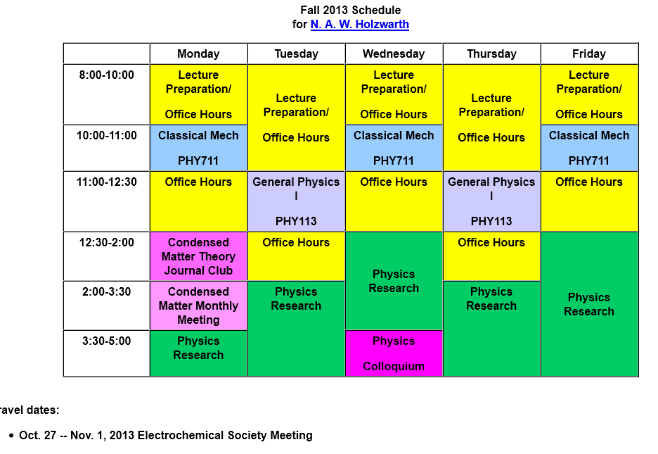

Slide 6
Physical laws as described in non-inertial coordinate systems
Newton’s laws are formulated in an inertial frame of reference
For some problems, it is convenient to transform the the equations into a non-inertial coordinate system

Slide 7
Comparison of analysis in “inertial frame” versus “non-inertial frame”

Slide 8
Properties of the frame motion (rotation only):
dΩ
dΩ

Slide 9
Properties of the frame motion (rotation only) -- continued
Effects on acceleration (rotation only):

Slide 10
Application of Newton’s laws in a coordinate system which has an angular velocity and linear acceleration
Newton’s laws; Let r denote the position of particle of mass m:
Centrifugal
force
Coriolis
force

Slide 11
Motion on the surface of the Earth:

Slide 12
Non-inertial effects on effective gravitational “constant”
0.03 m/s²
9.80 m/s²

Slide 13
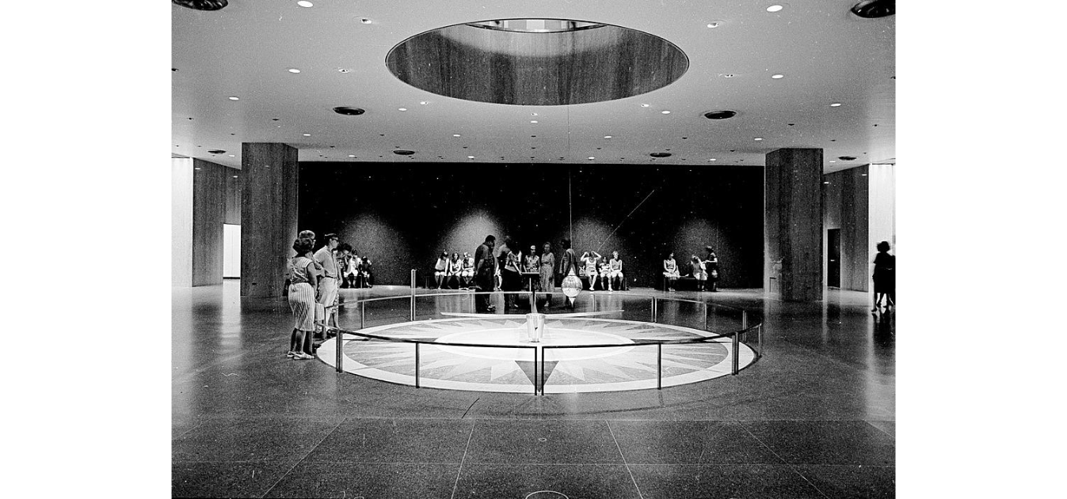
Foucault pendulum
http://www.si.edu/Encyclopedia_SI/nmah/pendulum.htm
The Foucault pendulum was displayed for many years in the Smithsonian's National Museum of American History. It is named for the French physicist Jean Foucault who first used it in 1851 to demonstrate the rotation of the earth.

Slide 14
Equation of motion on Earth’s surface
ω
y (east)
z (up)
θ
x (south)

Slide 15
Foucault pendulum continued – keeping leading terms:

Slide 16
Foucault pendulum continued – keeping leading terms:

Slide 17
Foucault pendulum continued – coupled equations:

Slide 18
Foucault pendulum continued – coupled equations:

