Slide 1
PHY 711 Classical Mechanics and Mathematical Methods
10-10:50 AM MWF Olin 103
Plan for Lecture 10:
    Continue reading Chapter 3 & 6
      Constants of the motion
      Conserved quantities

Slide 2
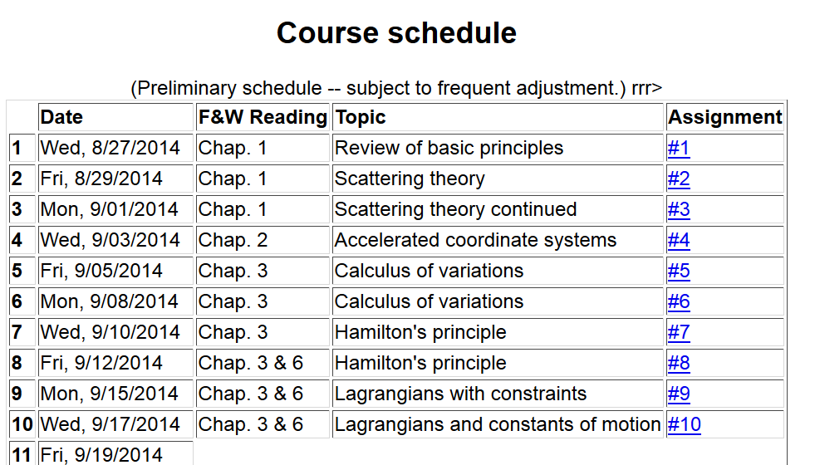

Slide 3
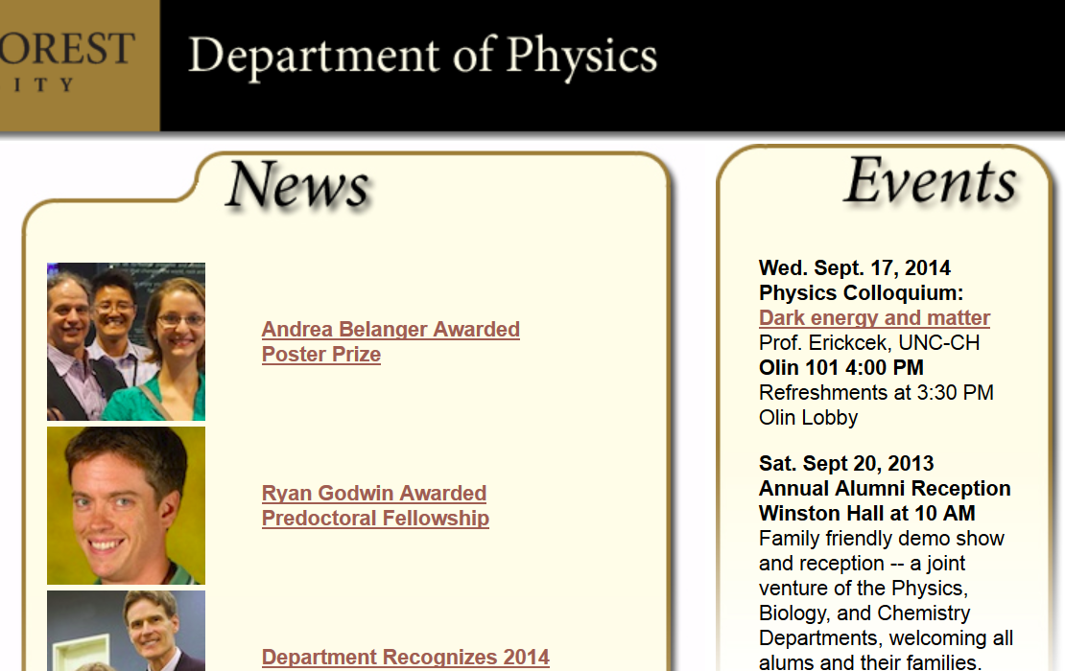

Slide 4
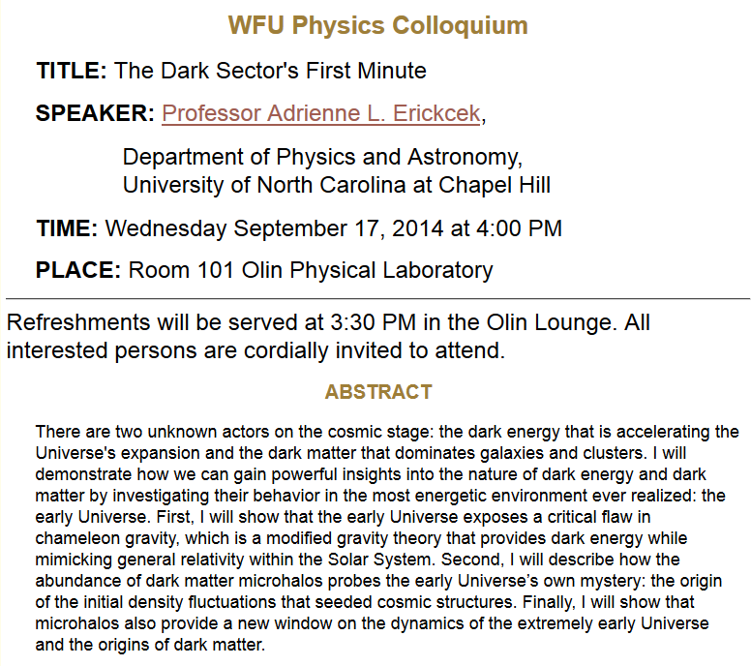

Slide 5
Summary of Lagrangian formalism (without constraints)

Slide 6
Examples of constants of the motion:

Slide 7
Examples of constants of the motion:

Slide 8
Recall alternative form of Euler-Lagrange equations:

Slide 9
Additional constant of the motion:

Slide 10
Additional constant of the motion -- continued:

Slide 11
Other examples

Slide 12
Other examples

Slide 13
Lagrangian picture
Switching variables – Legendre transformation

Slide 14
Mathematical transformations for continuous functions of several variables & Legendre transforms:

Slide 15
Mathematical transformations for continuous functions of several variables & Legendre transforms continued:

Slide 16
For thermodynamic functions:

Slide 17
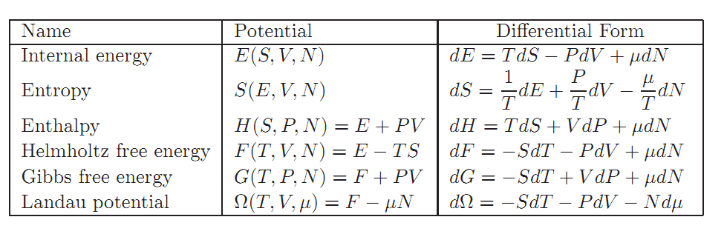

Slide 18
Lagrangian picture
Switching variables – Legendre transformation

Slide 19
Hamiltonian picture – continued

