Slide 1
PHY 711 Classical Mechanics and Mathematical Methods
10-10:50 AM MWF Olin 103
Plan for Lecture 13:
Finish reading Chapter 6
Canonical transformations
Hamilton-Jacobi formalism
Modern applications

Slide 2
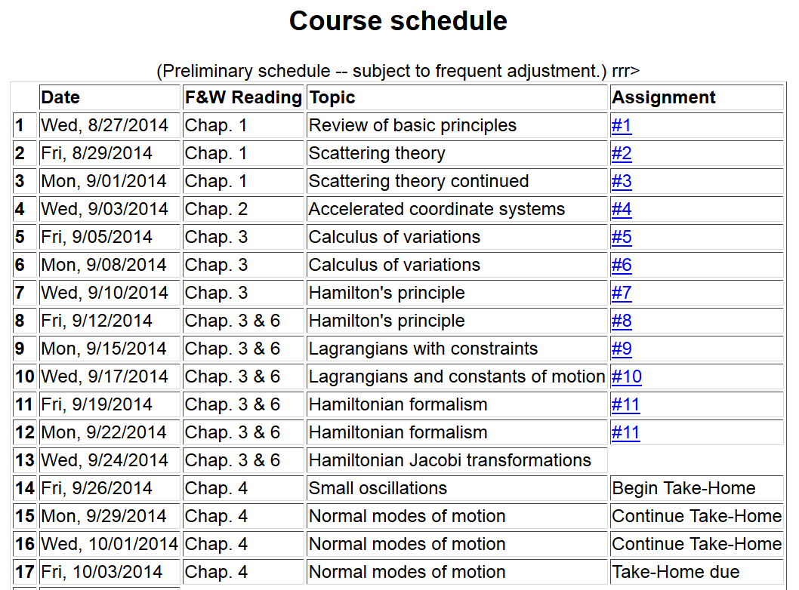

Slide 5
Hamiltonian formalism

Slide 6
Notion of “Canonical” distributions

Slide 7
Note that it is conceivable that if we were extraordinarily clever, we could find all of the constants of the motion!

Slide 9
Note that it is conceivable that if we were extraordinarily clever, we could find all of the constants of the motion!
Possible solution – Hamilton-Jacobi theory:

Slide 11
0
0
0

Slide 12
0
0
0

Slide 13
Differential equation for S:

Slide 14
Continued:

Slide 15
Continued:

Slide 16
Recap --
Lagrangian picture
Hamiltonian picture

Slide 17
Modern usage of Lagrangian and Hamiltonian formalisms
J. Chem. Physics 72 2384-2393 (1980)

Slide 18
“Molecular dynamics” is a subfield of computational physics focused on analyzing the motions of atoms in fluids and solids with the goal of relating the atomistic and macroscopic properties of materials. Ideally molecular dynamics calculations can numerically realize the statistical mechanics viewpoint.

Slide 19
r_{ij}
➔From this Lagrangian, can find the 3N coupled 2nd order differential equations of motion and/or find the corresponding Hamiltonian, representing the system at constant energy, volume, and particle number N (N,V,E ensemble).

Slide 20
Lagrangian and Hamiltonian forms

Slide 21
H. C. Andersen wanted to adapt the formalism for modeling an (N,V,E) ensemble to one which could model a system at constant pressure (P).
P
V constant
P constant, V variable

Slide 22
PV contribution to potential energy
kinetic energy of “balloon”

Slide 24
Relationship between system representations
Scaled Original
Equations of motion in “original” coordinates:

Slide 25
Physical interpretation:

Slide 26
Digression on numerical evaluation of differential equations

