Slide 1
PHY 711 Classical Mechanics and Mathematical Methods
10-10:50 AM MWF Olin 103
Plan for Lecture 16:
Continue reading Chapter 4
Normal modes for 2 and 3 dimensional systems
Finite systems
Periodic systems

Slide 2
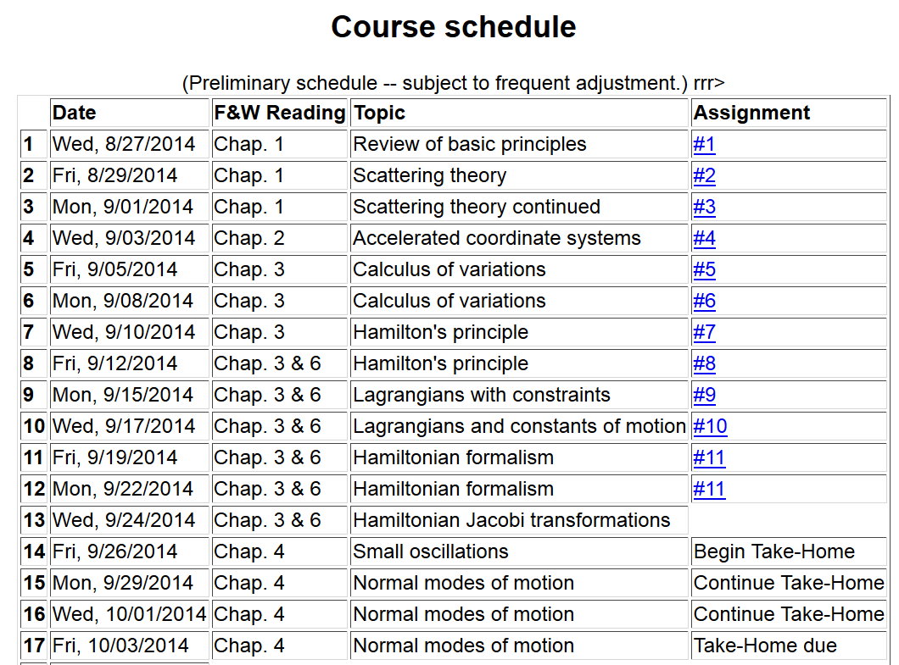

Slide 3
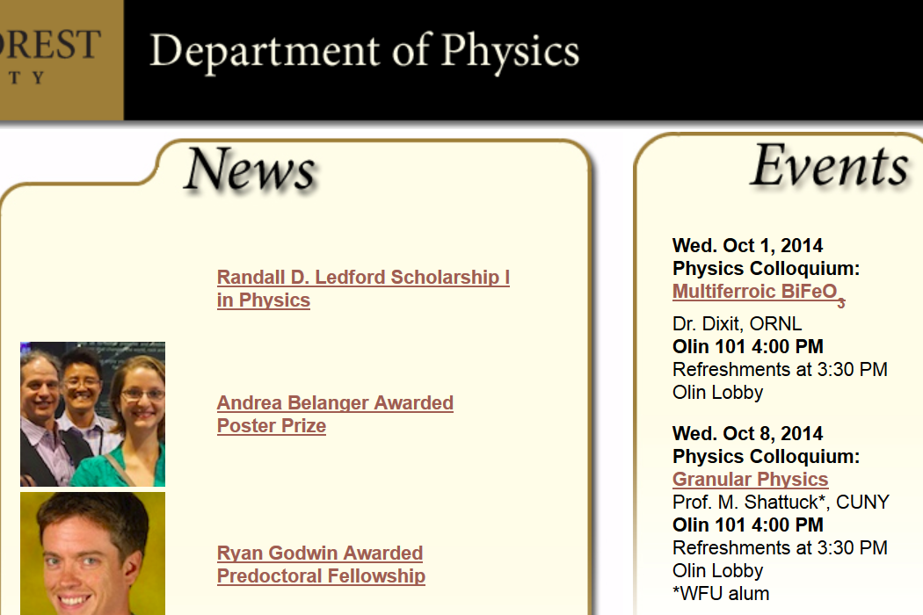

Slide 4
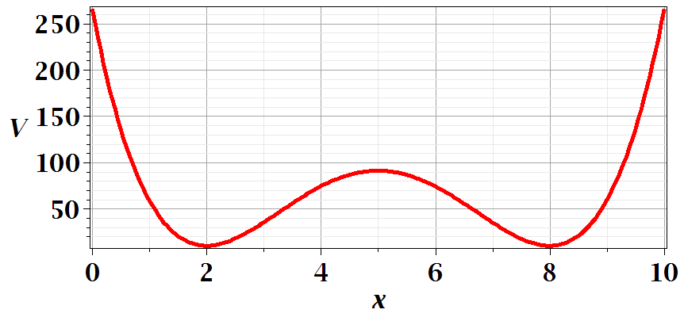
Motivation for studying small oscillations – many interacting systems have stable and meta-stable configurations which are well approximated by:

Slide 5
Example – linear molecule
m₁
m₂
m₃

Slide 6
Potential in 2 and more dimensions
V(x,y)

Slide 7
Example – normal modes of a system with the symmetry of an equilateral triangle
3
u₃
m
k
k
u₂
1
2
u₁
k
m
m

Slide 8
Example – normal modes of a system with the symmetry of an equilateral triangle -- continued
3
u₃
u₂
1
2
u₁

Slide 9
Example – normal modes of a system with the symmetry of an equilateral triangle -- continued

Slide 10
Example – normal modes of a system with the symmetry of an equilateral triangle -- continued
= ω²

Slide 11
Example – normal modes of a system with the symmetry of an equilateral triangle -- continued
3
u₃
m
k
k
u₂
1
2
u₁
k
m
m

Slide 12
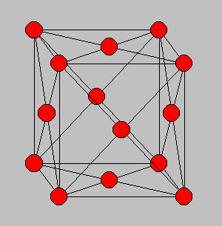
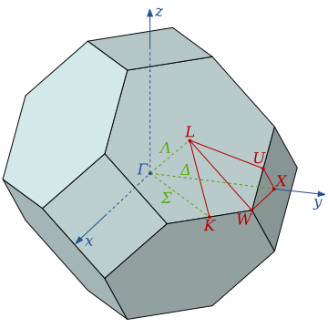
3-dimensional periodic lattices
Example – face-centered-cubic unit cell (Al or Ni)
Diagram of atom positions
Diagram of q-space ν(q)

Slide 13
From: PRB 59 3395 (1999); Mishin et. al. ν(q)

Slide 14
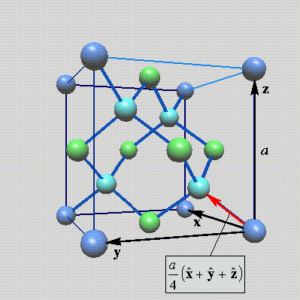
Lattice vibrations for 3-dimensional lattice
Example: diamond lattice
Ref: http://phycomp.technion.ac.il/~nika/diamond_structure.html

Slide 18
B. P. Pandy and B. Dayal, J. Phys. C. Solid State Phys. 6 2943 (1973)

