Slide 1
PHY 711 Classical Mechanics and Mathematical Methods
10-10:50 AM MWF Olin 103
Plan for Lecture 18:
Finish reading Chapter 4 and start reading Chapter 7
Coupled motion of extended systems; relationship to continuum models & wave equation
Analytic methods for solving Sturm-Liouville equations

Slide 3
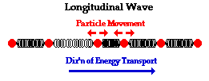
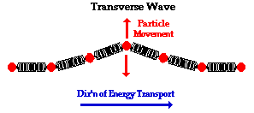
Returning to linear case; continuum limit --
Longitudinal versus transverse vibrations
Images from web page:
http://www.physicsclassroom.com/class/waves/u10l1c.cfm

Slide 4
Longitudinal case: a system of masses and springs:
m
m
m

Slide 5
system parameter with units of (velocity)²

Slide 6
Transverse displacement:
τ
μ(x,t)

Slide 18
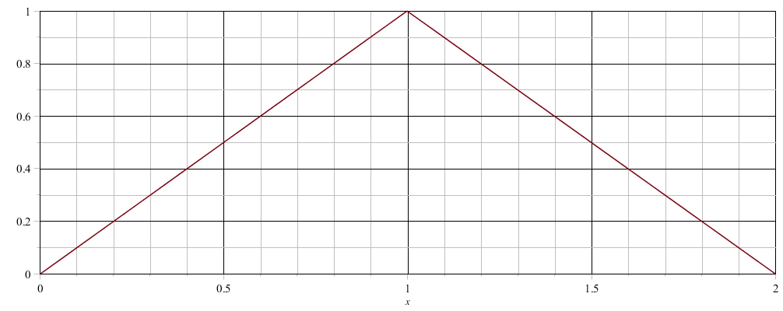
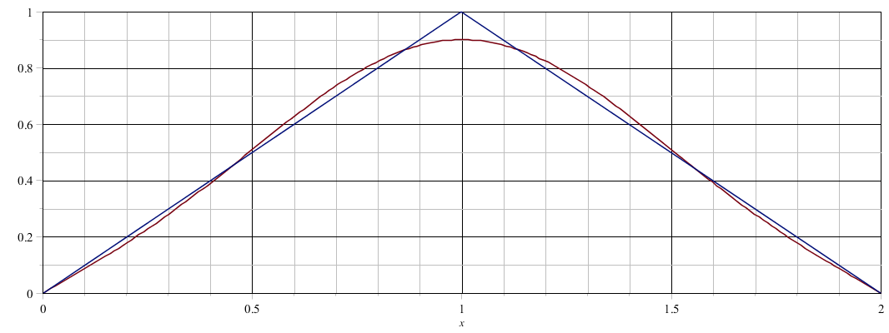
Example initial profile -- φ(x):

