Slide 1
PHY 711 Classical Mechanics and Mathematical Methods
10-10:50 AM MWF Olin 103
Plan for Lecture 20:
Summary of mathematical methods
Sturm-Liouville equations
Green’s function methods
Laplace transform
Contour integration

Slide 2
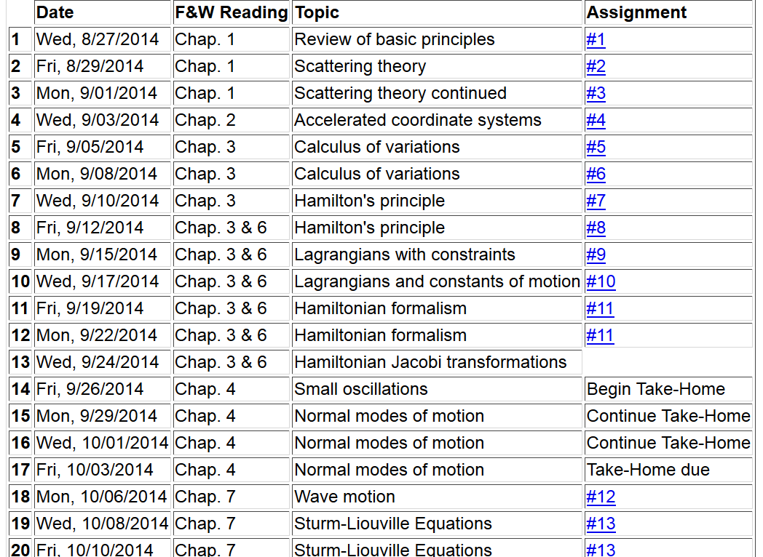

Slide 3
Sturm-Liouville equation (assume all functions and constants are real):
We can prove as a general property of the Sturm-Liouville
system, the eigenfunctions f_{n}(x) are orthogonal

Slide 4
It can be shown that for any reasonable function h(x), defined within the interval a < x <b, we can expand that function as a linear combination of the eigenfunctions f_{n}(x)
These ideas lead to the notion that the set of eigenfunctions f_{n}(x) form a ``complete'' set in the sense of ``spanning'' the space of all functions in the interval
a < x <b, as summarized by the statement:

Slide 5
In general, there are several techniques to determine the eigenvalues λ_{n} and eigenfunctions f_{n}(x). When it is not possible to find the ``exact'' functions, there are several powerful approximation techniques. For example, the lowest eigenvalue can be approximated by minimizing the function
where is a variable function which satisfies the
correct boundary values. The ``proof'' of this inequality is
based on the notion that can in principle be expanded
in terms of the (unknown) exact eigenfunctions f_{n}(x):
where the coefficients C_{n} can be
assumed to be real.

Slide 6
Estimation of the lowest eigenvalue – continued:
From the eigenfunction equation, we know that
It follows that:

Slide 7
Rayleigh-Ritz method of estimating the lowest eigenvalue

Slide 8
Recap: Sturm-Liouville equation:

