Slide 1
PHY 711 Classical Mechanics and Mathematical Methods
10-10:50 AM MWF Olin 103
Plan for Lecture 21:
Summary of mathematical methods – continued:
Green’s function methods
Laplace transform methods
Motivation for contour integration

Slide 2
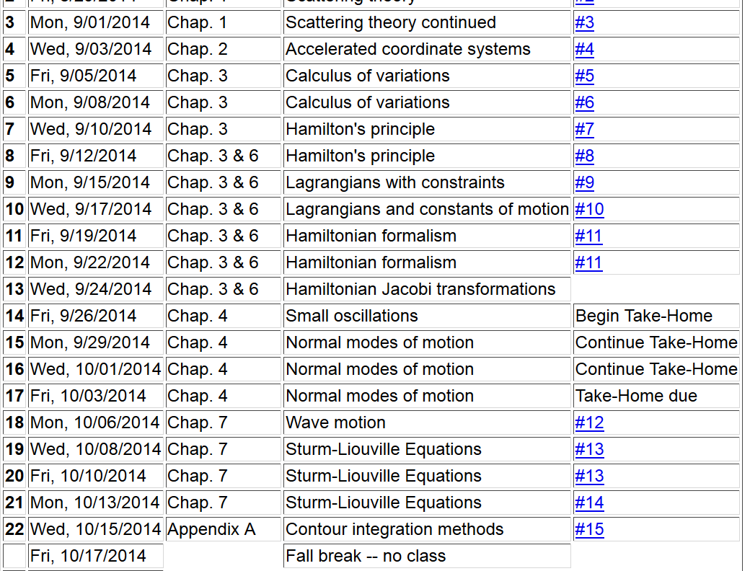

Slide 3
Recap: Sturm-Liouville equation (assume all functions and constants are real):
We proved several properties of the eigenfunctions f_{n}(x) –
including orthogonality and completeness.

Slide 5
Solution to inhomogeneous problem by using Green’s functions
Solution to homogeneous problem

Slide 6
Example Sturm-Liouville problem:

