Slide 1
PHY 711 Classical Mechanics and Mathematical Methods
10-10:50 AM MWF Olin 103
Plan for Lecture 22:
Summary of some mathematical tools
Contour integration
Fourier transforms
Fast Fourier transforms

Slide 2
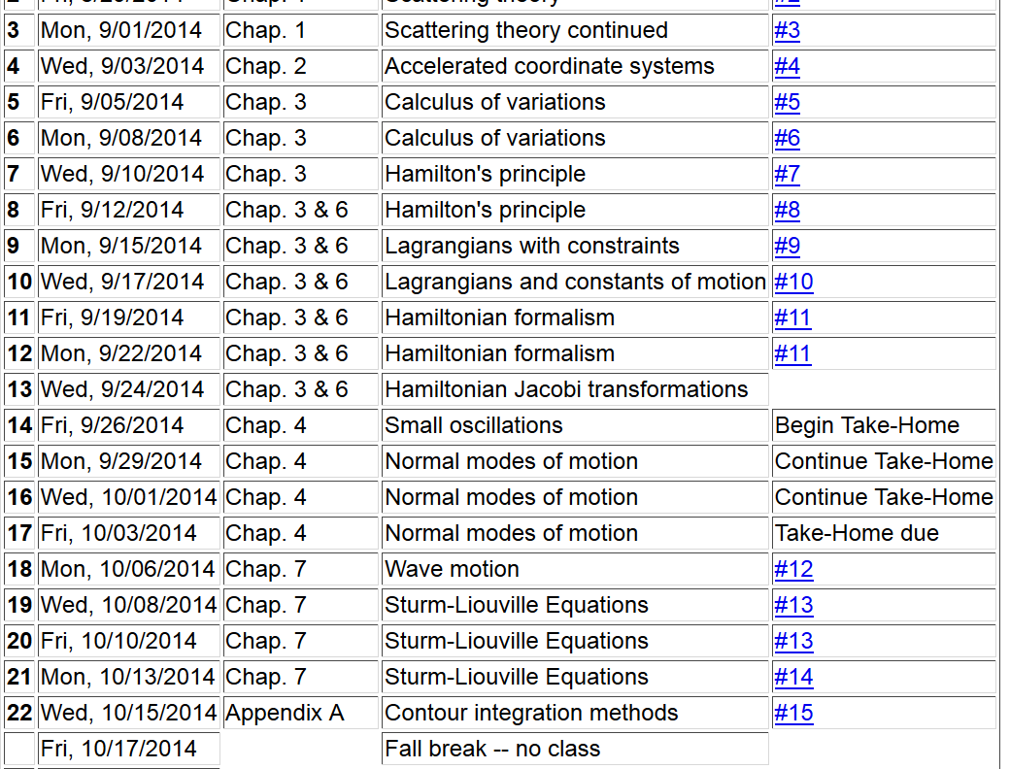

Slide 6
Example
Im(z)
Re(z)

Slide 7
Example -- continued
Im(z)
Re(z)

Slide 8
Example -- continued
Im(z)
x’
Re(z)

Slide 9
Example -- continued
Kramers-Kronig relationship

Slide 11
Example:
Im(z)
Re(z)

Slide 12
Contour integral for homework:

Slide 13
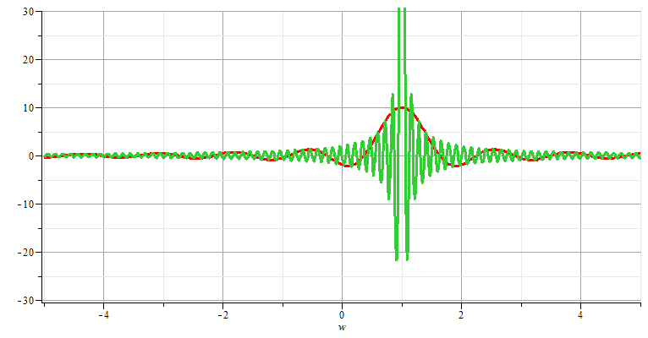
Fourier transforms

Slide 14
Note: The location of the 2π factor varies among texts.

Slide 16
Use of Fourier transforms to solve wave equation

Slide 17
Use of Fourier transforms to solve wave equation -- continued

Slide 20
Example:

Slide 21
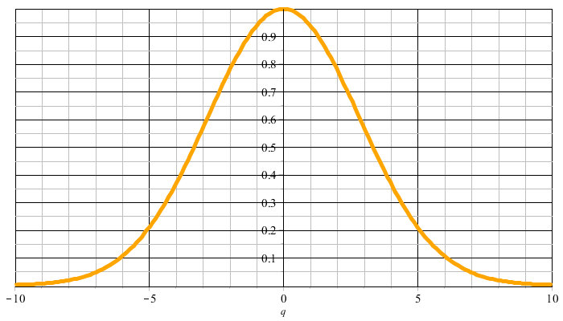
Example:
f(t)
F(νΩ)

Slide 22
F(νΩ)
ν=-M
ν=M

Slide 26
Cooley-Tukey algorithm: J. W. Cooley and J. W. Tukey, “An algorithm for machine calculation of complex Fourier series” Math. Computation 19, 297-301 (1965)

