Slide 1
PHY 711 Classical Mechanics and Mathematical Methods
10-10:50 AM MWF Olin 103
Plan for Lecture 23:
More mathematical tools
Fourier transforms
Fast Fourier transforms

Slide 2
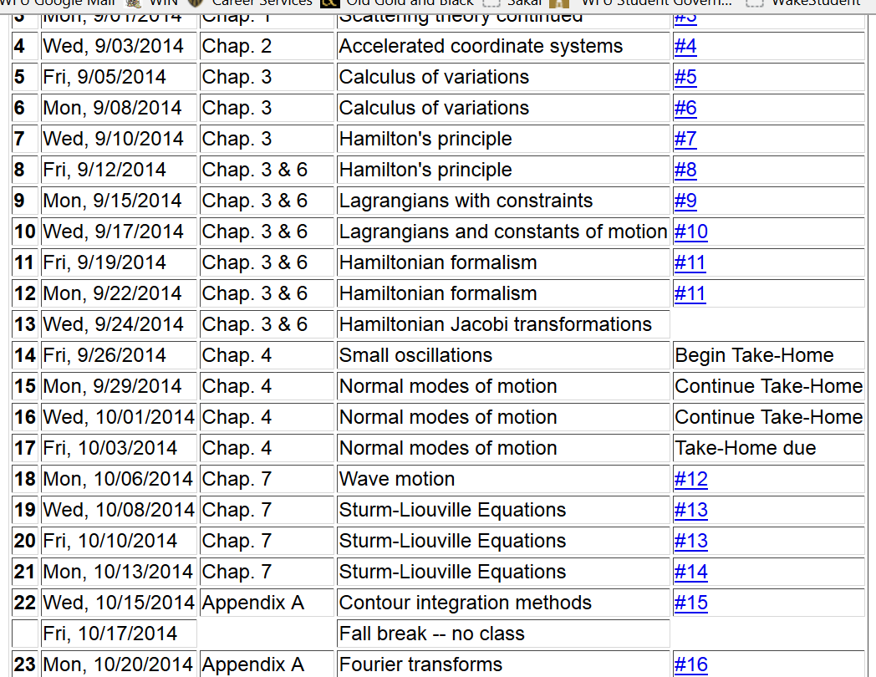

Slide 3
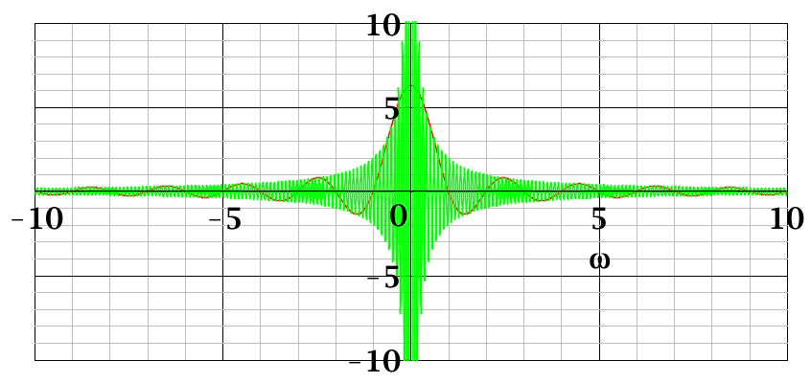
Fourier transforms
T=π
T=20π

Slide 4
Note: The location of the 2π factor varies among texts.

Slide 6
Use of Fourier transforms to solve wave equation

Slide 7
Use of Fourier transforms to solve wave equation -- continued

Slide 10
Example:

Slide 11
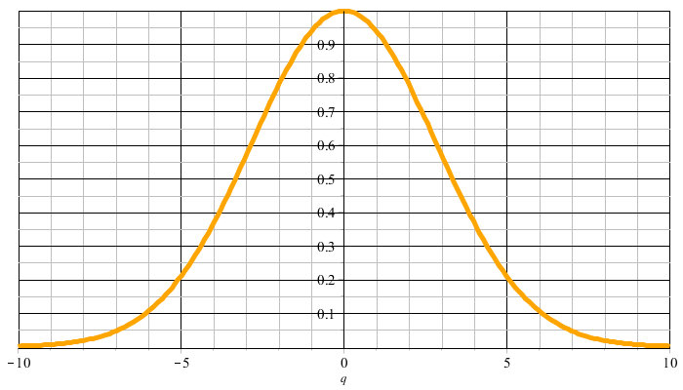
Example:
f(t)
F(νΩ)

Slide 12
F(νΩ)
ν=-M
ν=M

Slide 16
Cooley-Tukey algorithm: J. W. Cooley and J. W. Tukey, “An algorithm for machine calculation of complex Fourier series” Math. Computation 19, 297-301 (1965)

Slide 17
16 complex multiplications and additions
Some simplifications:

Slide 18
4 complex multiplications and 8 complex additions

