Slide 1
PHY 711 Classical Mechanics and Mathematical Methods
10-10:50 AM MWF Olin 103
Plan for Lecture 24:
Rotational motion (Chapter 5)
Rigid body motion
Moment of inertia tensor

Slide 2
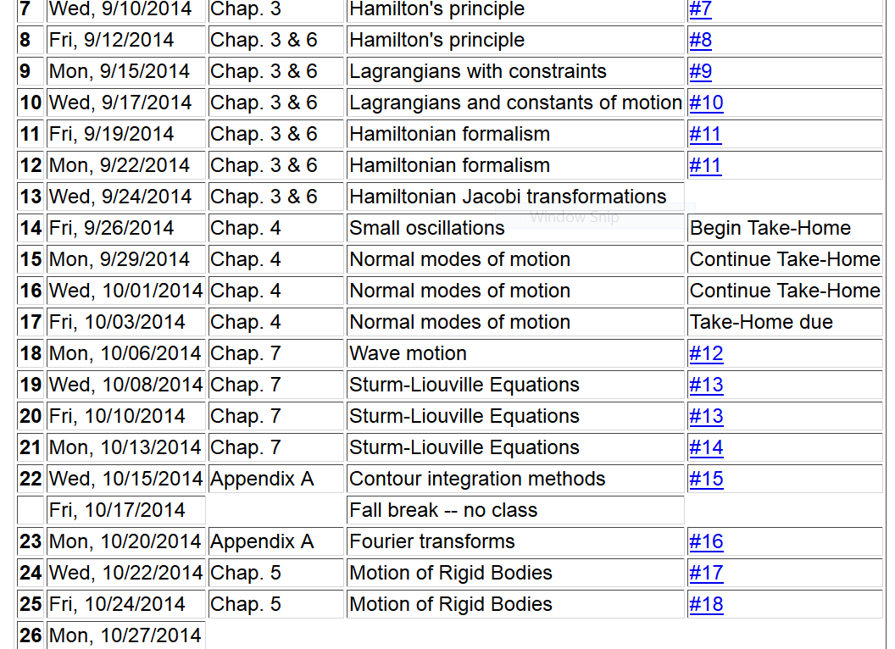

Slide 3
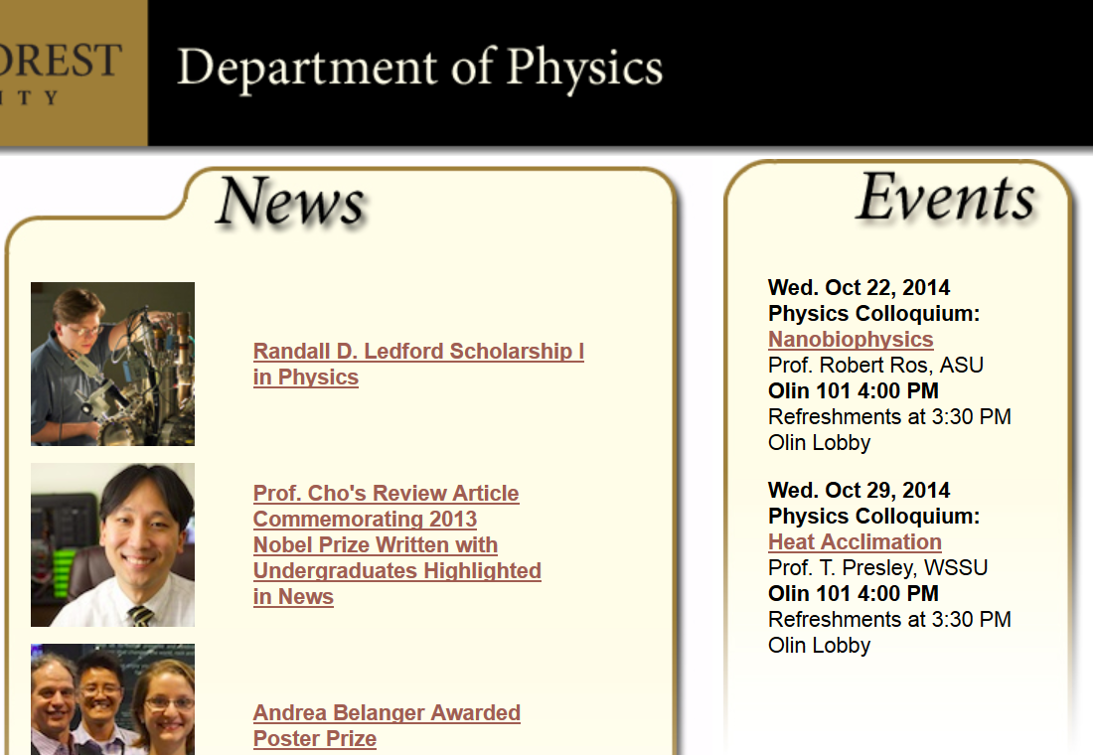

Slide 5
The physics of rigid body motion; body fixed frame vs inertial frame:

Slide 6
Comparison of analysis in “inertial frame” versus “non-inertial frame”

Slide 7
Properties of the frame motion (rotation):
dΘ
dΘ

Slide 8
Effects on acceleration:

Slide 9
ω
r

Slide 11
z
Example:
c
y
a
b
x

Slide 12
Properties of moment of inertia tensor:
Symmetric matrix ➔real eigenvalues I₁,I₂,I₃
➔orthogonal eigenvectors

Slide 13
Changing origin of rotation
z
z’
r_{p}
r’_{p}
c
R
y’
y
a
x’
b
x

Slide 14
z
z’
r_{p}
r’_{p}
c
R
y’
y
a
x’
b
x

Slide 15
z
z’
r_{p}
r’_{p}
c
R
y’
y
a
x’
b
x

Slide 16
Descriptions of rotation about a given origin

Slide 17
Descriptions of rotation about a given origin -- continued

Slide 18
Descriptions of rotation about a given origin -- continued

Slide 19
Descriptions of rotation about a given origin -- continued

Slide 21
Solution of Euler equations for a symmetric top -- continued

