Slide 1
PHY 711 Classical Mechanics and Mathematical Methods
10-10:50 AM MWF Olin 103
Plan for Lecture 26:
Rigid body rotational motion (Chap. 5)
Use of Euler angles as generalized coordinates.
Motion of a symmetric top
Begin to discuss membrane vibrations (Chap. 8)

Slide 3
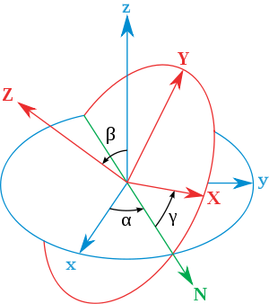
x
y
y
x

Slide 4
Rotational kinetic energy

Slide 5
Motion of a symmetric top under the influence of the torque of gravity:
γ
β
Mg
α

Slide 7
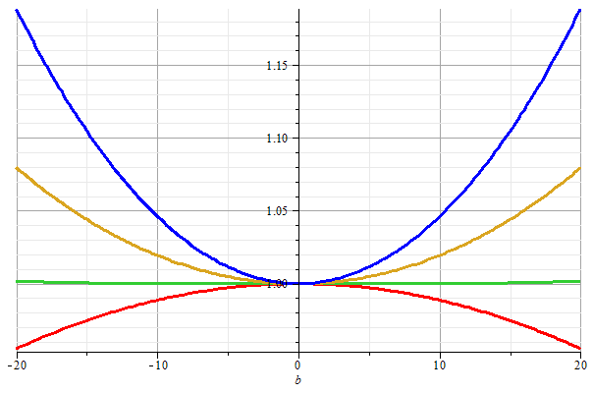
Stable/unstable solutions near
β=0

Slide 9
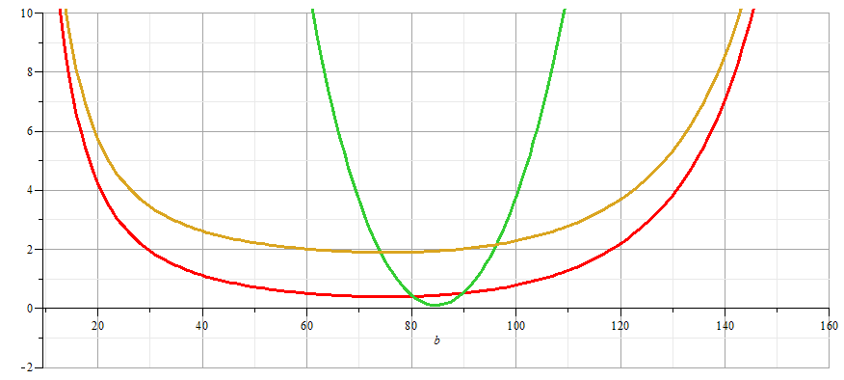
More general case:

Slide 10
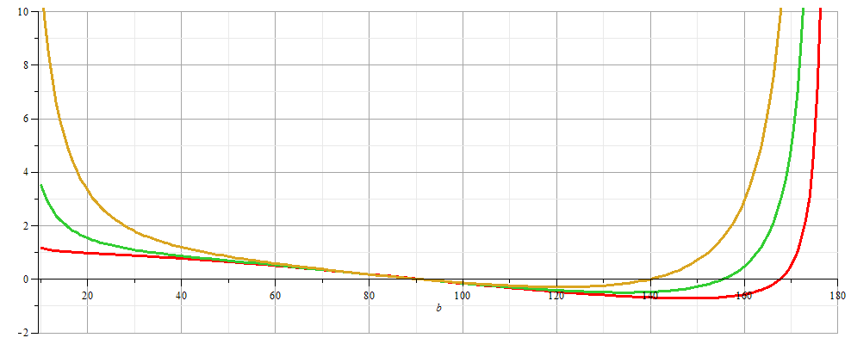
More general case:

Slide 11
β
Mg
α

Slide 12
Elastic media in two or more dimensions --
Review of wave equation in one-dimension – here μ(x,t) can describe either a longitudinal or transverse wave.
Traveling wave solutions --

Slide 14
Standing wave solutions of wave equation:

Slide 16
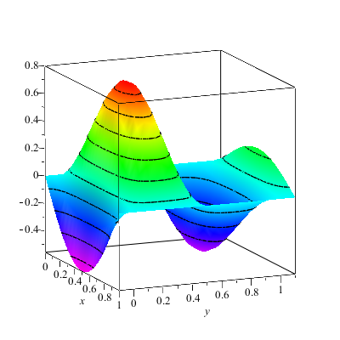
Extension of ideas to wave motion on a two-dimensional surface – elastic membrane (transverse wave; linear regime).
u(x,y,t)

Slide 19
Consider a rectangular boundary:
b
a

Slide 20
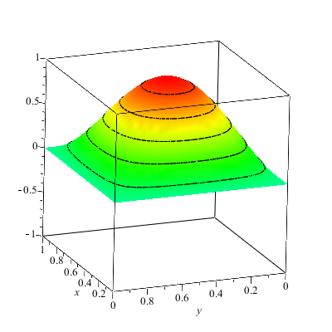
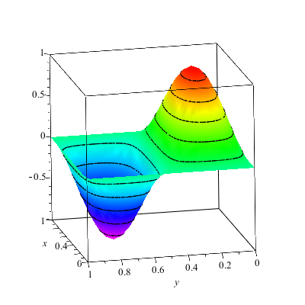
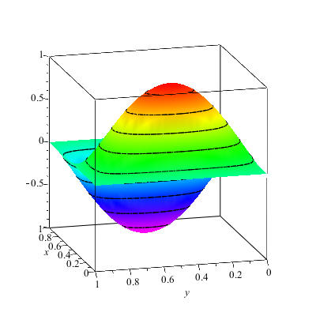
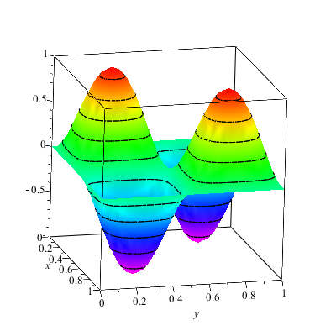

Slide 21
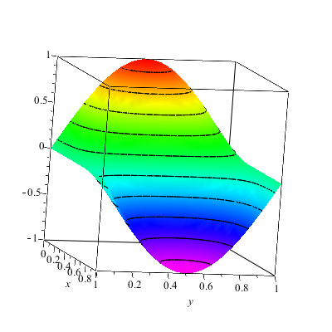
More general boundary conditions:

Slide 22
Consider a circular boundary:
R

Slide 23
Consider circular boundary -- continued

Slide 24
Some properties of Bessel functions

Slide 25
Some properties of Bessel functions -- continued

Slide 26
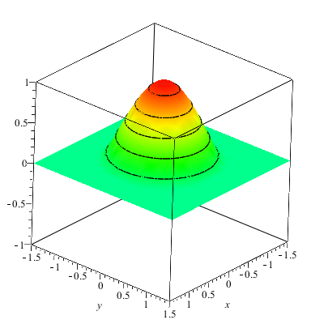
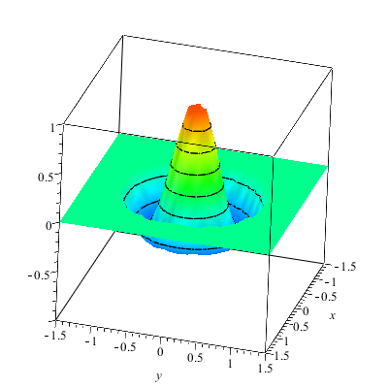

Slide 27
