Slide 1
PHY 711 Classical Mechanics and Mathematical Methods
10-10:50 AM MWF Olin 103
Plan for Lecture 27:
Membrane vibrations (Chap. 8)
2-dimensional rectangular membrane
2-dimensional circular membrane
Other examples

Slide 2
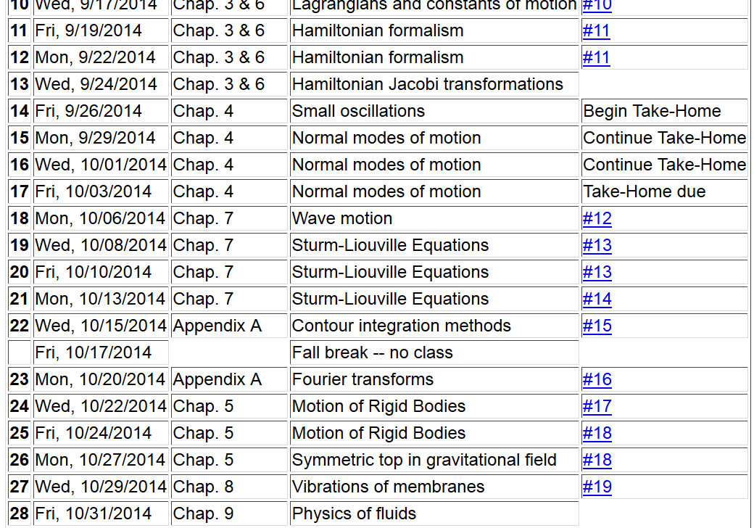

Slide 3
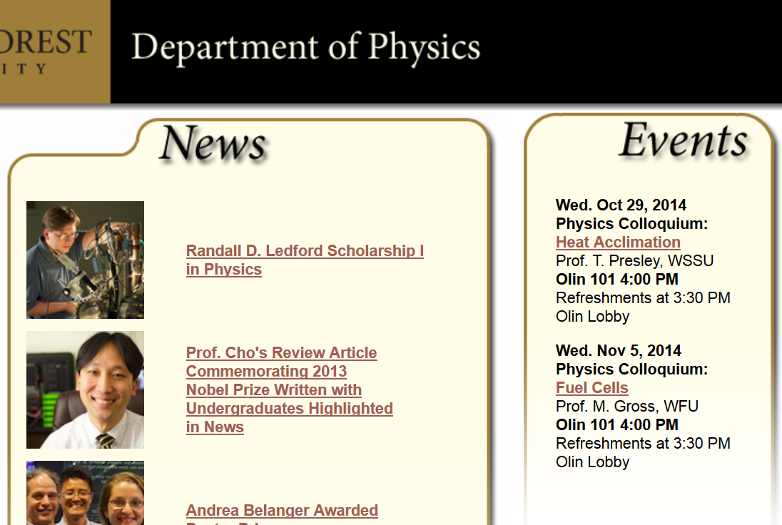

Slide 4
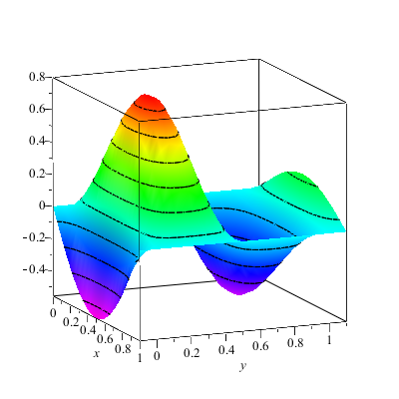
Wave motion on a two-dimensional surface – elastic membrane (transverse wave; linear regime).
u(x,y,t)

Slide 5
Consider a rectangular boundary:
b
a

Slide 6
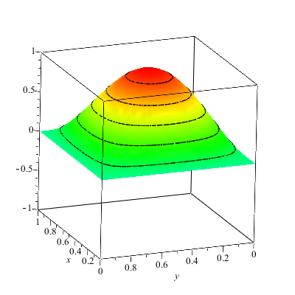
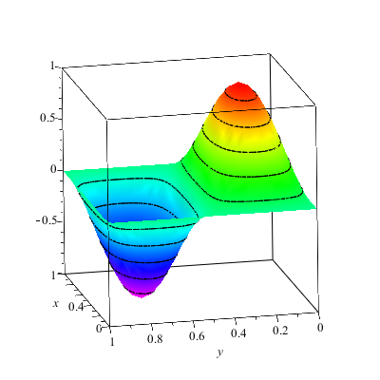
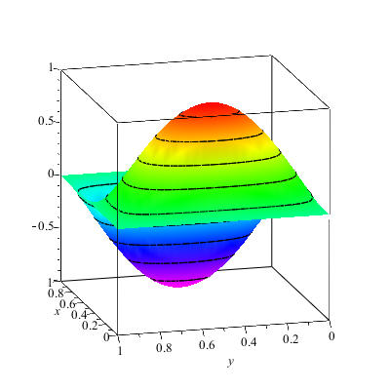
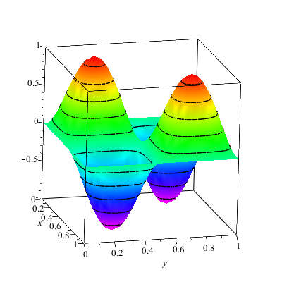

Slide 7
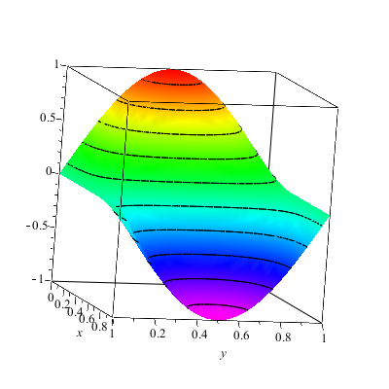
More general boundary conditions:

Slide 8
Consider a circular boundary:
R

Slide 9
Consider circular boundary -- continued

Slide 10
Some properties of Bessel functions

Slide 11
http://dlmf.nist.gov/

Slide 12
Series expansions of Bessel and Neumann functions

Slide 13
Some properties of Bessel functions -- continued

Slide 14
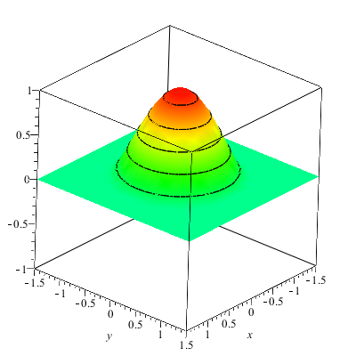
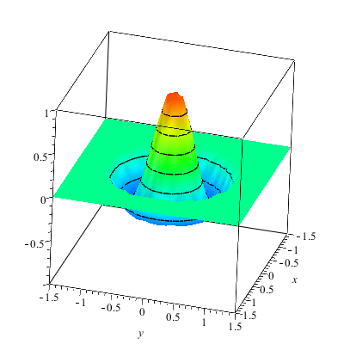

Slide 15
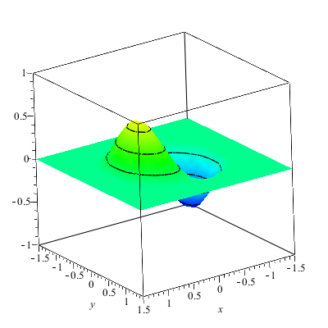
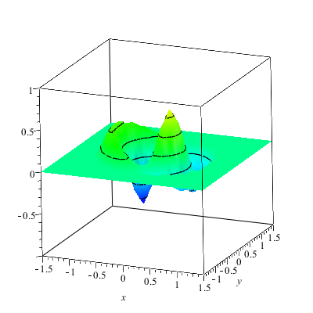

Slide 16
More complicated geometry – annular membrane
a
b

Slide 17
Consider circular boundary -- continued

Slide 18
Normal modes of an annular membrane -- continued
a
b

Slide 19
Normal modes of an annular membrane -- continued
a
b

Slide 20
Normal modes of an annular membrane -- continued
a
b

Slide 21
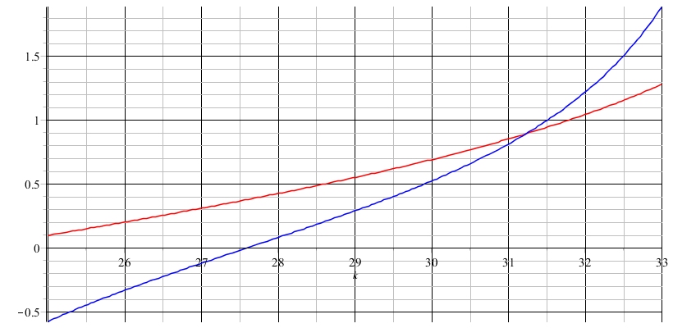
Analysis for m=0:

