Slide 1
PHY 711 Classical Mechanics and Mathematical Methods
10-10:50 AM MWF Olin 103
Plan for Lecture 30: Chap. 9 of F&W
Wave equation for sound in linear approximation
Standing wave solutions
Inhomogeneous equations

Slide 2
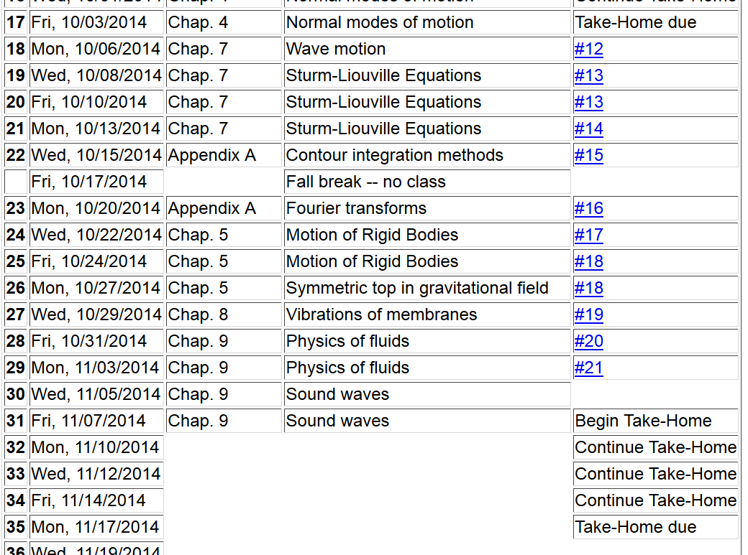

Slide 5
Application of fluid equations to the case of air in equilibrium plus small perturbation

Slide 9
Analysis of wave velocity in an ideal gas:

Slide 12
Time harmonic standing waves in a pipe
a
L

Slide 16
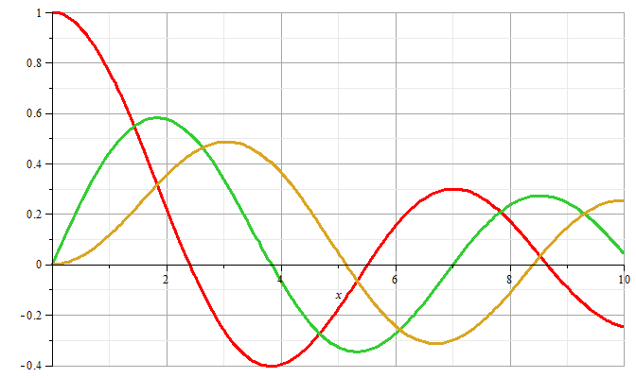
m=0
m=1
m=2

Slide 17
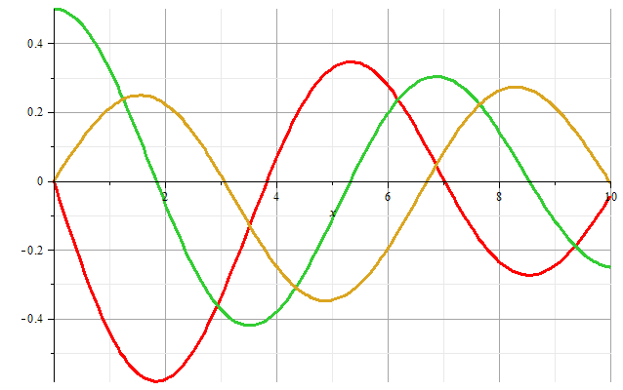
m=1
m=2
m=0
Zeros of derivatives: m=0: 0.00000, 3.83171, 7.01559
m=1: 1.84118, 5.33144, 8.53632
m=2: 3.05424, 6.70613, 9.96947

Slide 18
Boundary condition for z=0, z=L:

Slide 19
Example

Slide 20
Alternate boundary condition for z=0, z=L:

Slide 21
Other solutions to wave equation:

Slide 22
Wave equation with source:

Slide 23
Wave equation with source -- continued:

Slide 24
Derivation of Green’s function for wave equation

Slide 25
Derivation of Green’s function for wave equation -- continued

Slide 26
Derivation of Green’s function for wave equation -- continued

Slide 27
Derivation of Green’s function for wave equation -- continued

Slide 28
Derivation of Green’s function for wave equation – continued
need to find A and B.

Slide 29
Derivation of Green’s function for wave equation – continued

Slide 30
Derivation of Green’s function for wave equation – continued

Slide 31
For time harmonic forcing term we can use the corresponding Green’s function:
In fact, this Green’s function is appropriate for boundary conditions at infinity. For surface boundary conditions where we know the boundary values or their gradients, the Green’s function must be modified.

Slide 34
Wave equation with source:
z
y
x

Slide 35
Treatment of boundary values for time-harmonic force:

Slide 40
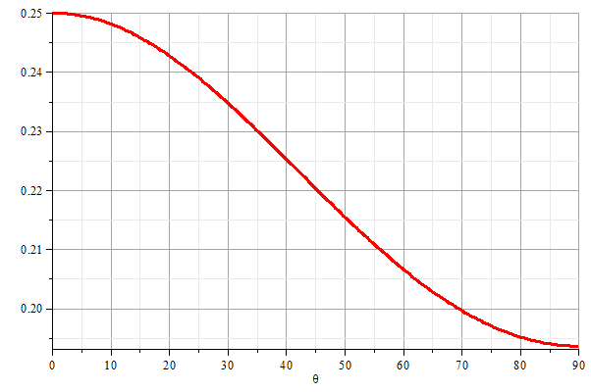
z
θ
y
x

