Slide 1
PHY 711 Classical Mechanics and Mathematical Methods
10-10:50 AM MWF Olin 103
Plan for Lecture 31: Chap. 9 of F&W
Wave equation for sound in linear approximation
Inhomogeneous equations
Green’s function methods

Slide 2
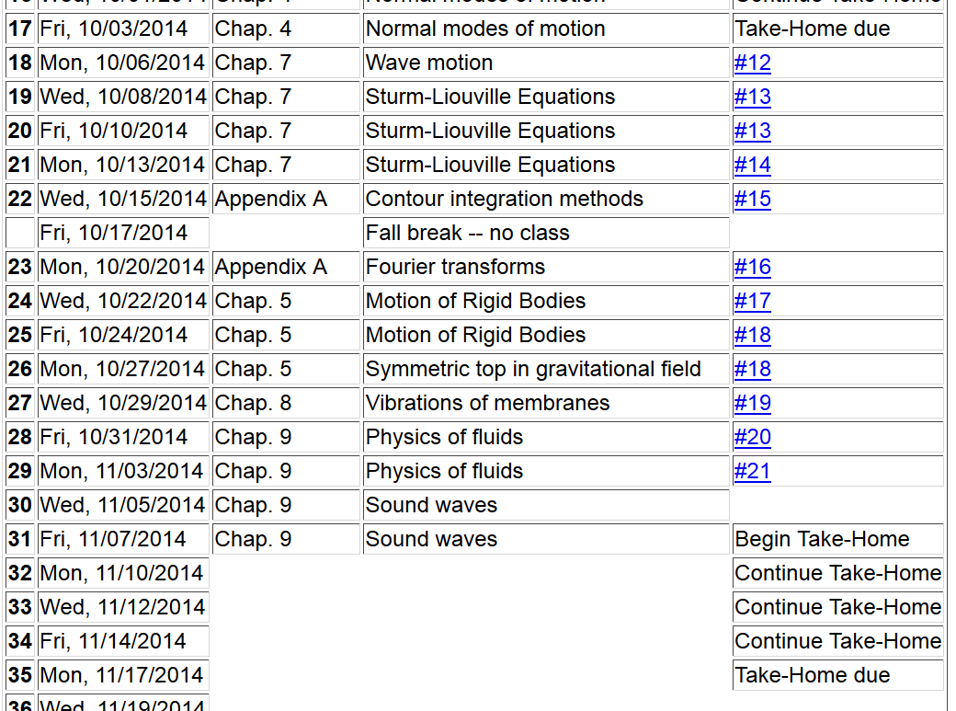
Chap. 9 | Non-linear effects

Slide 3
Wave equation with source:

Slide 4
Wave equation with source -- continued:

Slide 5
Derivation of Green’s function for wave equation

Slide 6
Derivation of Green’s function for wave equation -- continued

Slide 7
Derivation of Green’s function for wave equation -- continued

Slide 8
Derivation of Green’s function for wave equation -- continued

Slide 9
Derivation of Green’s function for wave equation – continued
need to find A and B.

Slide 10
Derivation of Green’s function for wave equation – continued

Slide 11
Derivation of Green’s function for wave equation – continued

Slide 12
For time harmonic forcing term we can use the corresponding Green’s function:
In fact, this Green’s function is appropriate for boundary conditions at infinity. For surface boundary conditions where we know the boundary values or their gradients, the Green’s function must be modified.

Slide 14
Green’s theorem – continued:

Slide 15
Wave equation with source:
z
y
x

Slide 16
Treatment of boundary values for time-harmonic force:

Slide 21
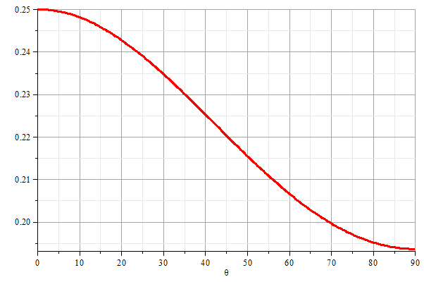
z
θ
y
x

Slide 22
ka =1
ka =5
ka =20

