Slide 1
PHY 711 Classical Mechanics and Mathematical Methods
10-10:50 AM MWF Olin 103
Plan for Lecture 32:
    Wave equation for sound
      Non-linear effects in traveling sound waves
      Shock waves

Slide 2
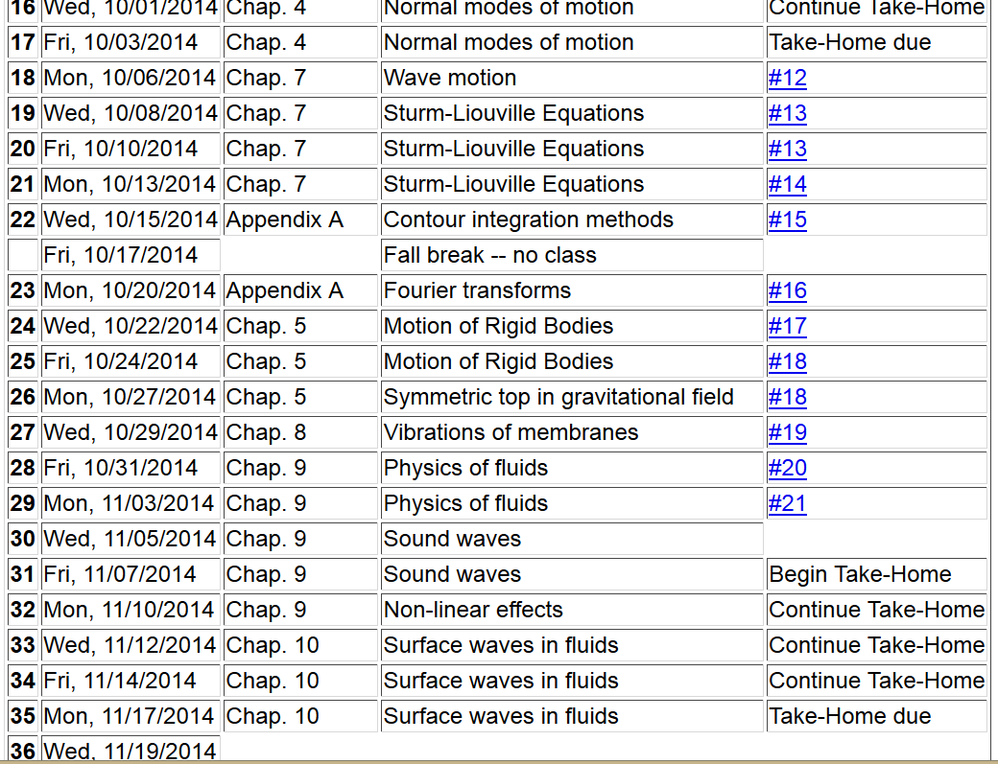

Slide 3
Effects of nonlinearities in fluid equations
-- one dimensional case

Slide 9
Traveling wave solution:

Slide 10
Traveling wave solution -- continued:

Slide 11
Traveling wave solution -- full non-linear case:

Slide 12
Visualization continued:

Slide 13
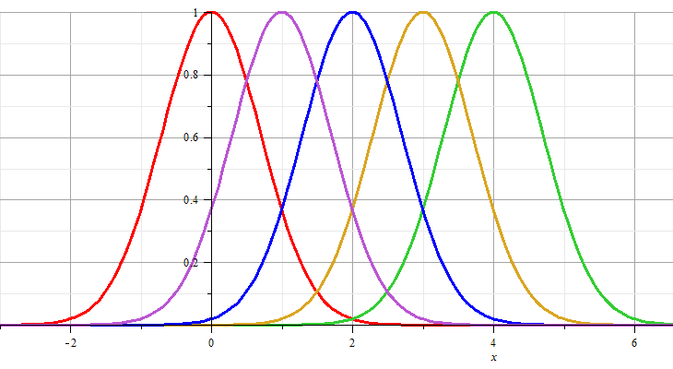
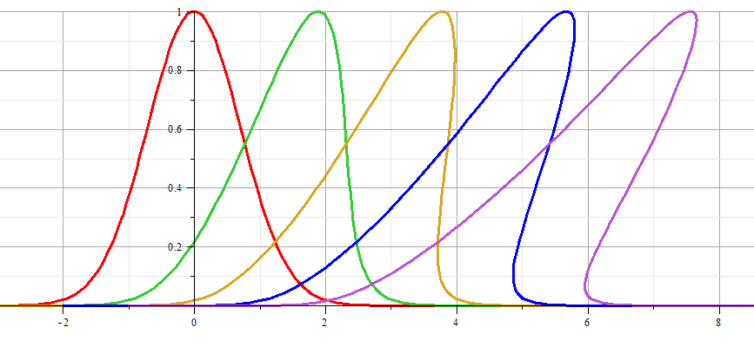
Linear wave:
Non-linear wave:

Slide 14
Analysis of shock wave
Plots of δρ
Solution becomes unphysical

Slide 15
Analysis of shock wave -- continued
After shock
t₂
δρ₂, δv₂
Before shock
t₁
δρ₁, δv₁
Shock front
x
u

Slide 16
Analysis of shock wave – continued
  While analysis in the shock region is complicated, we can use conservation laws to analyze regions 1 and 2

Slide 17
Analysis of shock wave – continued
  For adiabatic ideal gas, also considering energy conservation:

Slide 18
Analysis of shock wave – continued
  For adiabatic ideal gas, entropy considerations::

