Slide 1
PHY 711 Classical Mechanics and Mathematical Methods
10-10:50 AM MWF Olin 103
Plan for Lecture 33:
Chapter 10 in F & W: Surface waves
Water waves in a channel
Wave-like solutions; wave speed

Slide 2
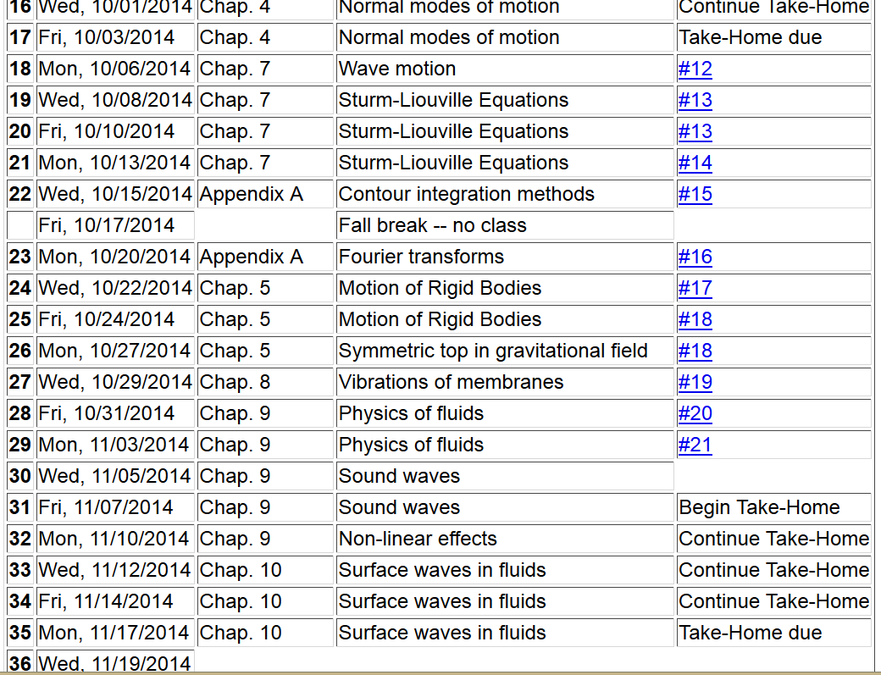

Slide 4
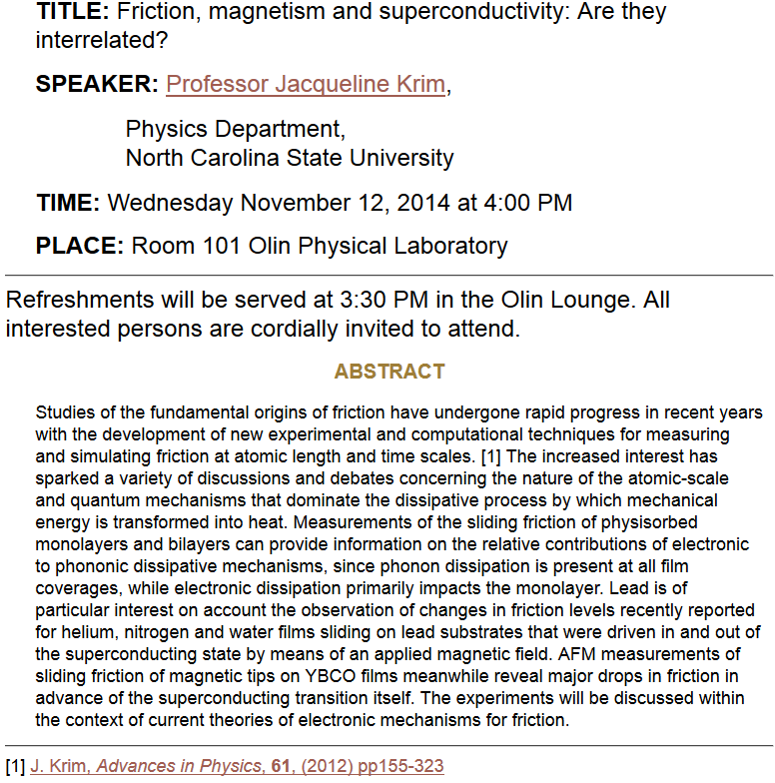

Slide 5
Physics of incompressible fluids and their surfaces
Reference: Chapter 10 of Fetter and Walecka

Slide 6
Consider a container of water with average height h and surface h+ζ(x,y,t); (h ⬅➔ z₀ on some of the slides)
p₀
ζ
z
h
y
x

Slide 8
dζ(x,y,t)/dt
z₀
v(x,y,t)
v(x+dx,y+dy,t)

Slide 9
Digression:
The form of the continuity equation given on previous (and subsequent) sides assumes that the transverse cross section of the channel is either very large or at least uniform. Your text also considers the case where there is a channel of varying width:
ζ(x,t)
v(x,t)
v(x+dx,t)
h(x)
b(x)
dx

Slide 10
For uniform channel:

Slide 11
More details: -- recall setup --
Consider a container of water with average height h and surface h+ζ(x,y,t)
p₀
ζ
z
h
y
x

Slide 12
Equations describing fluid itself (without boundaries)

Slide 13
p₀
ζ
z
h
y
x
(We have absorbed p₀ in “constant”)

Slide 14
Full equations:
(We have absorbed p₀ in “constant”)
Linearized equations:

Slide 15
For simplicity, keep only linear terms and assume that horizontal variation is only along x:

Slide 16
For simplicity, keep only linear terms and assume that horizontal variation is only along x – continued:

Slide 17
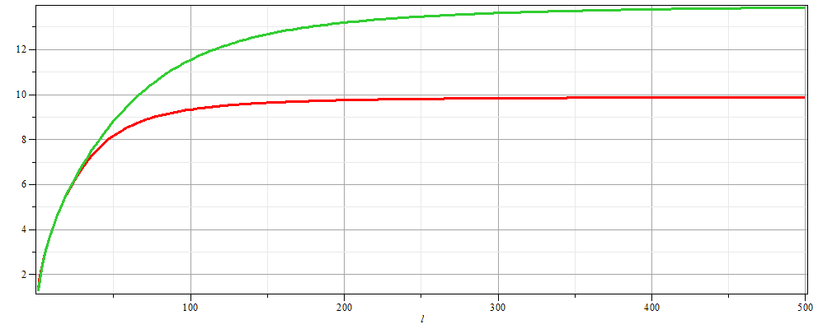
For simplicity, keep only linear terms and assume that horizontal variation is only along x – continued:
h=20 m
c
h=10 m
λ

Slide 18
For simplicity, keep only linear terms and assume that horizontal variation is only along x – continued:

Slide 19
General problem
including
non-linearities
p₀
ζ
z
h
y
x

