Slide 1
PHY 711 Classical Mechanics and Mathematical Methods
10-10:50 AM MWF Olin 103
Plan for Lecture 36:
Chapter 12: Effects of viscosity in fluid motion
Stokes’ viscosity relation

Slide 2
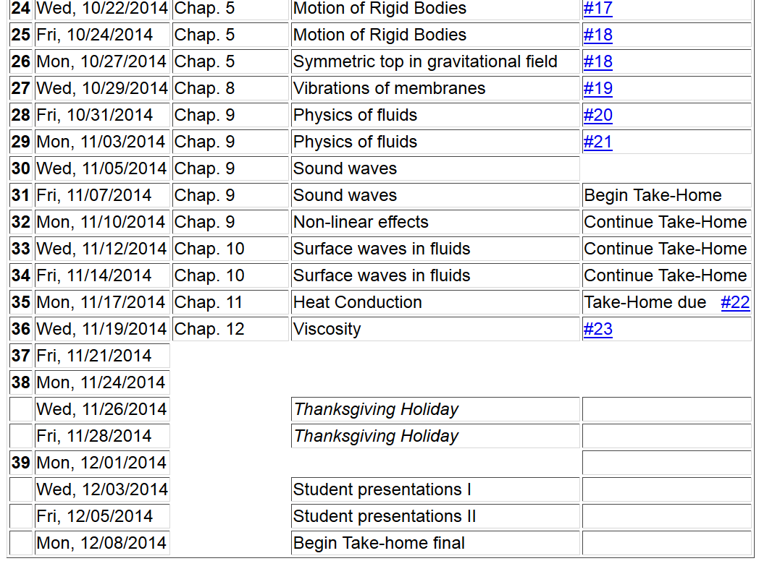
11/22/2013
PHY 711 Fall 2013 -- Lecture 34
2

Slide 3
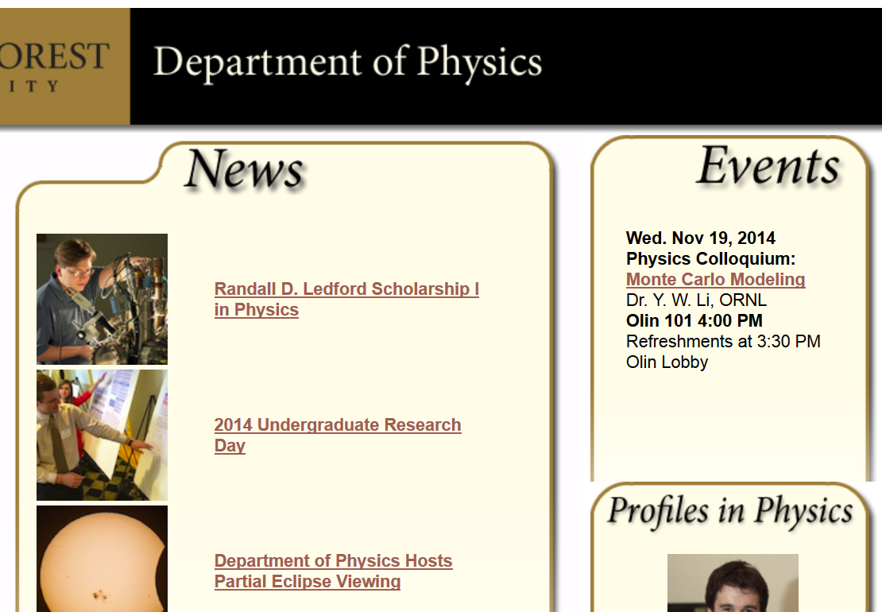

Slide 4
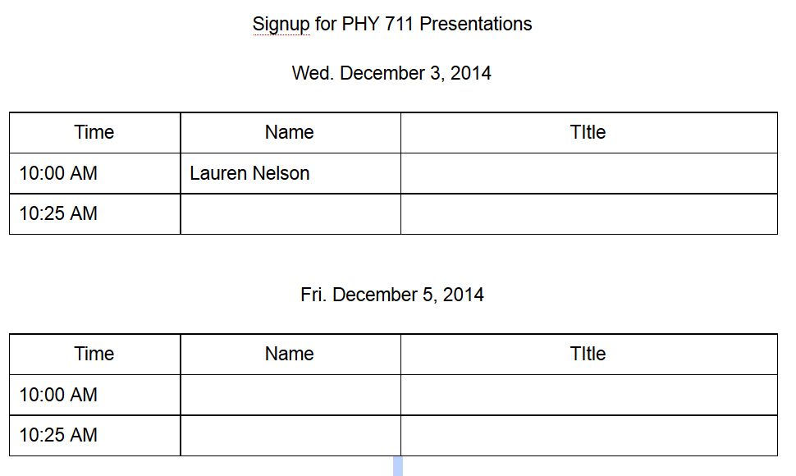

Slide 5
Brief introduction to viscous effects in incompressible fluids
u
F_{D}
Plan:
Consider the general effects of viscosity on fluid equations
Consider the solution to the linearized equations for the case of steady-state flow of a sphere of radius R
Infer the drag force needed to maintain the steady-state flow

Slide 6
Typical kinematic viscosities at 20º C and 1 atm:
Fluid | ν (m²/s)
Water | 1.00 x 10⁻⁶
Air | 14.9 x 10⁻⁶
Ethyl alcohol | 1.52 x 10⁻⁶
Glycerine | 1183 x 10⁻⁶

Slide 7
u
F_{D}

Slide 8
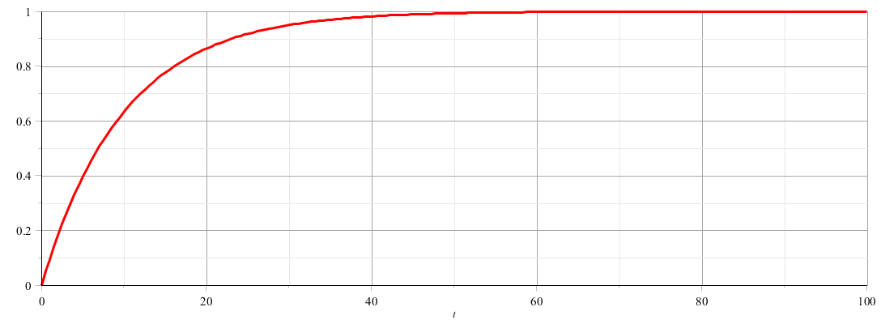
u
F_{D}
u
t

Slide 9
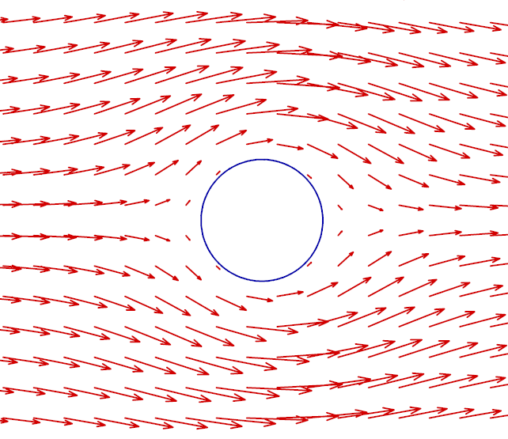
Recall: PHY 711 -- Assignment #21 Nov. 03, 2014
Determine the form of the velocity potential for an incompressible fluid representing uniform velocity in the z direction at large distances from a spherical obstruction of radius a. Find the form of the velocity potential and the velocity field for all r > a. Assume that the velocity in the radial direction is 0 for r = a and assume that the velocity is uniform in the azimuthal direction.

Slide 11
Digression

Slide 15
u
F_{D}

