Slide 1
PHY 711 Classical Mechanics and Mathematical Methods
10-10:50 AM MWF Olin 103
Plan for Lecture 37
Continued discussion of the effects of viscosity in fluid motion (Chap. 12)
Comment on Stokes’ viscosity
Navier-Stokes equation
Comments on Exam 2

Slide 2
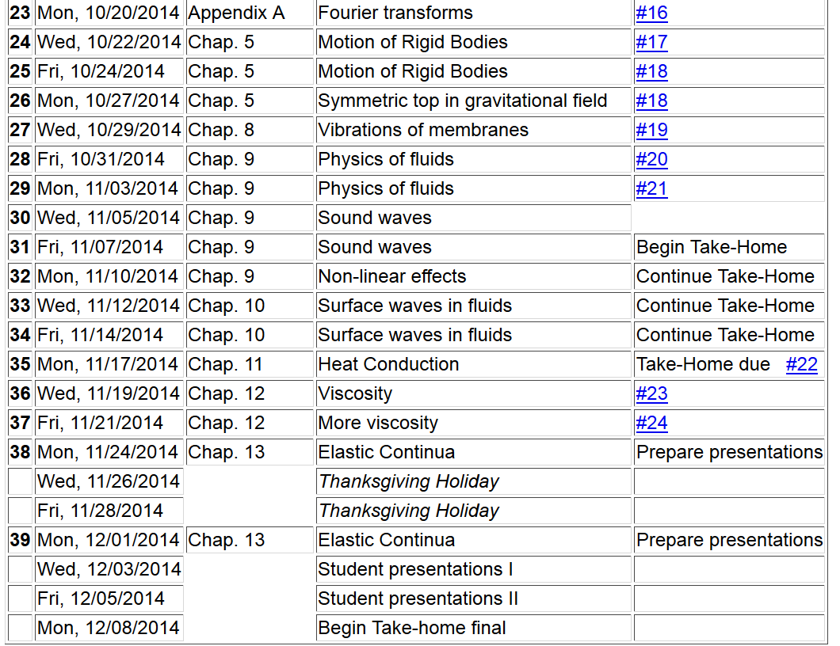
Final grades due 12/17/2014
11/22/2013
PHY 711 Fall 2013 -- Lecture 34
2

Slide 3
Please sign up

Slide 4
Comments on Stokes’ equation for viscous drag
u
F_{D}
Plan:
Consider the general effects of viscosity on fluid equations
Consider the solution to the linearized equations for the case of steady-state flow of a sphere of radius R
Infer the drag force needed to maintain the steady-state flow

Slide 9
u
F_{D}

Slide 10
More general formulation of viscosity from Chapter 12 of Fetter and Walecka

Slide 11
Effects of viscosity
bulk viscosity
viscosity

Slide 12
Effects of viscosity -- continued

Slide 13
Comments on Exam 2

Slide 16
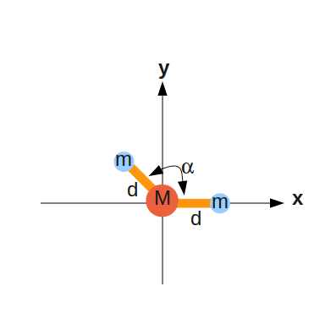

Slide 17
Principal moments of inertia
x

Slide 21
3a
a

Slide 22
3a
a

