Slide 1
PHY 711 Classical Mechanics and Mathematical Methods
10-10:50 AM MWF Olin 103
Plan for Lecture 38
Chapter 12: Example of solution to Navier-Stokes equation
Chapter 13: Physics of elastic continua

Slide 2
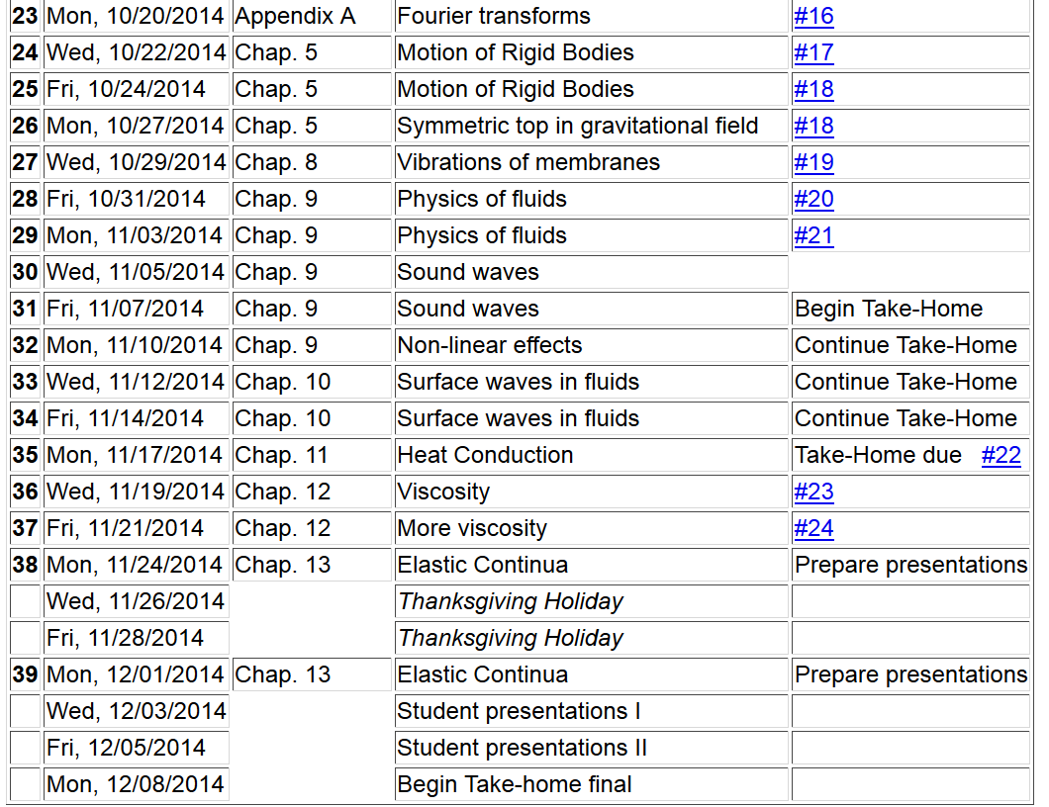
Final grades due 12/17/2014
11/22/2013
PHY 711 Fall 2013 -- Lecture 34
2

Slide 3
Please sign up

Slide 4
Newton-Euler equations for viscous fluids

Slide 5
Example – steady flow of an incompressible fluid in a long pipe with a circular cross section of radius R

Slide 6
Example – steady flow of an incompressible fluid in a long pipe with a circular cross section of radius R -- continued
R
L
v(r)

Slide 7
Example – steady flow of an incompressible fluid in a long pipe with a circular cross section of radius R -- continued
R
L
v(r)

Slide 8
Example – steady flow of an incompressible fluid in a long pipe with a circular cross section of radius R -- continued
R
L
v(r)
Poiseuille formula;
➔Method for measuring η

Slide 9
Newton-Euler equations for viscous fluids – effects on sound
Recall full equations:

Slide 10
Newton-Euler equations for viscous fluids – effects on sound
Without viscosity terms:
➔Pure longitudinal harmonic wave solutions

Slide 11
Newton-Euler equations for viscous fluids – effects on sound
Recall full equations:

Slide 12
Newton-Euler equations for viscous fluids – effects on sound
Note that pressure now depends both on density and entropy so that entropy must be coupled into the equations

Slide 13
Newton-Euler equations for viscous fluids – effects on sound
Linearized equations (with the help of various thermodynamic relationships):

Slide 14
Newton-Euler equations for viscous fluids – effects on sound
Linearized plane wave solutions:

Slide 15
Newton-Euler equations for viscous fluids – effects on sound
Linearized plane wave longitudinal solutions:

Slide 16
Brief introduction to elastic continua
r₁
r₁’
reference
deformation

Slide 17
Brief introduction to elastic continua

Slide 18
To be continued ….
Have a great Thanksgiving Holiday.

