Slide 1
PHY 711 Classical Mechanics and Mathematical Methods
10-10:50 AM MWF Olin 103
Plan for Lecture 39
Brief introduction to the physics of elastic continua (Chap. 13 of F & W)
Brief review of topics covered this semester
Course evaluation forms

Slide 2
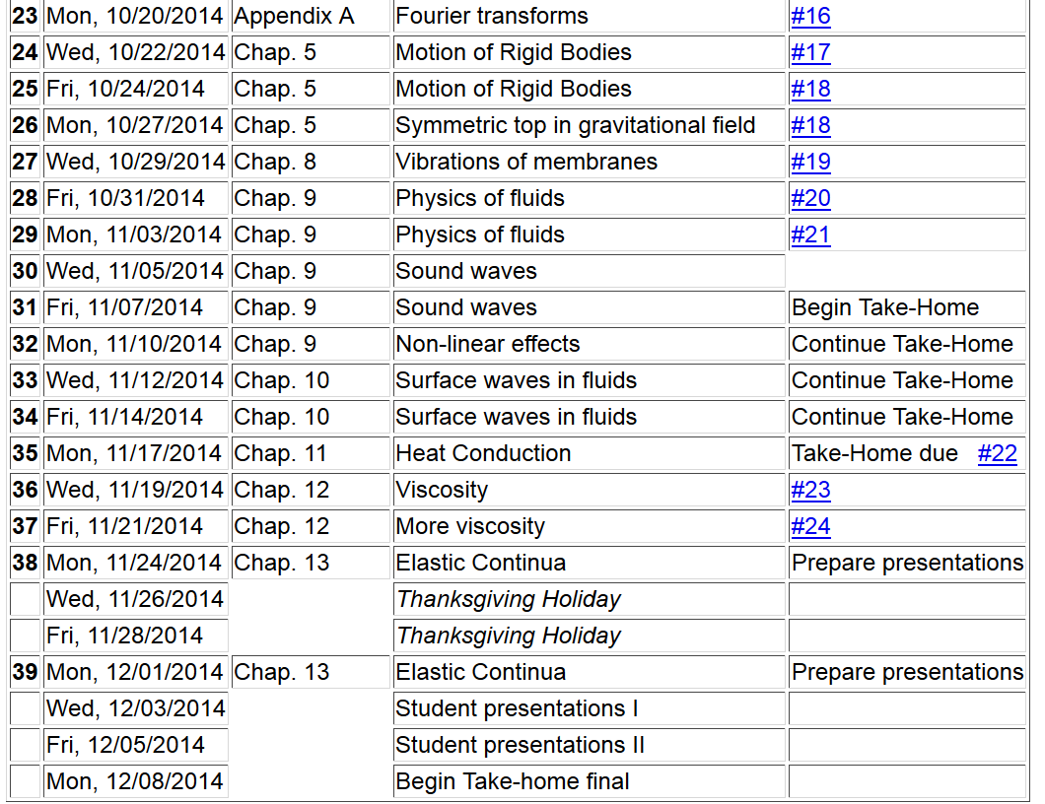
Final grades due 12/17/2014
2

Slide 4
Brief introduction to elastic continua
r₁
r₁’
reference
deformation

Slide 5
Brief introduction to elastic continua

Slide 6
Stress tensor

Slide 8
Dynamical equations of elastic continuum

Slide 9
Brief review of topics covered in this course --
Scattering theory:

Slide 10
b

Slide 11
Rotating reference frames
Inertial frame
Body frame

Slide 12
Newton’s laws; Let r denote the position of particle of mass m:
Coriolis
force
Centrifugal
force
Equation of motion on Earth’s surface
ω
y (east)
z (up)
θ
x (south)

Slide 13
Calculus of variation example for a pure integral functions

Slide 14
Application to particle dynamics

Slide 15
Potential energy
Kinetic energy

Slide 16
Recipe for constructing the Hamiltonian and analyzing the equations of motion

Slide 17
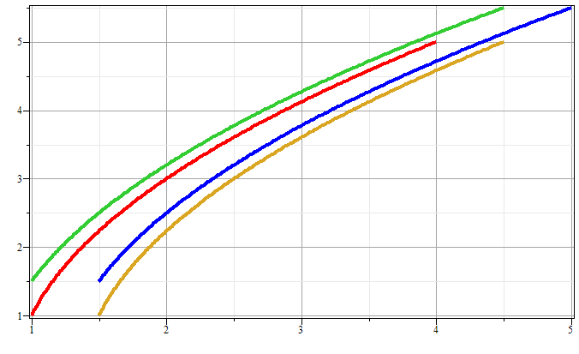
Notion of phase space – example for one-dimensional motion due to constant force
p
x

Slide 18
Liouville’s Theorem (1838)
The density of representative points in phase space corresponding to the motion of a system of particles remains constant during the motion.
Importance of Liouville’s theorem to statistical mechanical analysis: In statistical mechanics, we need to evaluate the probability of various configurations of particles. The fact that the density of particles in phase space is constant in time, implies that each point in phase space is equally probable and that the time average of the evolution of a system can be determined by an average of the system over phase space volume.

Slide 19
Analysis of small oscillations near equilibrium
Example – linear molecule
m₁
m₂
m₃

Slide 20
Normal modes of oscillation for linear molecule example--
m₁
m₂
m₃
m₁
m₂
m₃
m₁
m₂
m₃

Slide 21
Longitudinal waves as the continuum limit of a linear mass-spring system --
m
m
m

Slide 22
system parameter with units of (velocity)²=c²

Slide 23
Solution methods for wave equations and generalizations
D’Alembert’s method
Fourier transforms
Laplace transforms; contour integration
Eigenfunction expansions
Green’s functions
Variational methods

Slide 24
Physics of rigid bodies rotating
about a fixed origin
ω
r

Slide 25
Moment of inertia tensor

Slide 26
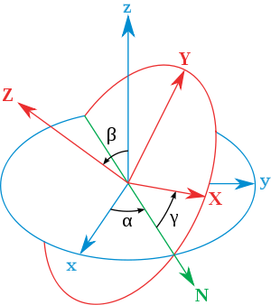
Euler angles for describing angular velocity ω in terms of body fixed contributions --
x
y
y
x

Slide 27
Equations describing fluid physics

Slide 28
Solution of equations in the linear approximation – (linear sound waves)

Slide 29
Wave analysis in fluid physics beyond linear regime
Non-linear effects in sound waves – shock phenomena
Application of Euler-Newton equations to surface waves in water
Korteweg-de Vries soliton analysis

Slide 30
Analysis of heat conduction
c
T₁
T₀
b
a

Slide 31
Newton-Euler equations for viscous fluids

Slide 32
Presentations –
After your presentation, please send me your slides and notes. In order to encourage discussion after the talks, points will be awarded for peer questions.

