Slide 1
PHY 711 Classical Mechanics and Mathematical Methods
10-10:50 AM MWF Olin 103
Plan for Lecture 7:
    Continue reading Chapter 3
      Lagrange’s equations
      D’Alembert’s principle

Slide 2
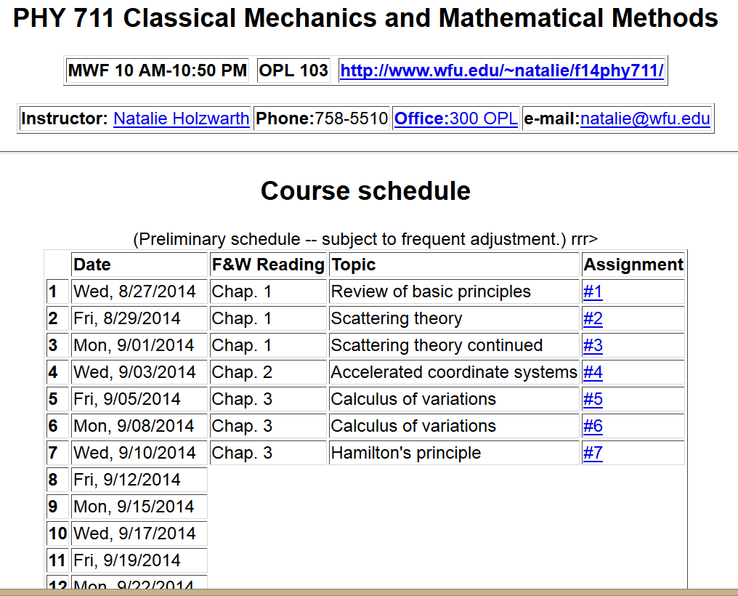

Slide 3
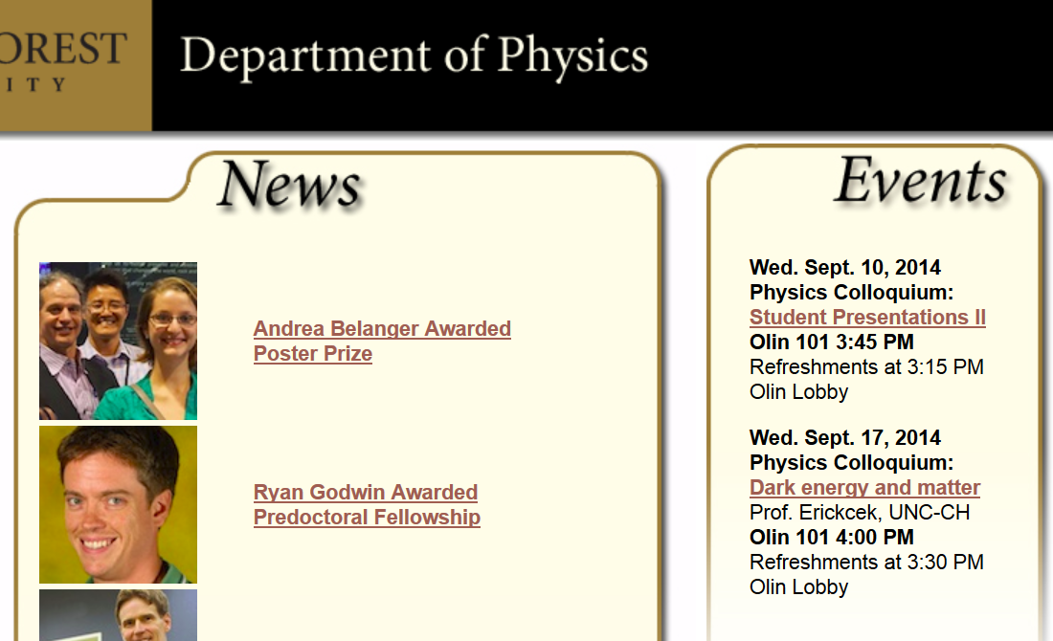

Slide 4
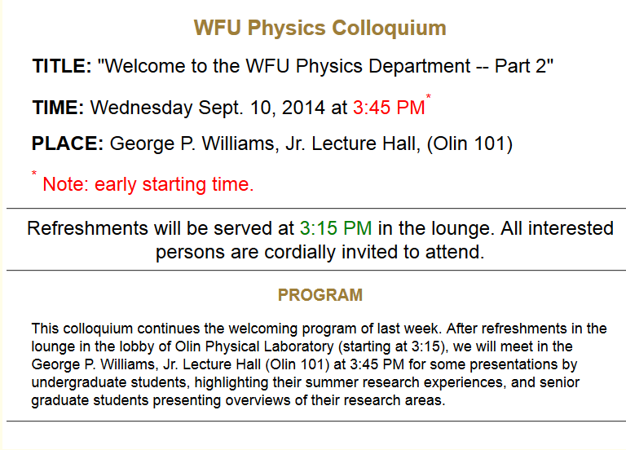

Slide 5
Summary of results from the calculus of variation

Slide 6
Application to particle dynamics
Simple example: vertical trajectory of particle of mass m subject to constant downward acceleration a=-g.

Slide 7
Potential energy
Kinetic energy

Slide 8
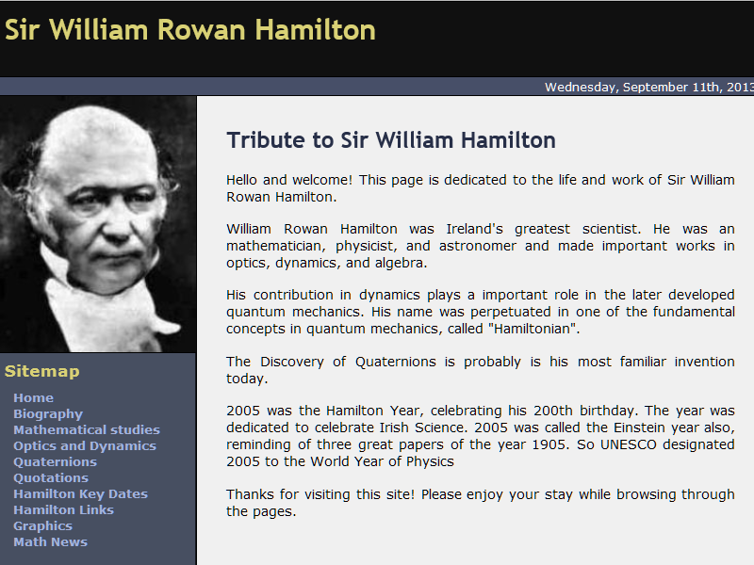
http://www.hamilton2005.ie/

Slide 9
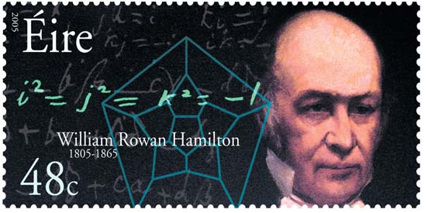
http://rjlipton.wordpress.com

Slide 12
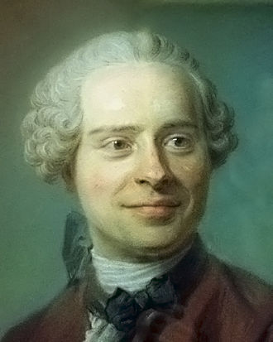
Jean d’Alembert 1717-1783

Slide 13
D’Alembert’s principle:

Slide 18
Example:
d
θ

