Slide 1
PHY 711 Classical Mechanics and Mathematical Methods
10-10:50 AM MWF Olin 103
Plan for Lecture 1:
Welcome & overview
Class structure & announcements
Introduction to algebraic manipulation software – Maple and Mathematica
Start reading Chap. 1 for next time

Slide 2
Comment about Physics Colloquia
http://physics.wfu.edu

Slide 3
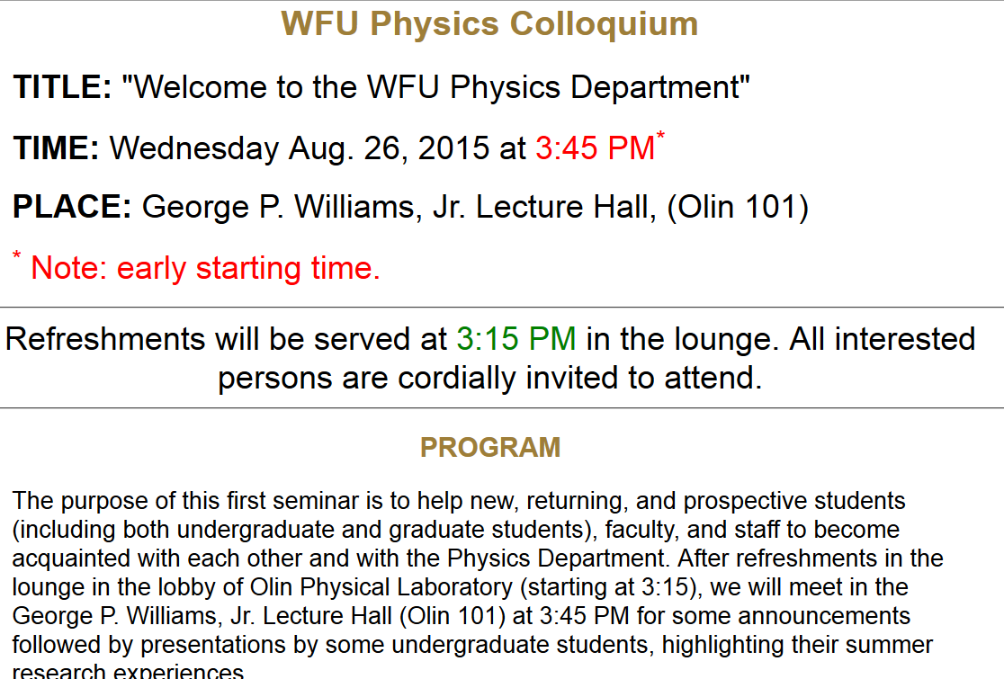

Slide 4
Textbook:

Slide 5
Topics
Classical Mechanics
Scattering theory
Accelerated reference frames
Calculus of variation
Lagrangian formalism
Hamiltonian formalism
Small oscillations
Wave equations
Rigid rotations
Physics of fluids
Sound waves
Surface waves
Heat conduction
Viscous fluids
Math Methods
Solutions methods for differential equations
Matrix properties; eigenvalues and eigenvectors
Contour integration
Fourier transforms
Laplace transforms
Use of Maple and/or Mathematica

Slide 6
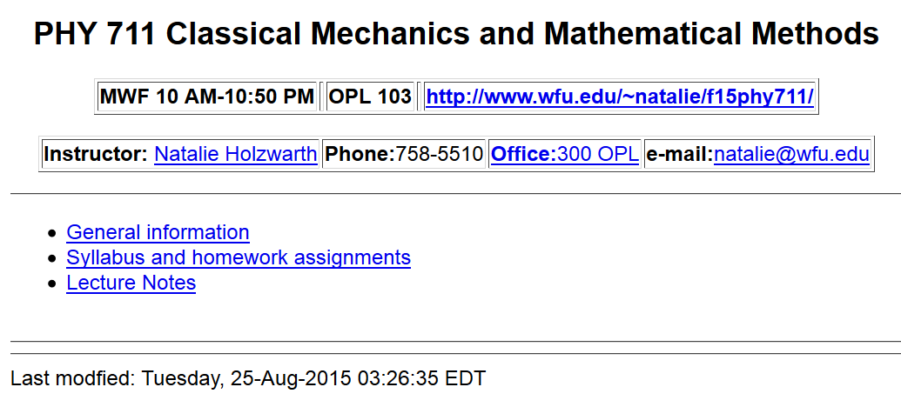
Course webpage: http://www.wfu.edu/~natalie/f15phy711

Slide 7
Course webpage: http://www.wfu.edu/~natalie/f15phy711

Slide 8
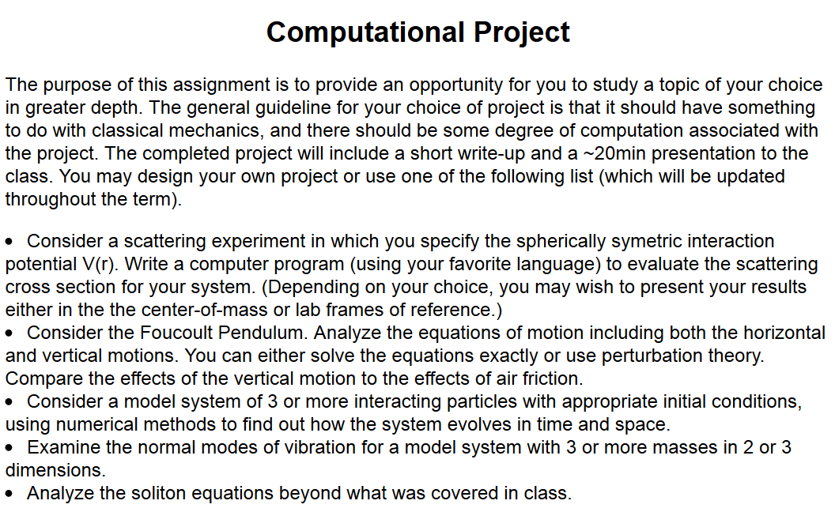
Course webpage: http://www.wfu.edu/~natalie/f15phy711

Slide 9
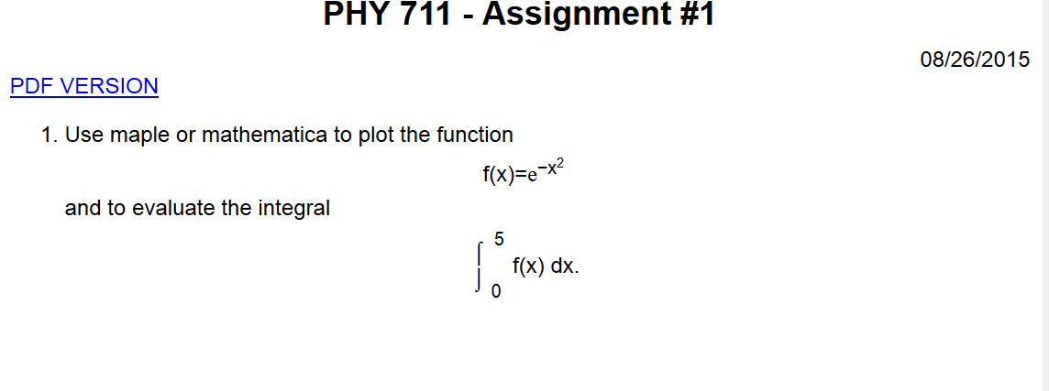
Course webpage: http://www.wfu.edu/~natalie/f15phy711

Slide 10
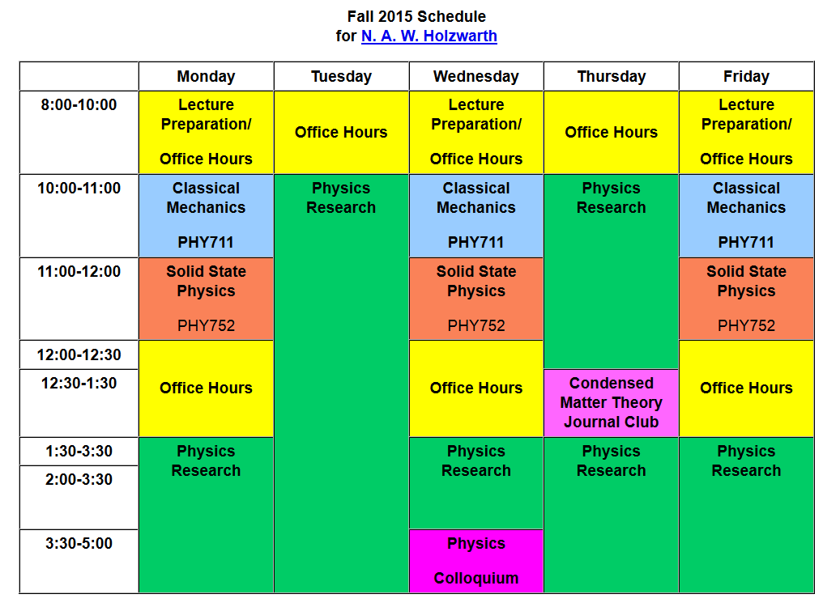
contact via email: natalie@wfu.edu

Slide 11
Brief assessment exercise.

Slide 12
Comments and introduction to algebraic manipulation software

Slide 13
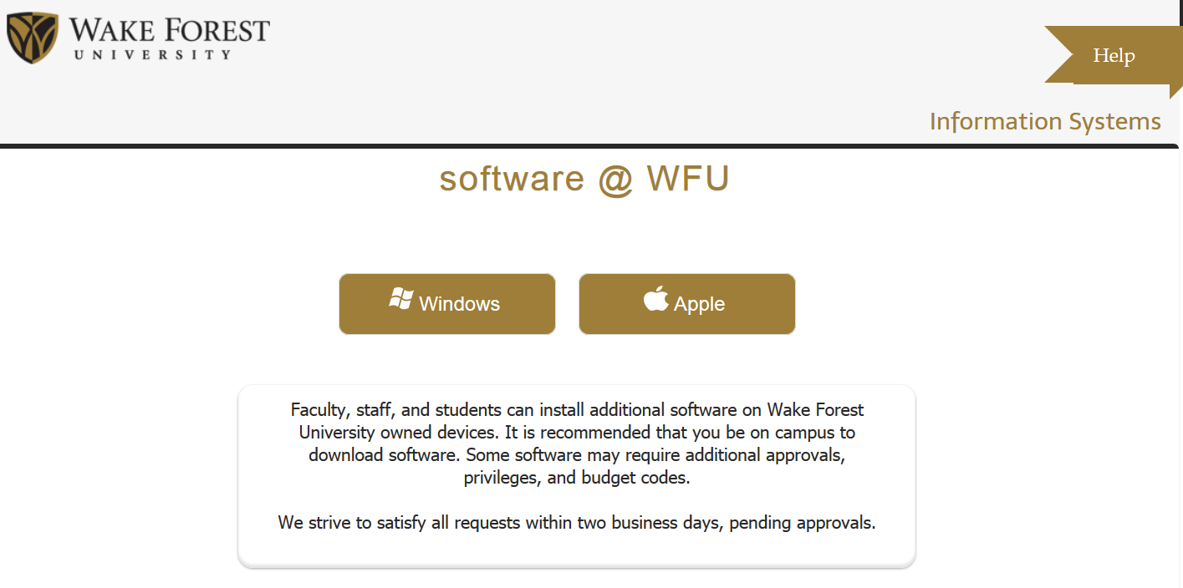
If you do not have Maple/Mathematica, download it using the webpage: http://software.wfu.edu/

Slide 14
