Slide 1
PHY 711 Classical Mechanics and Mathematical Methods
10-10:50 AM MWF Olin 103
Plan for Lecture 11:
Continue reading Chapter 3 & 6
Constructing the Hamiltonian
Hamilton’s canonical equation
Examples

Slide 2
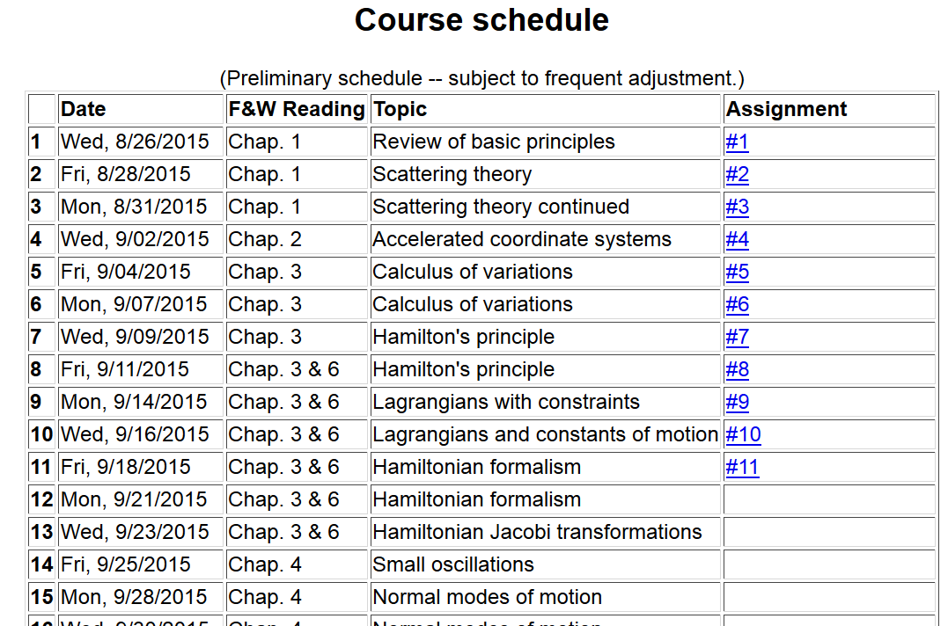

Slide 3
Lagrangian picture
Switching variables – Legendre transformation

Slide 4
Hamiltonian picture – continued

Slide 5
Direct application of Hamiltonian’s principle using the Hamiltonian function --

Slide 6
Hamilton’s principle continued:
Canonical equations
0

Slide 7
Constants of the motion in Hamiltonian formalism

Slide 8
Recipe for constructing the Hamiltonian and analyzing the equations of motion

Slide 11
Other examples

Slide 12
Other examples

Slide 13
Canonical equations of motion for constant magnetic field:

Slide 14
Canonical equations of motion for constant magnetic field -- continued:

Slide 15
Poisson brackets:
Recall:

Slide 16
Poisson brackets -- continued:

Slide 17
Poisson brackets -- continued:
Liouville theorem

