Slide 1
PHY 711 Classical Mechanics and Mathematical Methods
10-10:50 AM MWF Olin 103
Plan for Lecture 12:
Continue reading Chapter 3 & 6
Hamiltonian formalism
Phase space
Liouville’s theorem

Slide 2
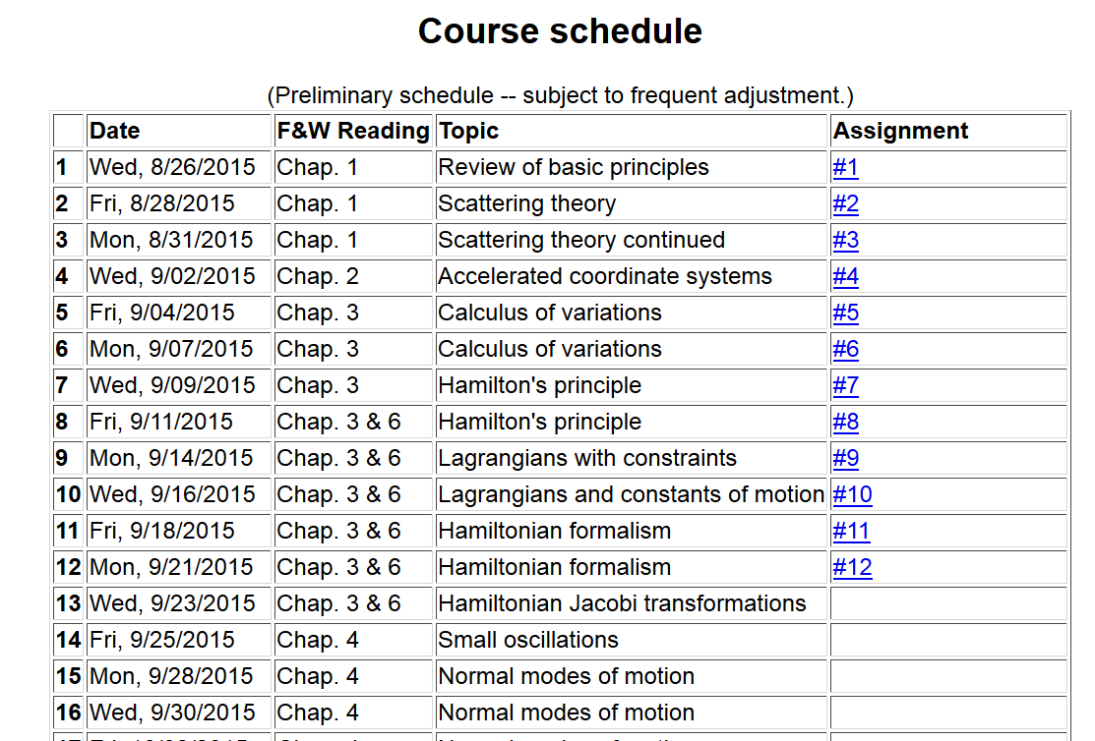

Slide 3
Hamiltonian formalism

Slide 4
Hamiltonian formalism and time evolution:

Slide 5
Hamiltonian formalism and time evolution:
Poisson brackets:

Slide 6
Poisson brackets -- continued:
Liouville theorem

Slide 7
Phase space

Slide 8
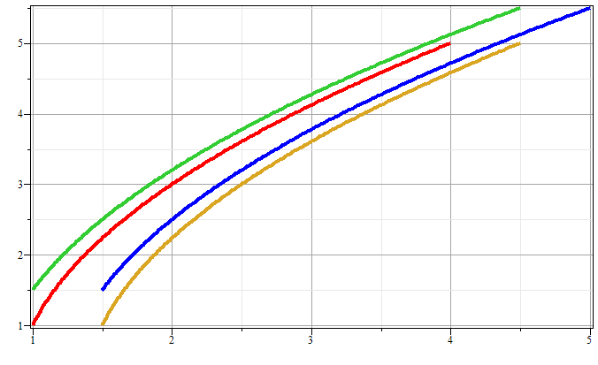
Phase space diagram for one-dimensional motion due to constant force
p
x

Slide 9
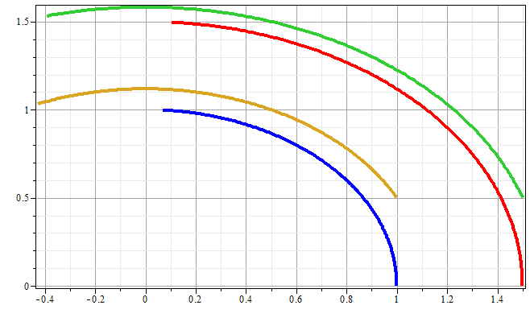
Phase space diagram for one-dimensional motion due to spring force
p
x

Slide 10
Liouville’s Theorem (1838)
The density of representative points in phase space corresponding to the motion of a system of particles remains constant during the motion.

Slide 11
Liouville’s theorem
(x,p+Δp)
(x+Δx,p+Δp)
p
(x,p)
(x+Δx,p)
x

Slide 12
Liouville’s theorem -- continued
(x,p+Δp)
(x+Δx,p+Δp)
p
(x,p)
(x+Δx,p)
x

Slide 13
Liouville’s theorem -- continued
(x,p+Δp)
(x+Δx,p+Δp)
p
(x,p)
(x+Δx,p)
x

Slide 14
Review:
Liouville’s theorem:
Imagine a collection of particles obeying the Canonical equations of motion in phase space.

Slide 15
Proof of Liouville’e theorem:

Slide 17
0

Slide 18
Importance of Liouville’s theorem to statistical mechanical analysis:
In statistical mechanics, we need to evaluate the probability of various configurations of particles. The fact that the density of particles in phase space is constant in time, implies that each point in phase space is equally probable and that the time average of the evolution of a system can be determined by an average of the system over phase space volume.

Slide 19
Modern usage of Lagrangian and Hamiltonian formalisms
J. Chem. Physics 72 2384-2393 (1980)

Slide 20
“Molecular dynamics” is a subfield of computational physics focused on analyzing the motions of atoms in fluids and solids with the goal of relating the atomistic and macroscopic properties of materials. Ideally molecular dynamics calculations can numerically realize the statistical mechanics viewpoint.

Slide 21
r_{ij}
➔From this Lagrangian, can find the 3N coupled 2nd order differential equations of motion and/or find the corresponding Hamiltonian, representing the system at constant energy, volume, and particle number N (N,V,E ensemble).

Slide 22
Lagrangian and Hamiltonian forms

Slide 23
H. C. Andersen wanted to adapt the formalism for modeling an (N,V,E) ensemble to one which could model a system at constant pressure (P).
P
V constant
P constant, V variable

Slide 24
PV contribution to potential energy
kinetic energy of “balloon”

Slide 26
Relationship between system representations
Scaled Original
Equations of motion in “original” coordinates:

Slide 27
Physical interpretation:

Slide 28
Digression on numerical evaluation of differential equations

