Slide 1
PHY 711 Classical Mechanics and Mathematical Methods
10-10:50 AM MWF Olin 103
Plan for Lecture 13:
    Finish reading Chapter 6
      Virial theorem
      Canonical transformations
      Hamilton-Jacobi formalism

Slide 2
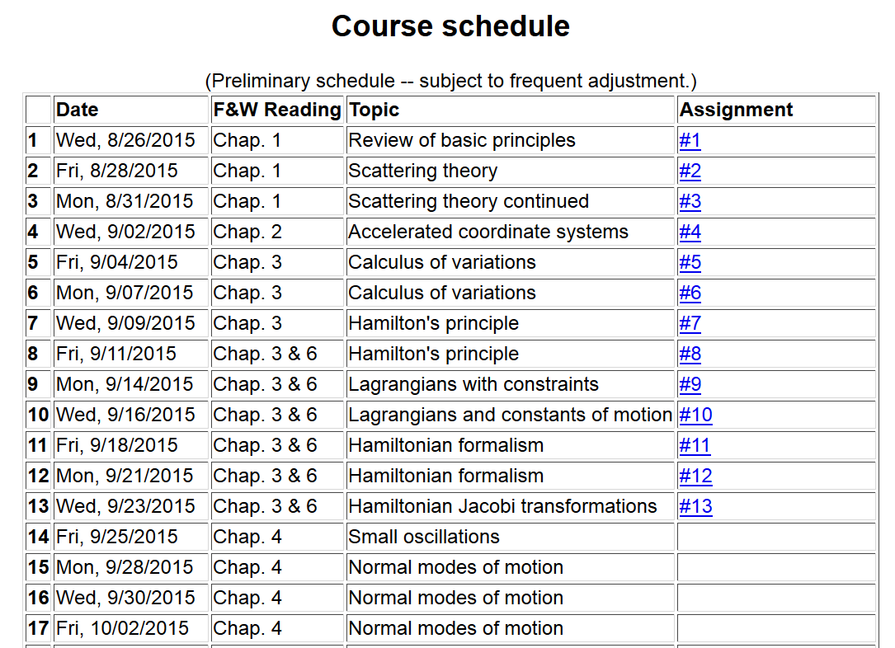

Slide 3
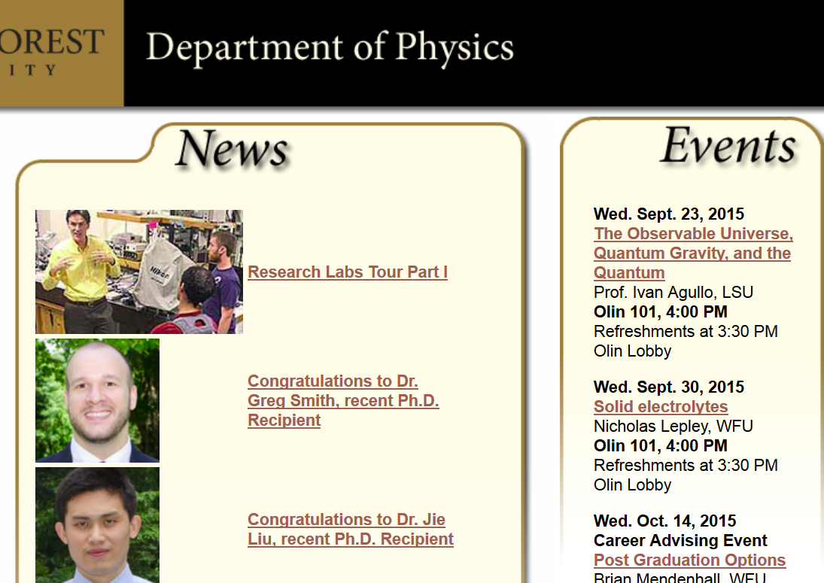

Slide 4
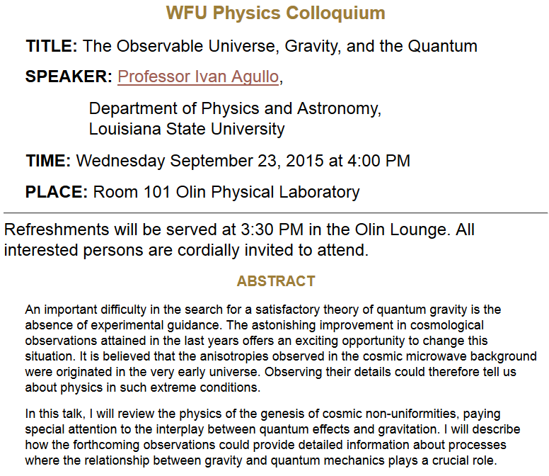

Slide 5
Virial theorem (Clausius ~ 1860)

Slide 6
Hamiltonian formalism

Slide 7
Notion of “Canonical” transformations

Slide 8
Some relations between old and new variables:

Slide 10
Note that it is conceivable that if we were extraordinarily clever, we could find all of the constants of the motion!
Possible solution – Hamilton-Jacobi theory:

Slide 12
0
0
0

Slide 13
0
0
0

Slide 14
Differential equation for S:

Slide 15
Continued:

Slide 16
Continued:

Slide 17
Another example of Hamilton Jacobi equations

Slide 19
Check action:

Slide 20
Recap --
Lagrangian picture
Hamiltonian picture

