Slide 1
PHY 711 Classical Mechanics and Mathematical Methods
10-10:50 AM MWF Olin 103
Plan for Lecture 14:
Start reading Chapter 4
Small oscillations about equilibrium
Normal modes

Slide 2
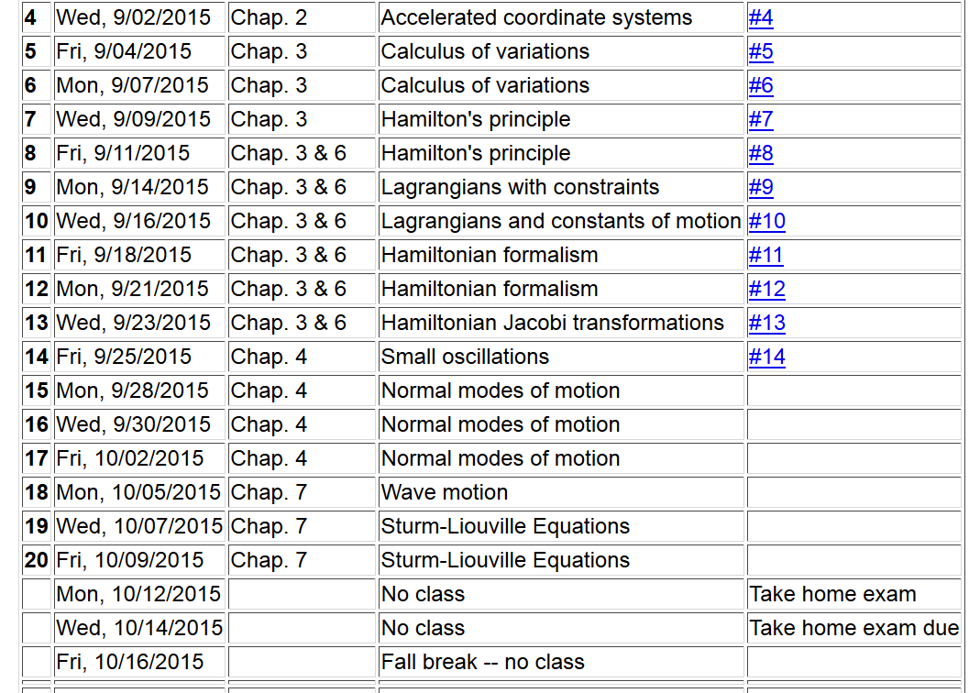

Slide 3
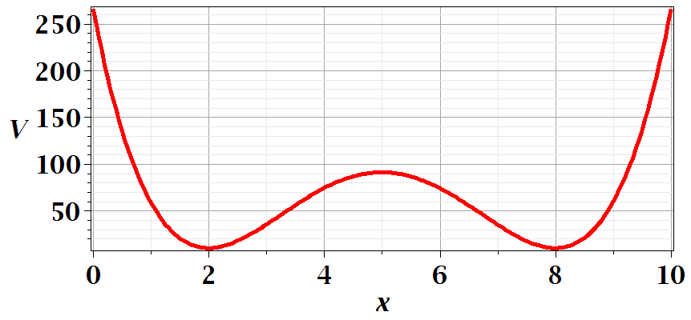
Motivation for studying small oscillations – many interacting systems have stable and meta-stable configurations which are well approximated by:

Slide 5
Example – linear molecule
m₁
m₂
m₃

Slide 10
Digression:

Slide 11
Digression on matrices -- continued
Eigenvalues of a matrix are “invariant” under a similarity transformation

Slide 12
Example of transformation:

Slide 15
m₁
m₂
m₃
m₁
m₂
m₃
m₁
m₂
m₃

Slide 17
Additional digression on matrix properties
Singular value decomposition

Slide 18
Singular value decomposition -- continued

Slide 19
Consider an extended system of masses and springs:
m
m
m

Slide 24
