Slide 1
PHY 711 Classical Mechanics and Mathematical Methods
10-10:50 AM MWF Olin 103
Plan for Lecture 16:
    Start reading Chapter 7
      Linear versus non-linear oscillators
      Coupled motion of extended systems; relationship to continuum models & wave equation

Slide 2
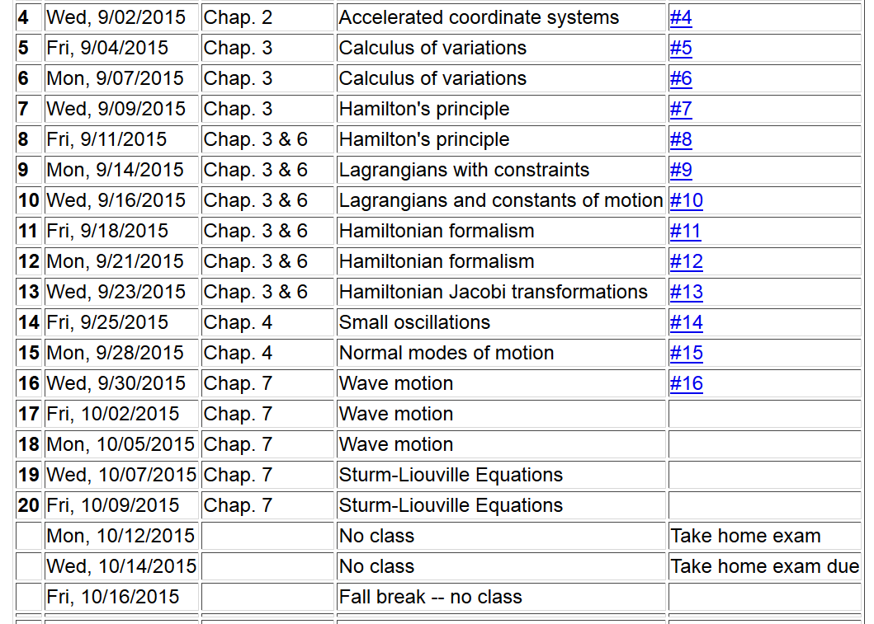

Slide 3


Slide 4


Slide 7
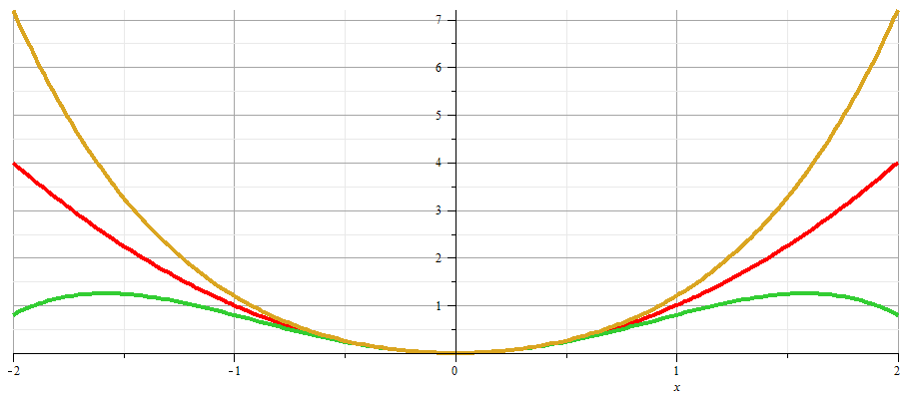
x

Slide 12
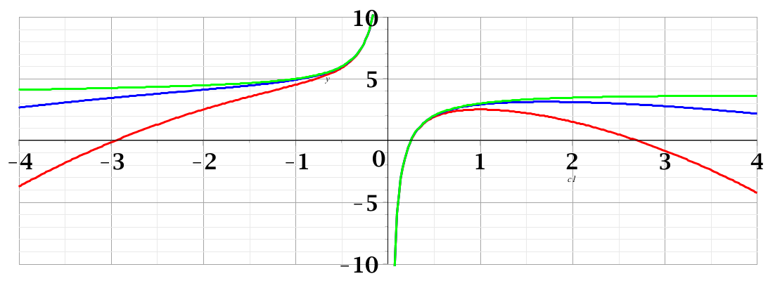
Duffing oscillator -- continued
Plot for ω=2
A=1
c₁

Slide 13
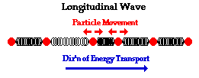
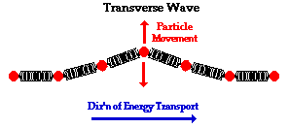
Returning to linear case; continuum limit --
Longitudinal versus transverse vibrations
Images from web page:
http://www.physicsclassroom.com/class/waves/u10l1c.cfm

Slide 14
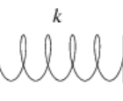
Longitudinal case: a system of masses and springs:
m
m
m

Slide 15
system parameter with units of (velocity)²

Slide 16
Transverse displacement:
τ
μ(x,t)

Slide 23
