Slide 1
PHY 711 Classical Mechanics and Mathematical Methods
10-10:50 AM MWF Olin 103
Plan for Lecture 17:
Appendix A from Fetter & Walecka
Review/presentation of some useful mathematical tools
Complex variables
Contour integration
Fourier transforms

Slide 2
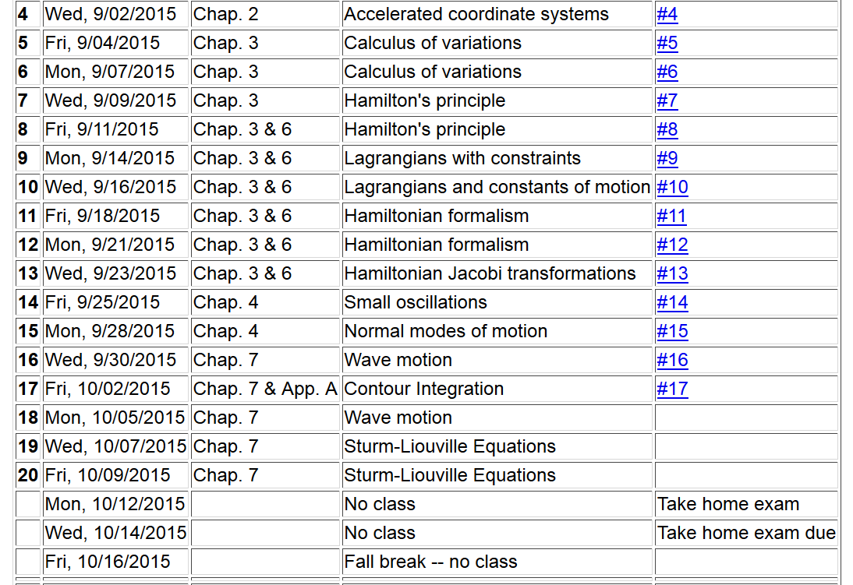

Slide 3
Complex numbers
Functions of complex variables
Derivatives:
Cauchy-Riemann equations

Slide 4
Analytic function

Slide 5
Some details

Slide 8
Example
Im(z)
Re(z)

Slide 9
Example -- continued
Im(z)
Re(z)

Slide 10
Example -- continued
Im(z)
x’
Re(z)

Slide 11
Example -- continued
Kramers-Kronig relationship

Slide 12
Comment on evaluating principal parts integrals
y’
x’

Slide 13
Comment on evaluating principal parts integrals
y’
-2L
-L
L
2L
x’

Slide 14
For our example:

Slide 16
Example:
Im(z)
Re(z)

Slide 17
Contour integral for homework:

Slide 18
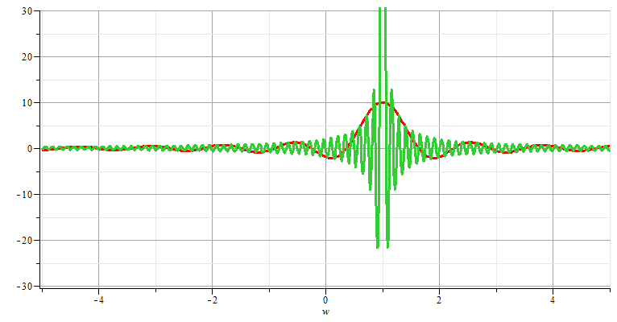
Fourier transforms

Slide 19
Note: The location of the 2π factor varies among texts.

Slide 21
Use of Fourier transforms to solve wave equation

Slide 22
Use of Fourier transforms to solve wave equation -- continued

Slide 25
Example:

Slide 26
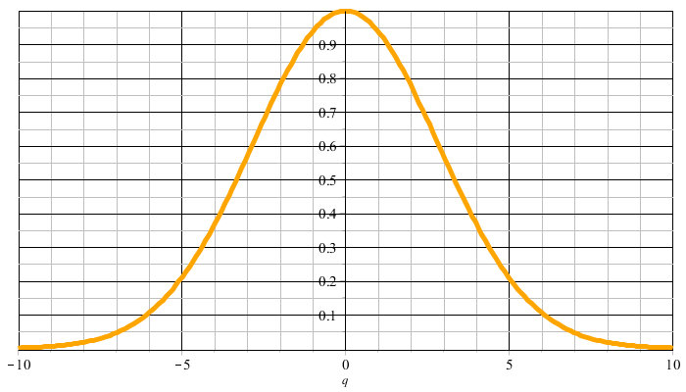
Example:
f(t)
F(νΩ)

Slide 27
F(νΩ)
ν=-M
ν=M

Slide 31
Cooley-Tukey algorithm: J. W. Cooley and J. W. Tukey, “An algorithm for machine calculation of complex Fourier series” Math. Computation 19, 297-301 (1965)

