Slide 1
PHY 711 Classical Mechanics and Mathematical Methods
10-10:50 AM MWF Olin 103
Plan for Lecture 18:
Chapter 7 in Fetter & Walecka
Review/presentation of some useful mathematical tools
Fourier series and transforms
Orthogonal function expansions

Slide 2
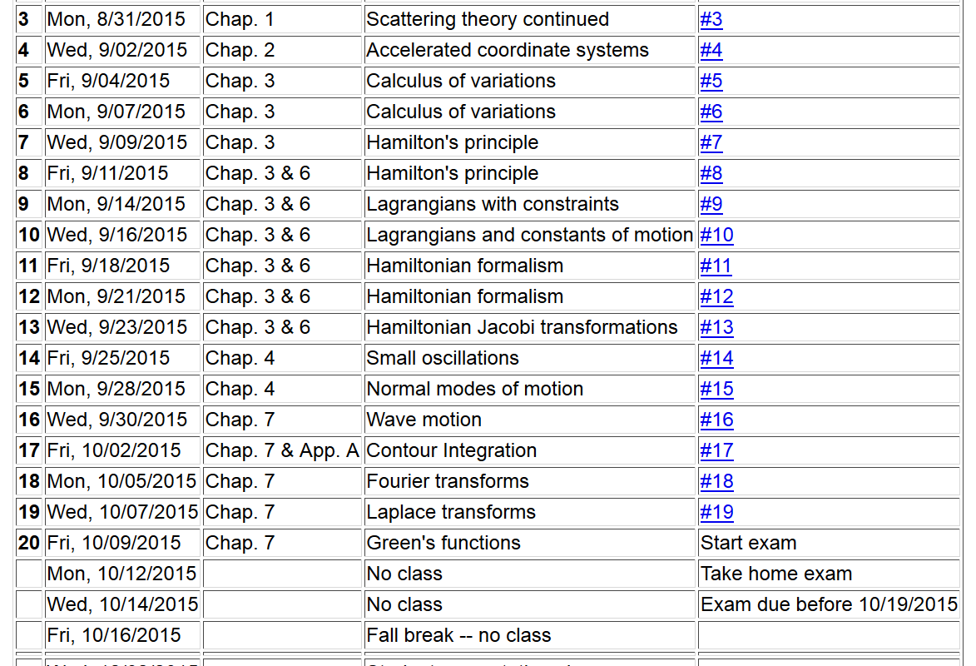

Slide 3
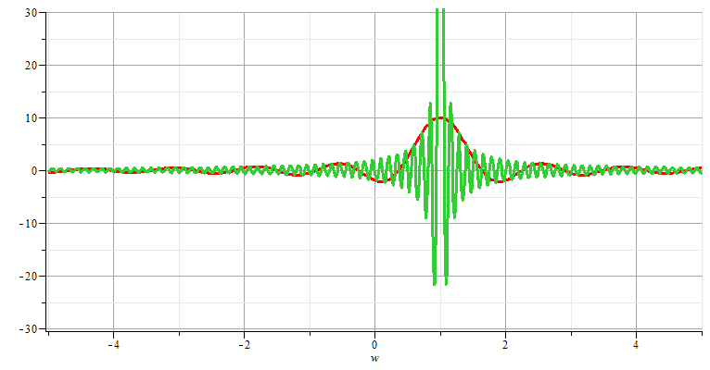
Fourier transforms

Slide 4
Note: The location of the 2π factor varies among texts.

Slide 6
Use of Fourier transforms to solve wave equation

Slide 7
Use of Fourier transforms to solve wave equation -- continued

Slide 10
Example:

Slide 11
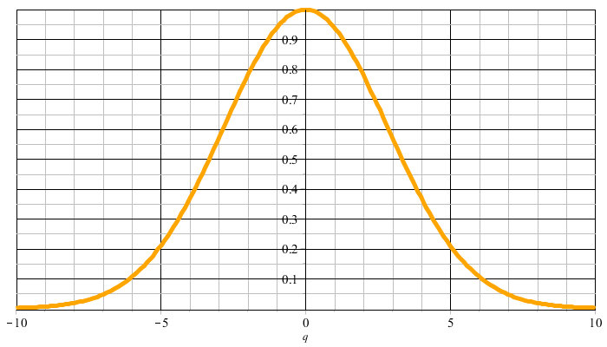
Example:
f(t)
F(νΩ)

Slide 12
F(νΩ)
ν=-M
ν=M

Slide 16
Cooley-Tukey algorithm: J. W. Cooley and J. W. Tukey, “An algorithm for machine calculation of complex Fourier series” Math. Computation 19, 297-301 (1965)

