Slide 1
PHY 711 Classical Mechanics and Mathematical Methods
10-10:50 AM MWF Olin 103
Plan for Lecture 19:
Introduction/review of mathematical methods
Laplace transform methods
Green’s function methods

Slide 2
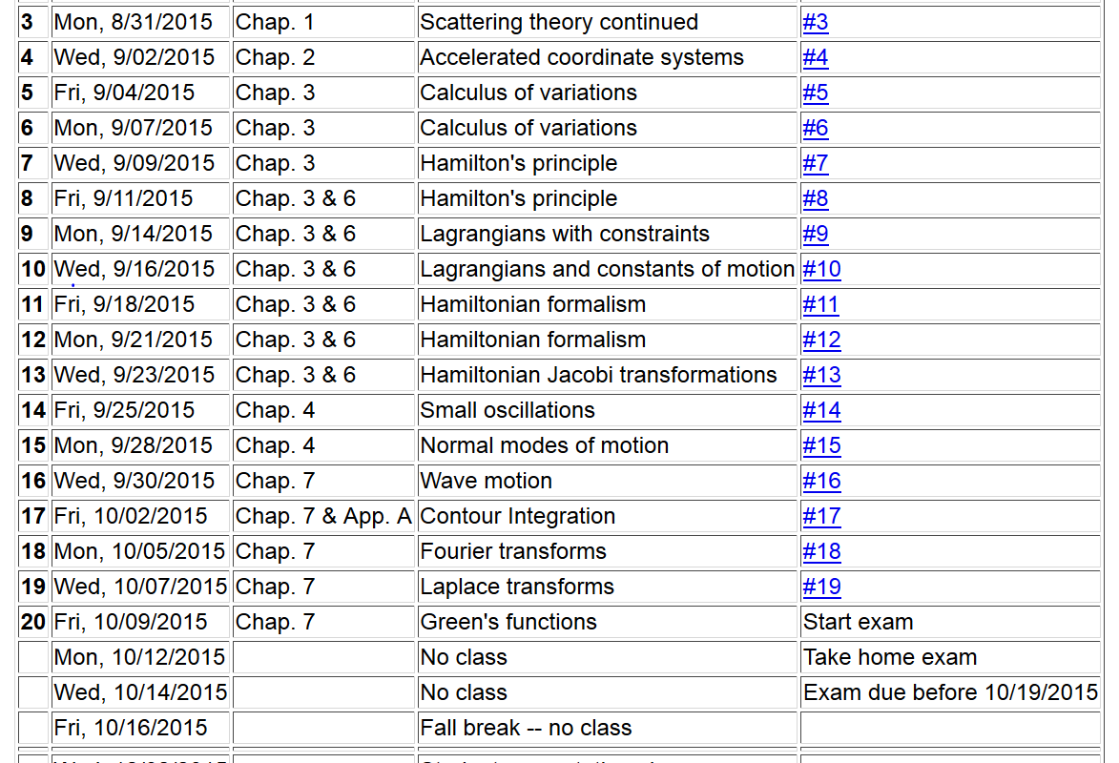

Slide 9
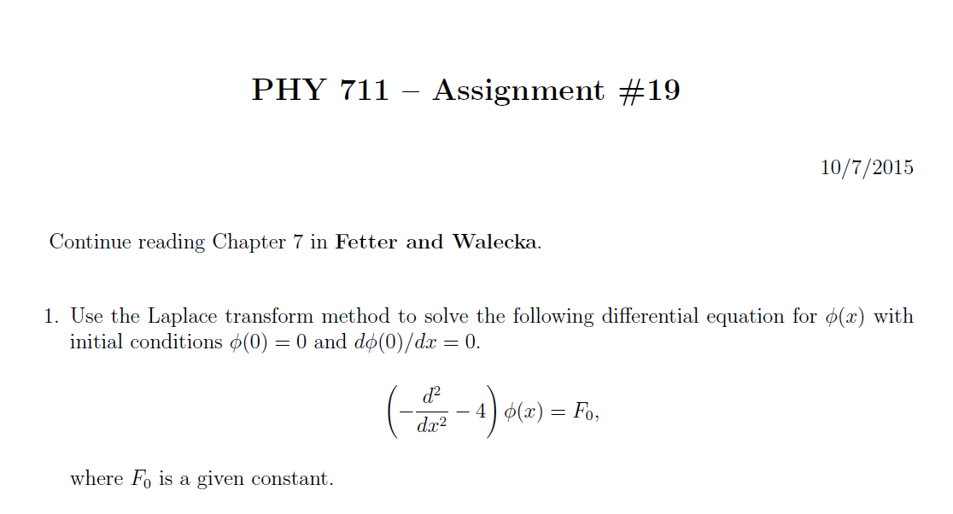

Slide 10
Linear second-order ordinary differential equations
Sturm-Liouville equations
given functions
applied force
solution to be determined

Slide 11
Solution methods of Sturm-Liouville equations (assume all functions and constants are real):
It is possible to prove several properties of the
eigenfunctions f_{n}(x) – including orthogonality and
completeness.

Slide 13
Solution to inhomogeneous problem by using Green’s functions
Solution to homogeneous problem

Slide 14
Example Sturm-Liouville problem:

