Slide 1
PHY 711 Classical Mechanics and Mathematical Methods
10-10:50 AM MWF Olin 103
Plan for Lecture 2:
Brief comment on quiz
Particle interactions
Notion of center of mass reference fame
Introduction to scattering theory

Slide 2
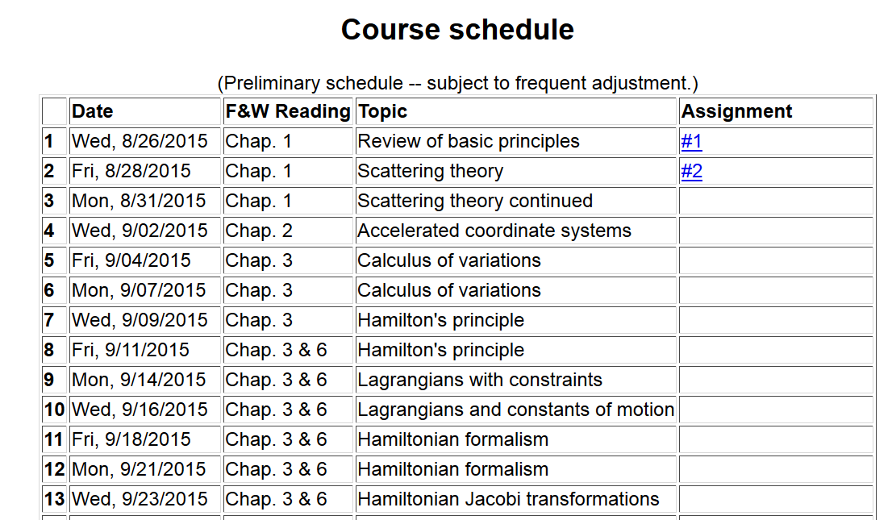

Slide 3
Comment on quiz questions
1.
3.

Slide 4
Classical mechanics of a conservative 2-particle system.
1
2

Slide 5
Relationship between center of mass and laboratory frames of reference

Slide 6
Classical mechanics of a conservative 2-particle system -- continued

Slide 7
Note: The following analysis will be carried out in the center of mass frame of reference.
In laboratory frame: In center-of-mass frame:
V₁
v₁
μ
m₁
r
origin
v_{CM}
m_{target}
Also note: We are assuming that the interaction between particle and target V(r) conserves energy and angular momentum.

Slide 8
Scattering theory:

Slide 9
b
Figure from Marion & Thorton, Classical Dynamics

Slide 10
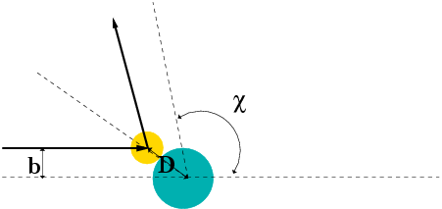
Simple example – collision of hard spheres
Microscopic view:

Slide 11
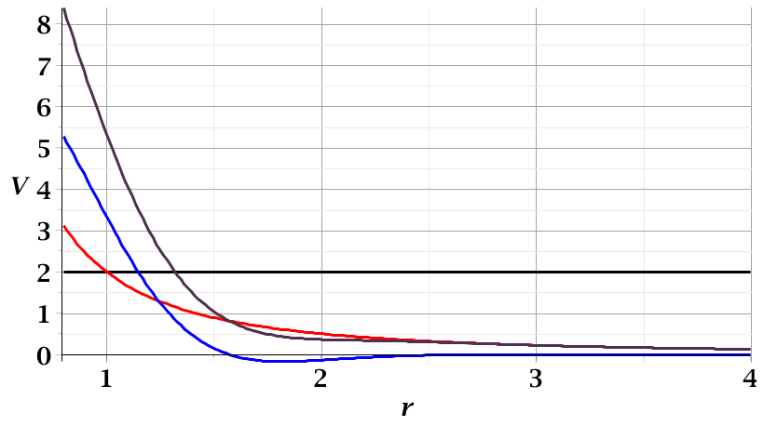
For a continuous potential interaction’
in center of mass reference frame:
V(r)
E
r_{min}

Slide 12
φ
r_{min}
r(φ)

Slide 16
b
Figure from Marion & Thorton, Classical Dynamics

Slide 19
Relationship between φ_{max} and θ:

