Slide 1
PHY 711 Classical Mechanics and Mathematical Methods
10-10:50 AM MWF Olin 103
Plan for Lecture 20:
Introduction/review of mathematical methods
Green’s function methods
Orthogonal function expansion
Construction using homogeneous solutions

Slide 2
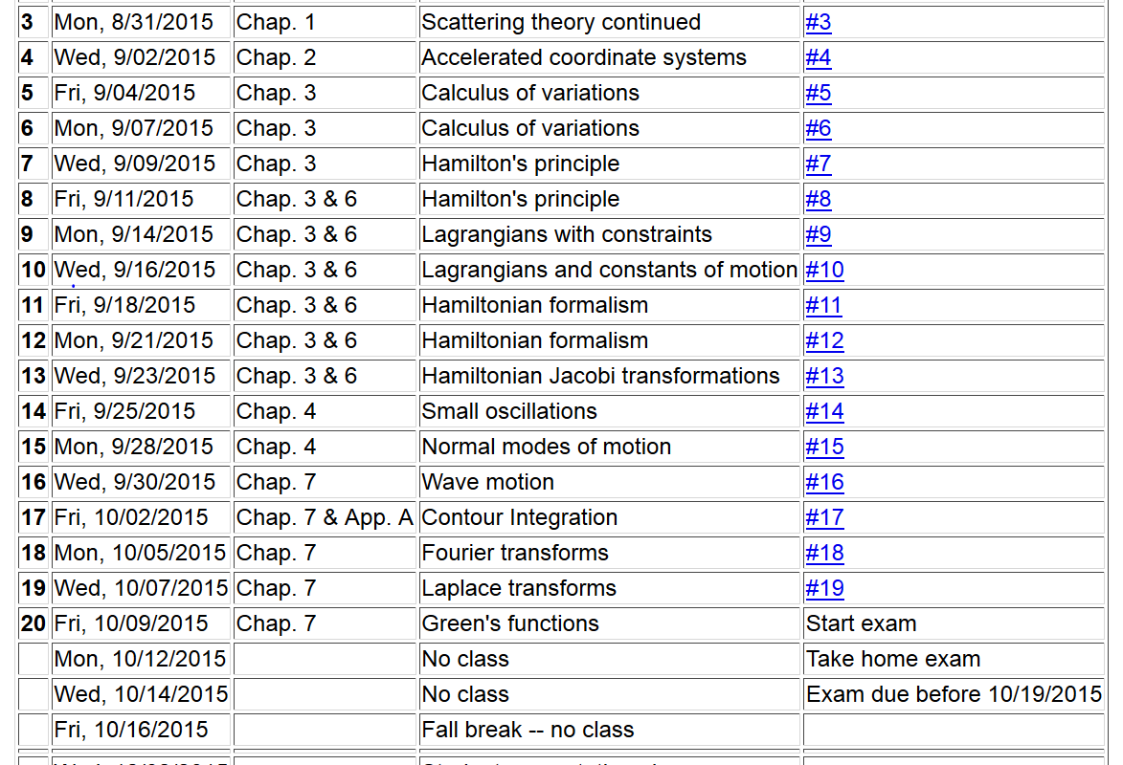

Slide 3
Linear second-order ordinary differential equations
Sturm-Liouville equations
given functions
applied force
solution to be determined

Slide 4
Solution methods of Sturm-Liouville equations (assume all functions and constants are real):

Slide 5
Comment on “completeness”
It can be shown that for any reasonable function h(x), defined within the interval a < x <b, we can expand that function as a linear combination of the eigenfunctions f_{n}(x)
These ideas lead to the notion that the set of eigenfunctions f_{n}(x) form a ``complete'' set in the sense of ``spanning'' the space of all functions in the interval
a < x <b, as summarized by the statement:

Slide 6
Variation approximation to lowest eigenvalue
In general, there are several techniques to determine the eigenvalues λ_{n} and eigenfunctions f_{n}(x). When it is not possible to find the ``exact'' functions, there are several powerful approximation techniques. For example, the lowest eigenvalue can be approximated by minimizing the function
where is a variable function which satisfies the
correct boundary values. The ``proof'' of this inequality is
based on the notion that can in principle be expanded
in terms of the (unknown) exact eigenfunctions f_{n}(x):
where the coefficients C_{n} can be
assumed to be real.

Slide 7
Estimation of the lowest eigenvalue – continued:
From the eigenfunction equation, we know that
It follows that:

Slide 8
Rayleigh-Ritz method of estimating the lowest eigenvalue

Slide 9
Green’s function solution methods
Recall:

Slide 10
Solution to inhomogeneous problem by using Green’s functions
Solution to homogeneous problem

Slide 11
Example Sturm-Liouville problem:

Slide 16
General method of constructing Green’s functions using homogeneous solution

