Slide 1
PHY 711 Classical Mechanics and Mathematical Methods
10-10:50 AM MWF Olin 103
Plan for Lecture 21:
    Rotational motion (Chapter 5)
      Rigid body motion
      Moment of inertia tensor
      Torque free motion

Slide 2
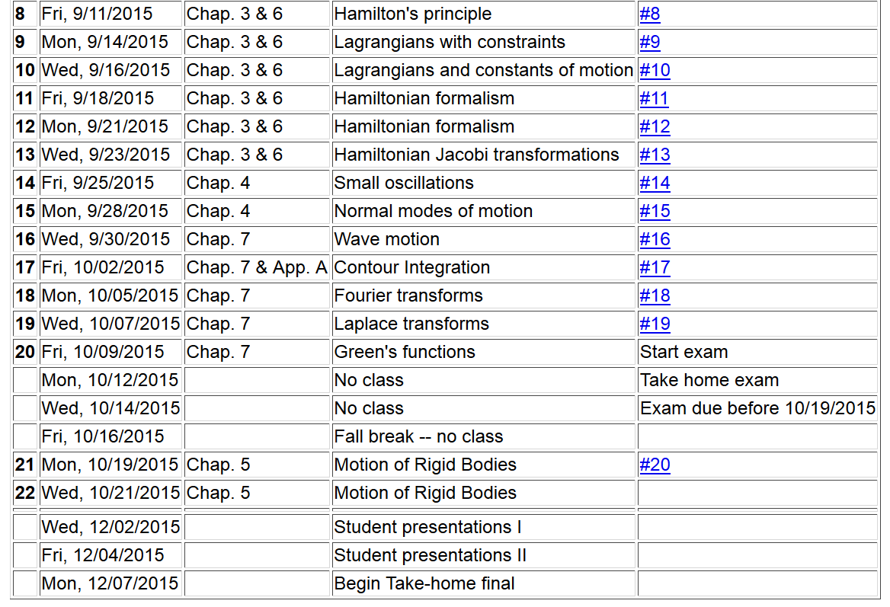

Slide 3
Comparison of analysis in “inertial frame” versus “non-inertial frame”

Slide 4
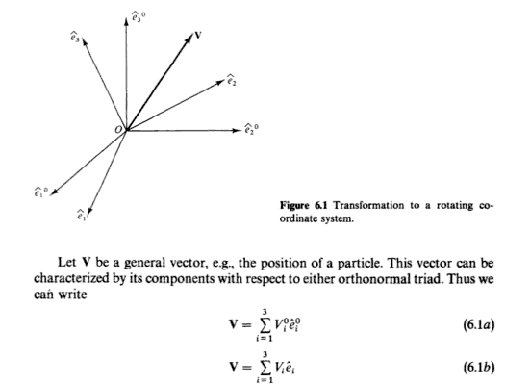
The physics of rigid body motion; body fixed frame vs inertial frame; results from Chapter 2:

Slide 5
Properties of the frame motion (rotation):
dΘ
dΘ

Slide 6
Effects on acceleration:

Slide 7
ω
r
=0 for rigid body
➔

Slide 9
z
Example:
c
y
a
b
x

Slide 10
Properties of moment of inertia tensor:
  Symmetric matrix ➔real eigenvalues I₁,I₂,I₃
  ➔orthogonal eigenvectors

Slide 11
Changing origin of rotation
z
z’
r_{p}
r’_{p}
c
R
y’
y
a
x’
b
x

Slide 12
z
z’
r_{p}
r’_{p}
c
R
y’
y
a
x’
b
x

Slide 13
z
z’
Note: This is a special case; changing the center of rotation does not necessarily result in a diagonal I’
r_{p}
r’_{p}
c
R
y’
y
a
x’
b
x

Slide 14
Descriptions of rotation about a given origin
ω

Slide 15
Descriptions of rotation about a given origin -- continued

Slide 16
Descriptions of rotation about a given origin -- continued

Slide 17
➔

Slide 18
Solution of Euler equations for a symmetric top -- continued

Slide 19
➔

Slide 21
Euler equations for asymmetric top -- continued

