Slide 1
PHY 711 Classical Mechanics and Mathematical Methods
10-10:50 AM MWF Olin 103
Plan for Lecture 22:
Rotational motion (Chapter 5)
Rigid body motion in body fixed frame
Conversion between body and inertial reference frames
Symmetric top motion

Slide 2
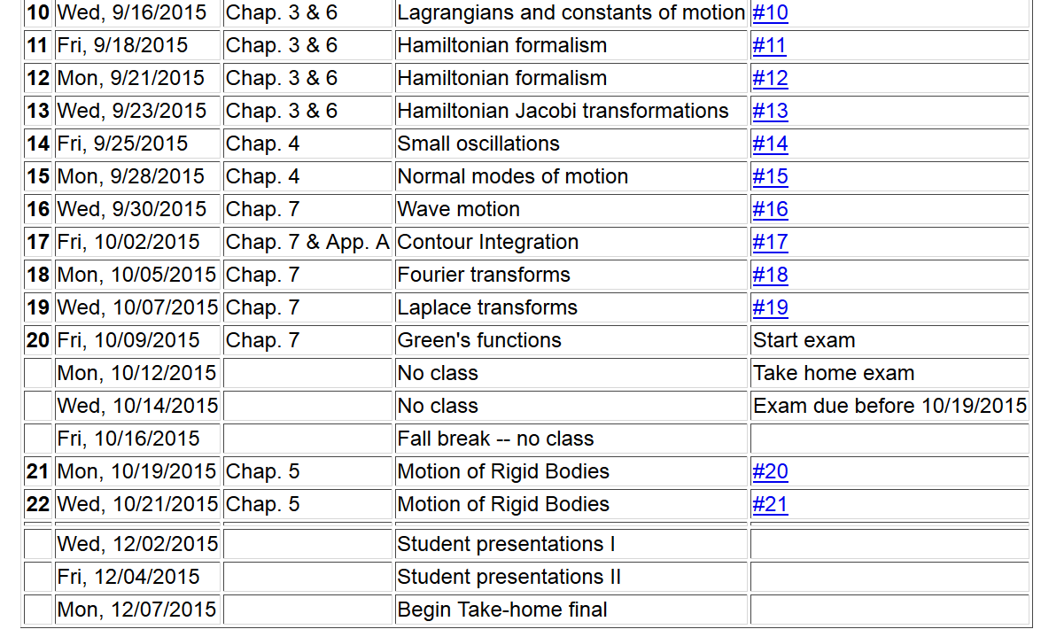

Slide 4
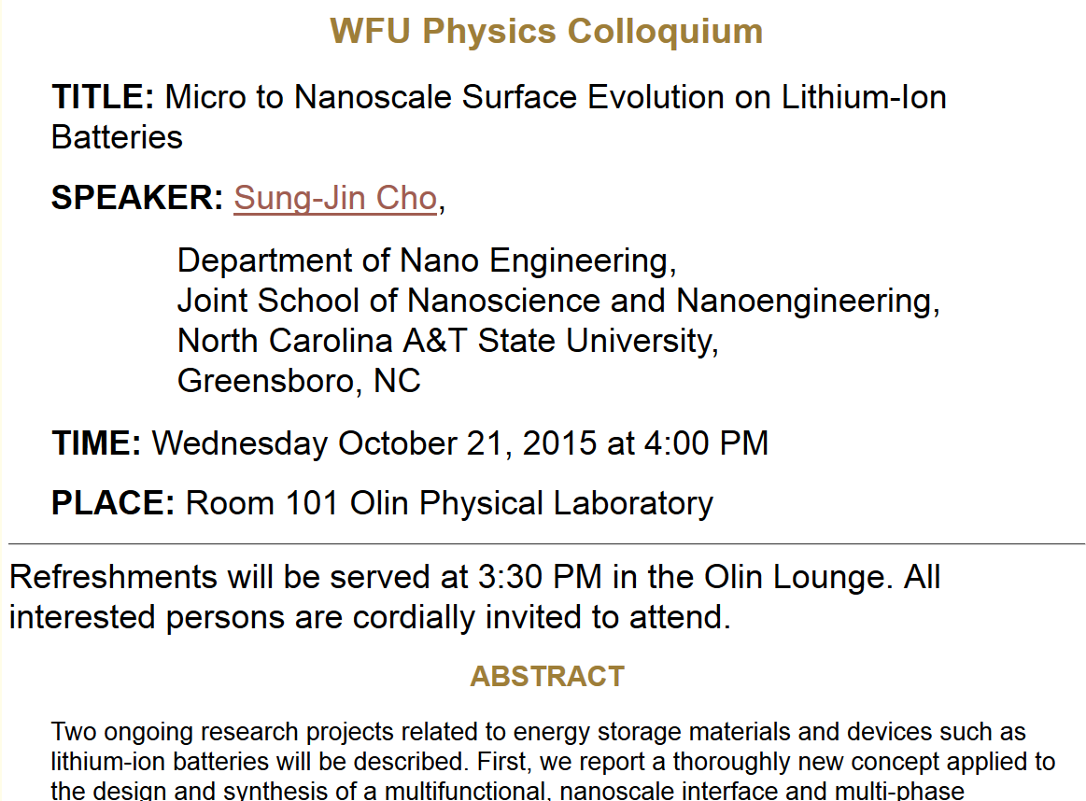

Slide 5
Summary of previous results
describing rigid bodies rotating
about a fixed origin
ω
r

Slide 6
Moment of inertia tensor

Slide 7
Summary of previous results
describing rigid bodies rotating
about a fixed origin
ω
r

Slide 8
Descriptions of rotation about a given origin -- continued

Slide 9
Descriptions of rotation about a given origin -- continued

Slide 11
Solution of Euler equations for a symmetric top -- continued

Slide 13
Euler equations for asymmetric top -- continued

Slide 14
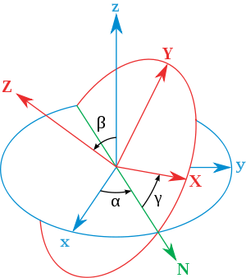
Transformation between body-fixed and inertial coordinate systems – Euler angles
inertial
body
x
y
y
x
http://en.wikipedia.org/wiki/Euler_angles

Slide 15
x
Need to express all components in body-fixed frame:
y
y
x

Slide 16
x
y
y
x

Slide 19
x
y
y
x

Slide 20
Rotational kinetic energy

Slide 21
Transformation between body-fixed and inertial coordinate systems – Euler angles
inertial
body
x
y
y
x
http://en.wikipedia.org/wiki/Euler_angles

Slide 22
General transformation between rotated coordinates – Euler angles
inertial
body
x
y
y
x
http://en.wikipedia.org/wiki/Euler_angles

Slide 23
Motion of a symmetric top under the influence of the torque of gravity:
γ
β
Mg
α

Slide 25
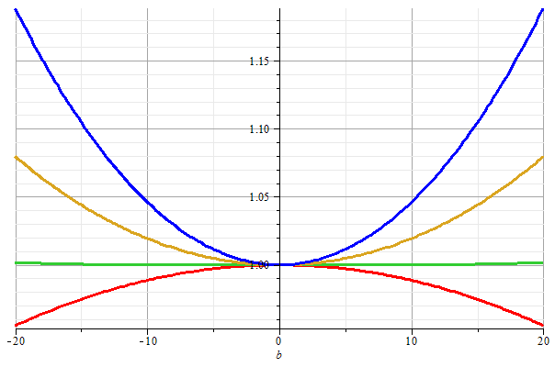
Stable/unstable solutions near
β=0

Slide 27
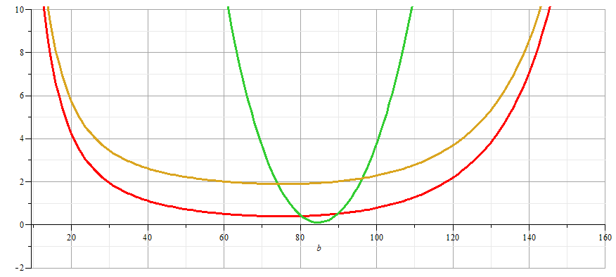
More general case:

Slide 28
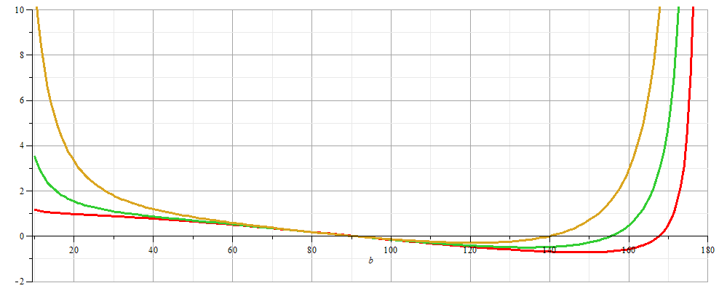
More general case:

Slide 29
β
Mg
α

