Slide 1
PHY 711 Classical Mechanics and Mathematical Methods
10-10:50 AM MWF Olin 103
Plan for Lecture 24:
Introduction to hydrodynamics
(Chap. 9 in F & W)
Motivation for topic
Newton’s laws for fluids
Conservation relations

Slide 2
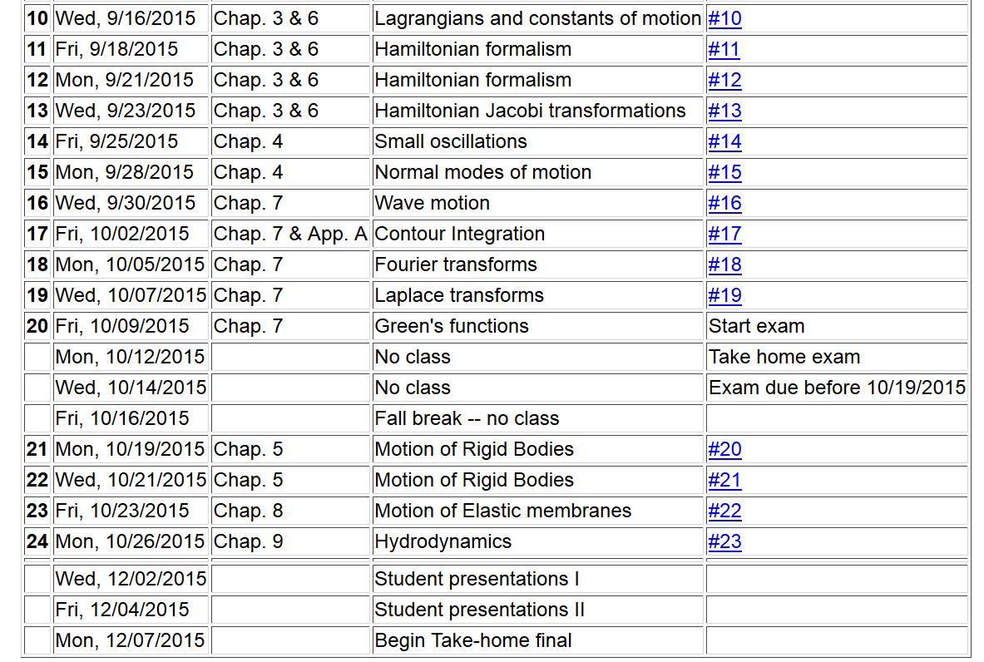

Slide 3
Motivation
Natural progression from strings, membranes, fluids; description of 1, 2, and 3 dimensional continua
Interesting and technologically important phenomena associated with fluids
Plan
Newton’s laws for fluids
Continuity equation
Stress tensor
Energy relations
Bernoulli’s theorem
Various examples
Sound waves

Slide 4
Newton’s equations for fluids
Use Lagrange formulation; following “particles” of fluid

Slide 5
p(x)
p(x+dx)

Slide 6
Newton’s equations for fluids -- continued

Slide 8
Newton’s equations for fluids -- continued

Slide 9
Solution of Euler’s equation for fluids

Slide 10
Bernoulli’s integral of Euler’s equation

Slide 11
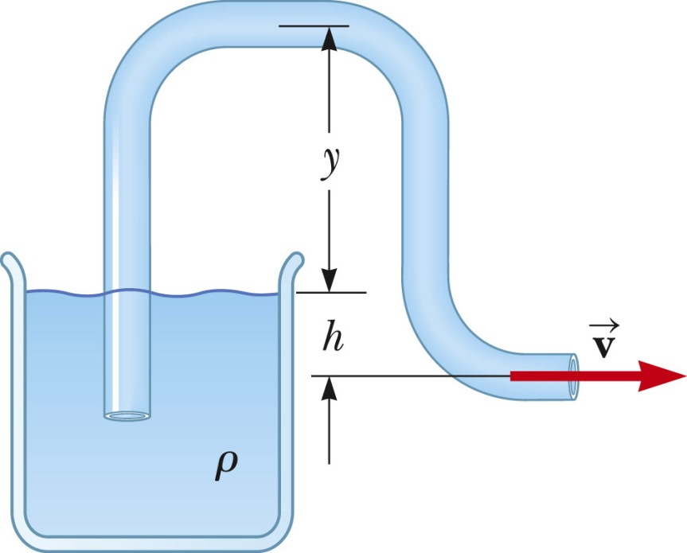
Examples of Bernoulli’s theorem
1
2

Slide 12
Examples of Bernoulli’s theorem -- continued
1
2

Slide 13
Examples of Bernoulli’s theorem -- continued
2
1

Slide 14
Examples of Bernoulli’s theorem -- continued
2
1

Slide 15
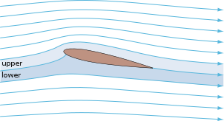
Examples of Bernoulli’s theorem – continued
Approximate explanation of airplane lift
Cross section view of airplane wing
http://en.wikipedia.org/wiki/Lift_%28force%29
1
2

Slide 16
Continuity equation connecting fluid density and velocity:

Slide 17
Some details on the velocity potential

Slide 18
Example – uniform flow
b
a
z

Slide 19
Example – flow around a long cylinder (oriented in the Y direction)
^
X
^
v₀ Z
r=a
^
θ
v₀ Z
^
Z

Slide 22
to be continued …

