Slide 1
PHY 711 Classical Mechanics and Mathematical Methods
10-10:50 AM MWF Olin 103
Plan for Lecture 25:
Introduction to hydrodynamics
(Chap. 9 in F & W)
Incompressible fluids
Isentropic fluids

Slide 2
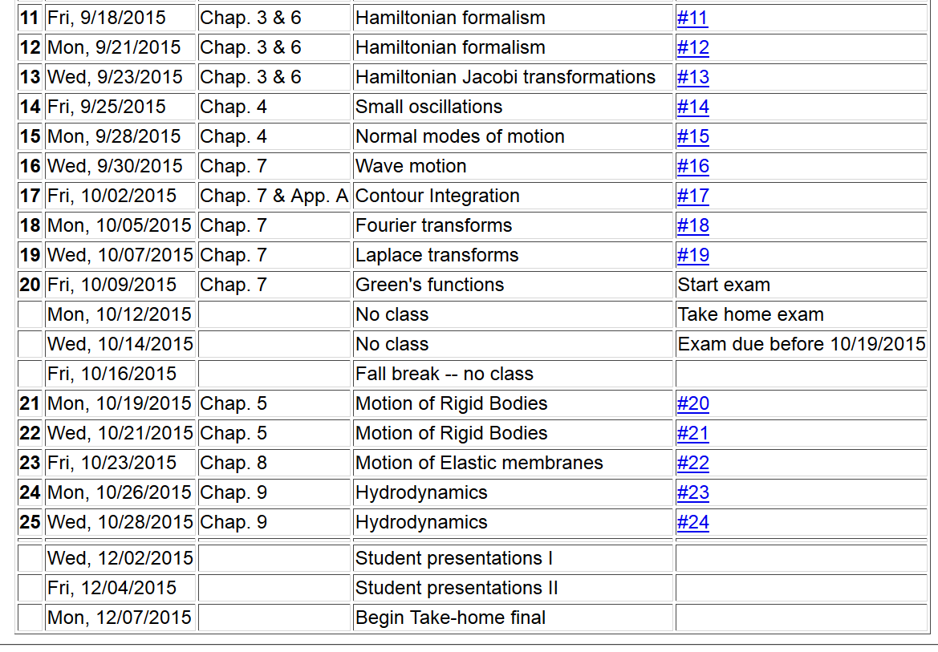

Slide 4
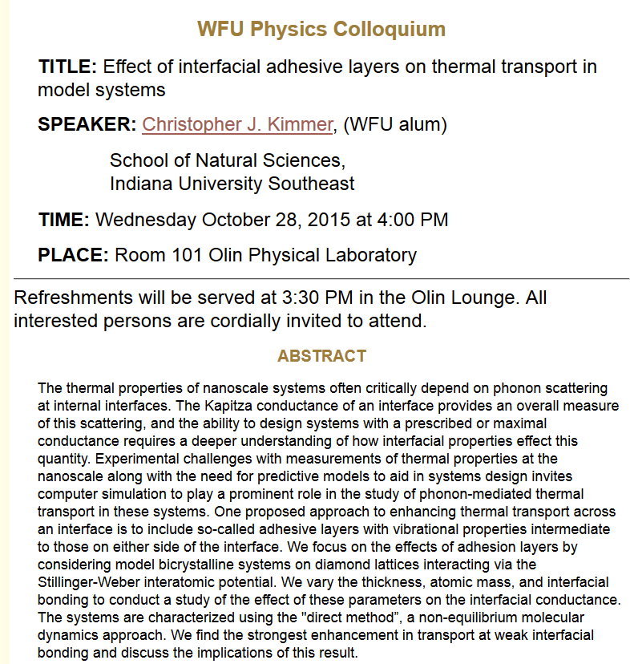

Slide 5
Newton’s equations for fluids
Use Euler formulation; properties described in terms of
stationary spatial grid
t’
t

Slide 6
Euler analysis -- continued

Slide 7
Some details on the velocity potential

Slide 8
Example – uniform flow
b
a
z

Slide 9
Example – flow around a long cylinder (oriented in the Y direction)
^
X
^
v₀ Z
r=a
^
θ
v₀ Z
^
Z

Slide 13
Spherical system continued:
(Continue analysis for homework)

Slide 14
Solution of Euler’s equation for fluids

Slide 15
Bernoulli’s integral of Euler’s equation for constant ρ
For incompressible fluid

Slide 16
Solution of Euler’s equation for fluids -- isentropic

Slide 17
Solution of Euler’s equation for fluids – isentropic (continued)

Slide 18
Solution of Euler’s equation for fluids – isentropic (continued)

Slide 19
Solution of Euler’s equation for fluids – isentropic (continued)

Slide 20
Summary of Bernoulli’s results
For incompressible fluid
For isentropic fluid with internal energy density ε

Slide 21
Application of fluid equations to the case of air in equilibrium plus small perturbation

Slide 25
Analysis of wave velocity in an ideal gas:

