Slide 1
PHY 711 Classical Mechanics and Mathematical Methods
10-10:50 AM MWF Olin 103
Plan for Lecture 27: Chap. 9 of F&W
Wave equation for sound in the linear approximation
Sound generation
Sound scattering

Slide 2
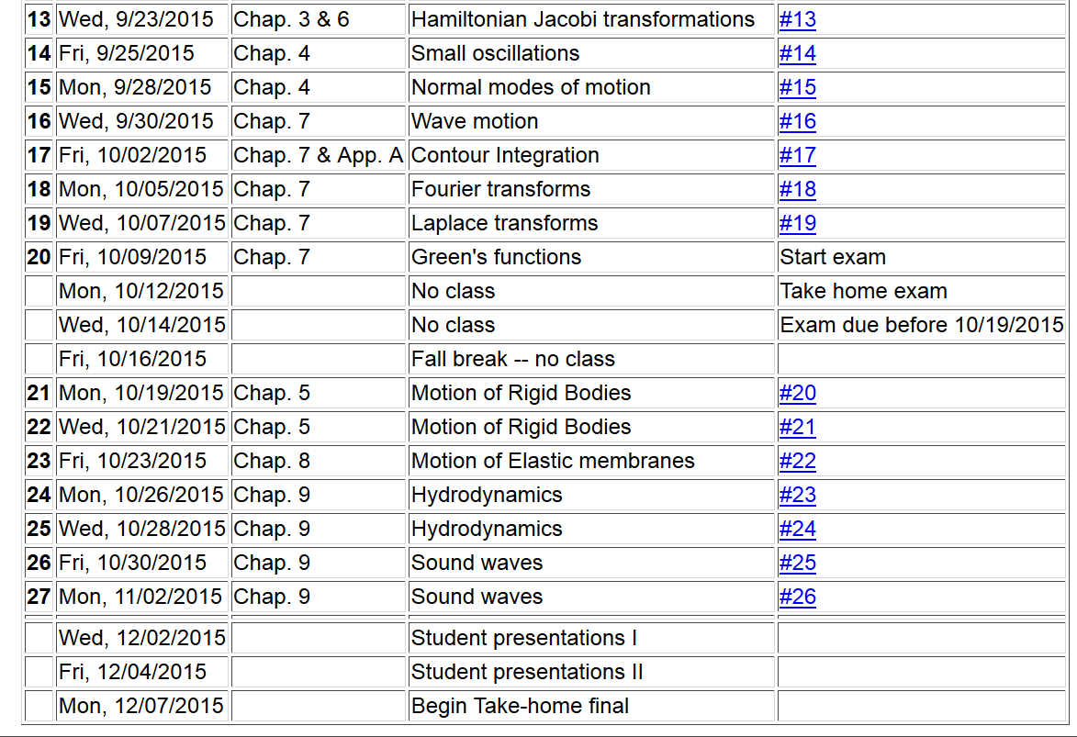

Slide 3
Solutions to wave equation:

Slide 4
Wave equation with source:

Slide 5
Wave equation with source -- continued:

Slide 6
Derivation of Green’s function for wave equation

Slide 7
Derivation of Green’s function for wave equation -- continued

Slide 8
Derivation of Green’s function for wave equation -- continued

Slide 9
Derivation of Green’s function for wave equation -- continued

Slide 10
Derivation of Green’s function for wave equation – continued
need to find A and B.

Slide 11
Derivation of Green’s function for wave equation – continued

Slide 12
Derivation of Green’s function for wave equation – continued

Slide 13
For time harmonic forcing term we can use the corresponding Green’s function:
In fact, this Green’s function is appropriate for boundary conditions at infinity. For surface boundary conditions where we know the boundary values or their gradients, the Green’s function must be modified.

Slide 16
Wave equation with source:
z
y
x

Slide 17
Treatment of boundary values for time-harmonic force:

Slide 22
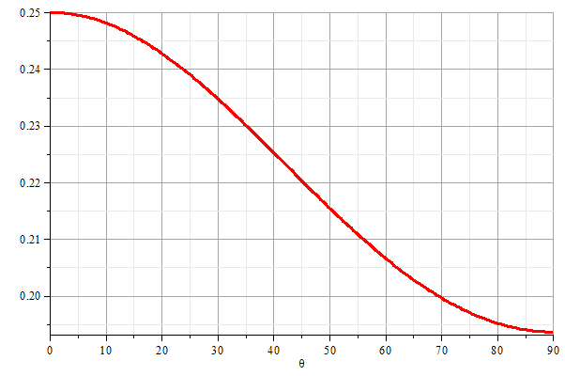
z
θ
y
x

Slide 23
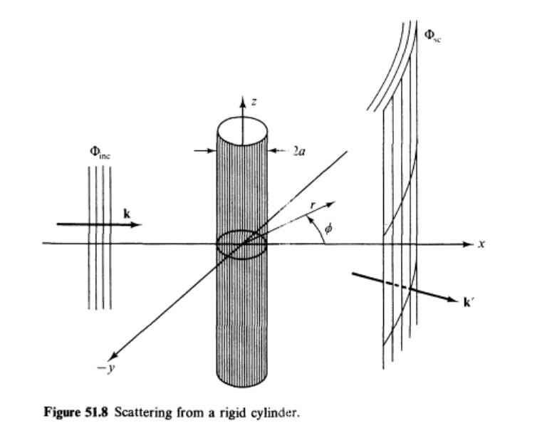
Scattering of sound waves –
for example, from a rigid cylinder
Figure from Fetter and Walecka pg. 337

Slide 24
Scattering of sound waves –
for example, from a rigid cylinder

Slide 27
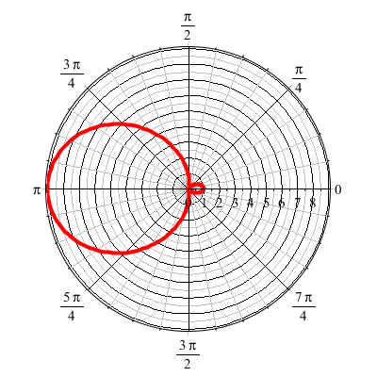
For ka << 1

